Slide 1
Strong Supervision from Weak Annotation: Interactive Training of Deformable Part Models
S. Branson, P. Perona, S. Belongie

Slide 2
Methods by level of supervision
simple models, weak annotations
  least effort, potentially fast learning, not best results
complicated models, weak annotation
  state-of-the-art performance (multiple instance learning, latent parts, latent structural SVM)
  non-convex optimization
  slow training
  Hard to pinpoint error source (optimization error, inappropriate model or feature space, insufficient training data)

Slide 3
Methods by level of supervision
Strong annotation
  Very time consuming
  Easy learning task (possible convex optimization)
  Generalization guarrantee
  Sensitive to quality and style of annotation
  Qusetion: Is it possible to have strong supervision properties with weak annotation computational efficiency?

Slide 4
Yes! Interactive Labelling and Online Learning
1- Model part structures with structured models
2- Bring up a new image,
  predict the part locations with current model
  Correct the wrong locations
3-Update the learned model and go to 2

Slide 5
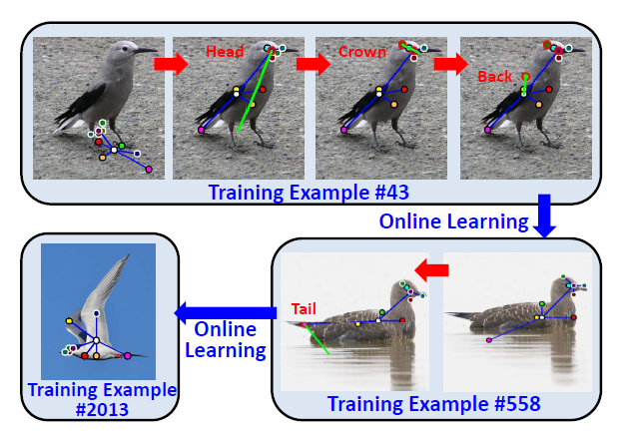
Interactive Labelling + Online Learning

Slide 6
Interactive Labelling + Online Learning
Interactive Labelling
  Real time detection
  Easy update
  Tree-structured deformable parts model with dynamic programming is a good choice!
Online Learning
  Fast model updating
  Convex optimization
  Stochastic gradient descent

Slide 7
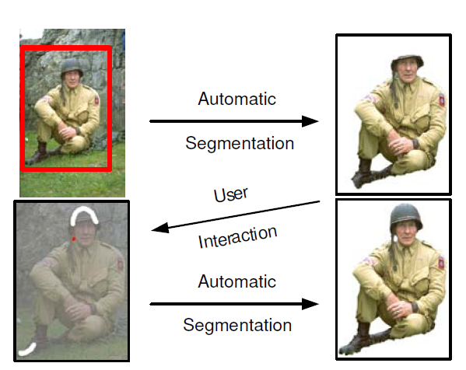
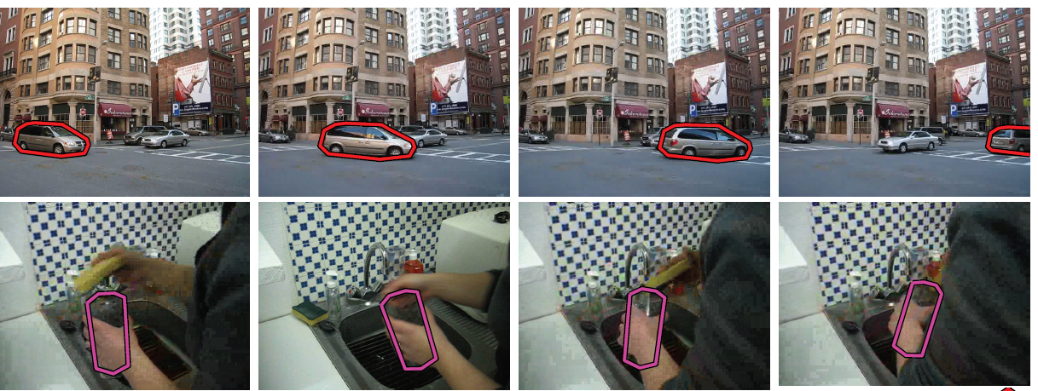
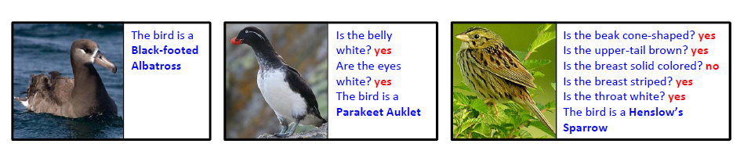
Related works
Interactive labelling
  Grab cut (Segmentation)
  Label me video
  Visipedia (attributes)

Slide 8
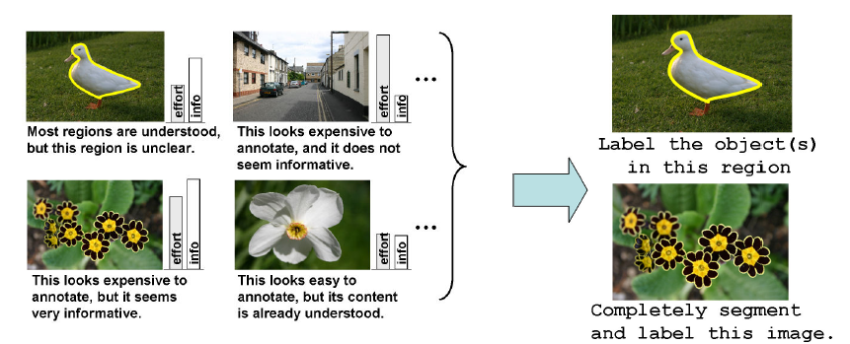
Related works
Active learning
  Intelligent computer decide which image to annotate
  More savings than interactive labeling
  In comparison to strong supervision
    Higher computational complexity
    Fewer theoretical guarantees

Slide 9

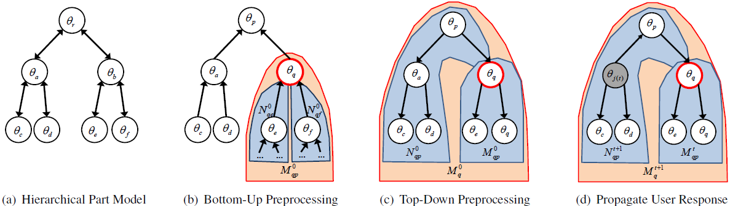
Model and Interactive UI

Slide 10
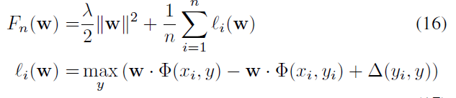

Learning framework
Strong Convex formualtion
Gradient computable
by one inference
Stochastic gradient descent
Process an image at each step
  Pegasus!

Slide 11
Theoretical properties
Pegasos
  Faster convergence rate than linear SVM
  Performance guarantee with the number of iterations
  Training time does not increase with increasing number of images (for a specific performance)
  Slower steps than linear svm
    Inference at each step
Interactive labelling
  Loss function is defined as the number of misplaced part
  Number of annotation is bounded!

Slide 12
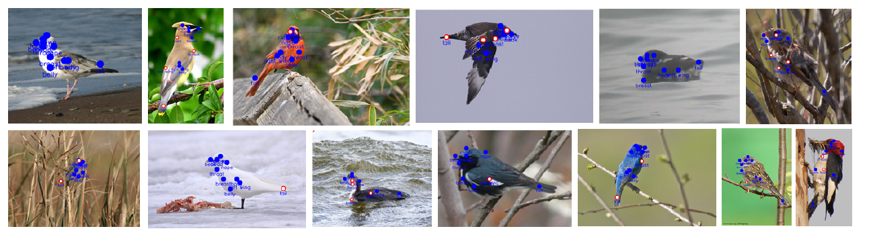
Some results...

Slide 13
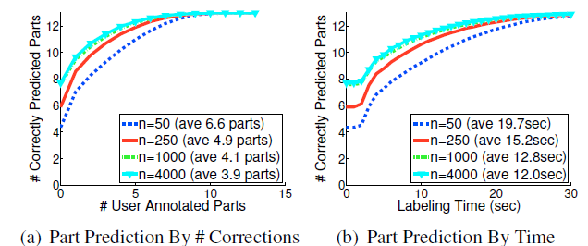
Tables
50 images:
  6.6 / 13 correction.
  19.7 seconds
4000 images:
  3.9 / 13 correction
  12 seconds

Slide 14
Conclusion
Framework for large scale annotation
Simulataneous learning of structured models
Nice theoretical properties, seen in practice

Slide 15
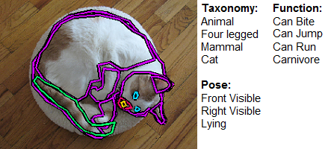
Cross-category Object Recognition (CORE)
University of Illinois at Urbana-Champaign
more detailed models and for exploring cross-category generalization in object recognition

Slide 16
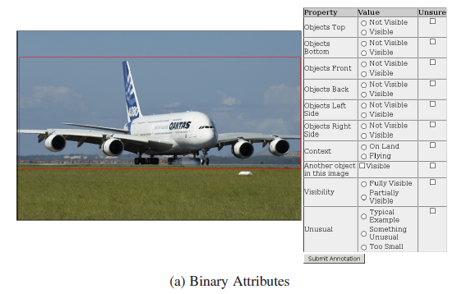
CORE – Data overview
Images from ImageNet, thus coming with object hierarchy
Binary attributes
  Pose
  Sorrounding context
  Viewpoint
  Etc.

Slide 17
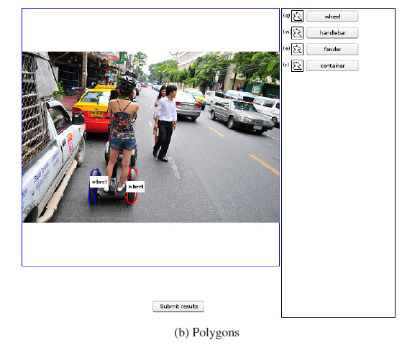
CORE – data overview
Ploygon labels
  Objects
  Pre-defined parts of
  a category

Slide 18
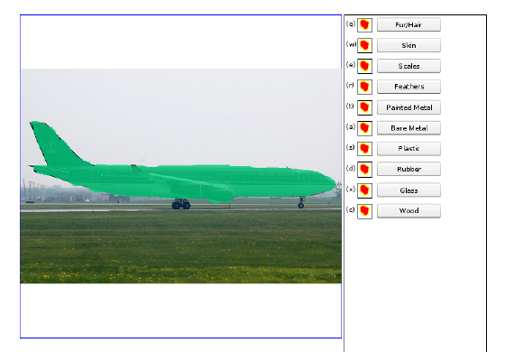
CORE – data overview
Segmentation mask
  Materials

Slide 19
Quality Measures
Way of collecting images
Which attributes
  Easily annotatable
  Unsure buttun
Quality assurance methods...

