Slide 1
SCHLICHTING – TRUCKENBRODT
AERODYNAMICS OF THE AIRPLANE
A CRITICAL REVIEW OF CHAPTER TWO: AIRFOIL OF INIFINITE SPAN IN INCOMPRESSIBLE FLOW

Slide 2
2D FLOW
THE FLOW ABOUT AN AIRFOIL OF INFINITE LENGTH IS TWO-DIMENSIONAL.
INCORRECT: THE FLOW IS 3D

Slide 3
LIFT VS CIRCULATION
LIFT PRODUCTION OF AN AIRFOIL IS CLOSELY RELATED TO THE CIRCULATION OF ITS VELOCITY IN THE NEAR-FIELD.
INCORRECT: THERE IS NO DEFINITE RELATION BETWEEN LIFT AND CIRCULATION

Slide 4
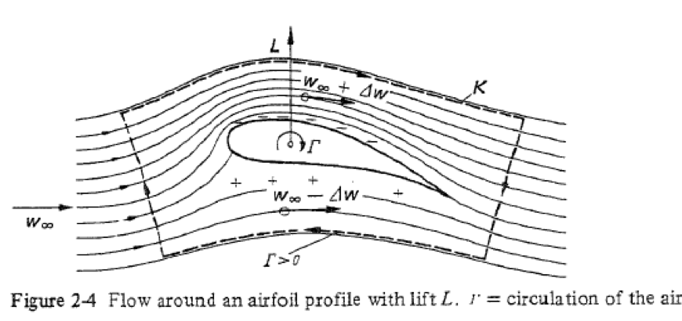
LIFT BY CIRCULATION

Slide 5
LOWER PRESSURE ABOVE
THERE IS HIGHER PRESSURE ON THE LOWER SURFACE, LOWER PRESSURE ON THE UPPER SURFACE.
IT FOLLOWS THEN FROM BERNOULLI THAT THE VELOCITIES ON THE LOWER AND UPPER SURFACE ARE LOWER AND HIGHER THAN THE VELOCITY OF THE INCIDENT FLOW.
TRIVIALITY: LIFT FROM PRESSURE DIFFERENCE

Slide 6
LIFT FORMULA
THE LIFT L IS GIVEN BY THE KUTTA-ZHUKOVSKY FORMULA:
L = CONSTANT x CIRCULATION
IF THE CIRCULATION IS KNOWN THE KZ FORMULA IS OF PRACTICAL VALUE FOR THE CALCULATION OF LIFT.
DANGEROUS: DOES NOT PREDICT STALL

Slide 7
CIRCULATION DETERMINED BY
SHARP TRAILING EDGE
EXPERIENCE SHOWS THAT A CIRCULATION FORMS OF THE MAGNITUDE THIS IS NECESSARY TO PLACE THE REAR STAGNATION POINT EXACTLY ON THE SHARP TRAILING EDGE.
NO THEORY: FREE SPECULATION

Slide 8
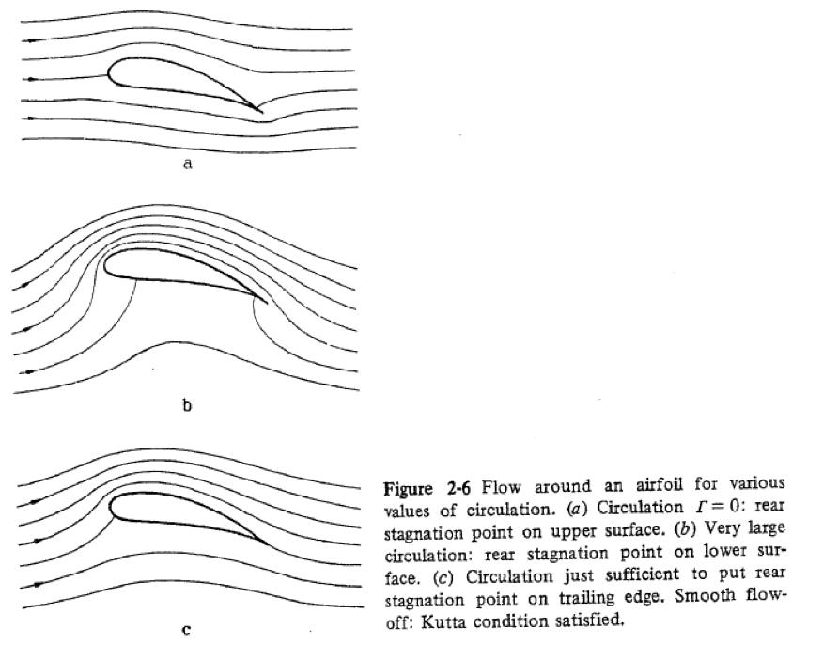
CIRCULATION DETERMINED BY SEPARATION AT SHARP TRAILING EDGE

Slide 9
STARTING VORTEX
BECAUSE OF FRICTION A VORTEX FORMS AT THE TRAILING EDGE WHICH QUICKLY DRIFTS AWAY FROM THE WING AND REPRESENTS THE SO-CALLED STARTING VORTEX.
SINCE THE CIRCULATION REMAINS CONSTANT FOR ALL TIMES ACCORDING TO THE THOMSON THEOREM, THERE MUST BY A CIRCULATION AROUND THE WING EQUAL TO THE STARTING VORTEX.
INCORRECT: CIRCULATION NOT CONSTANT IN TURBULENT FLOW

Slide 10
VISCOSITY
THE VISCOSITY OF THE FLUID, AFTER ALL, CAUSES THE FORMATION OF CIRCULATION AND THEREFORE THE ESTABLISHMENT OF LIFT.
NO REASON: VISCOSITY NOT ORIGIN OF LIFT

Slide 11
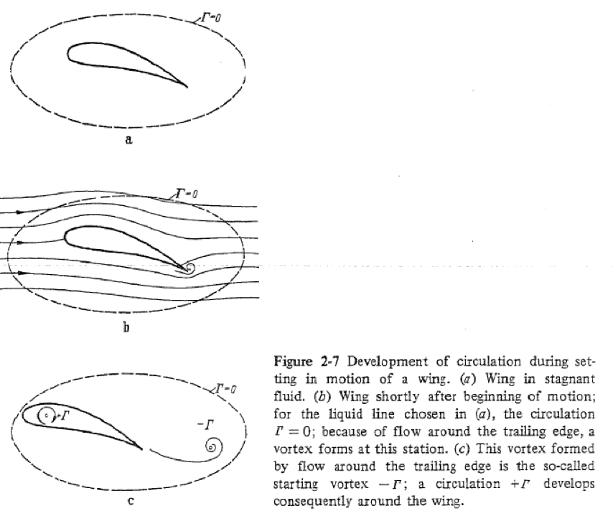
STARTING VORTEX GENERATED BY VISCOSITY

Slide 12
SUMMARY: LIFT BY CIRCULATION
NO THEORY
NO RATIONALE
EVIDENCE BY OBSERVATION ONLY SPECULATION

Slide 13
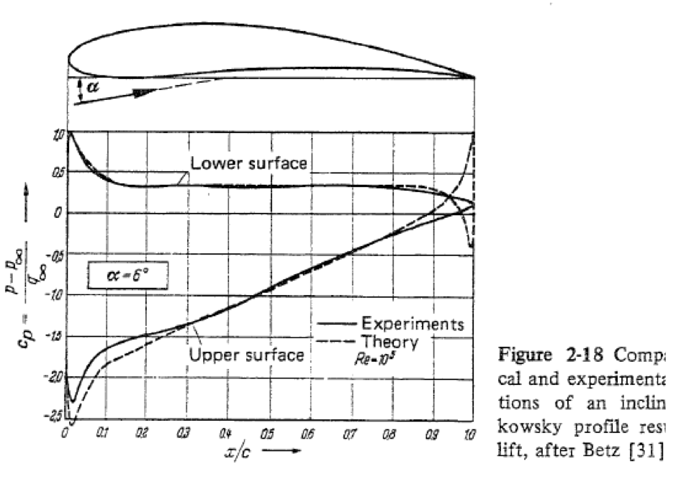
INCORRECT PRESSURE AT
TRAILING EDGE

