Slide 1
CO2 CLIMATE ALARMISM DEBUNKED BY MATHEMATICS
Claes Johnson KTH

Slide 2
CENSORS OF SCIENCE
SCIENTIFIC JOURNALS
SCIENTIFIC SOCIETIES
(INTER) GOVERNMENTAL INST.
MEDIA
WIKIPEDIA
CLIMATE SCIENCE: POLITICAL CORRECTNESS
KTH-GATE: MATH BOOK BURNED 2010
HELP FROM ROYAL SWEDISH ACAD of SCIENCES
HOSTED CLIMATE ALARMIST NOBEL SYMP 2011

Slide 3
SCIENCE: EXPERT KNOWLEGDE
ONLY PHYSICIST CAN UNDERSTAND PHYSICS
ONLY PRIEST CAN UNDERSTAND RELIGION
PHYSICS MADE IMPOSSIBLE TO UNDERSTAND
MODERN PHYSICS: IRRATIONAL AFTER 1900
CLASSICAL PHYSICS: RATIONAL BEFORE 1900
FAUSTIAN DRAMA: SELL SOUL FOR POWER
BOOK: DR FAUSTUS OF MODERN PHYSICS

Slide 4
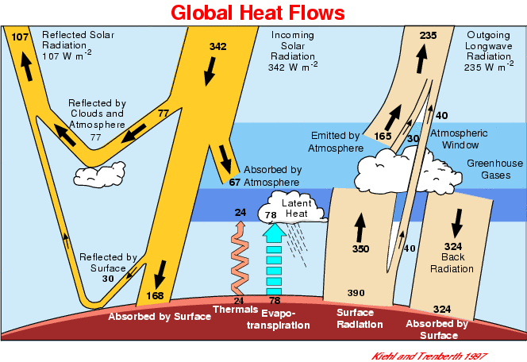

ATMOSPHERE: AIR CONDITIONER

Slide 5
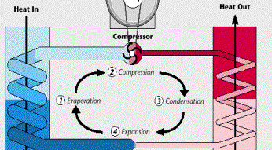
AIR CONDITIONER: HEAT PUMP

Slide 6
HEAT PUMP
THERMODYNAMICS + RADIATION
NAVIER-STOKES + RADIATIVE TRANSFER EQ
2ND LAW of THERMODYNAMICS
BLACKBODY RADIATION

Slide 7
STABLE SYSTEM
HEATS
COOLS
MAINTAINS TEMPERATURE
NO RUN AWAY EFFECTS
SMALL FORCING – SMALL EFFECT
DOUBLED CO2 – SMALL FORCING

Slide 8
BACKGROUND CJ
Computational Mathematics
Finite Element Methods
Computational Fluid Dynamics: Turbulence
Computational Thermodynamics: 2ND LAW
Computational Blackbody Radiation
books, articles, knols, blog,…
Chalmers, KTH, UChicago,…
ICIHighlyCited, Humboldt Prize

Slide 9
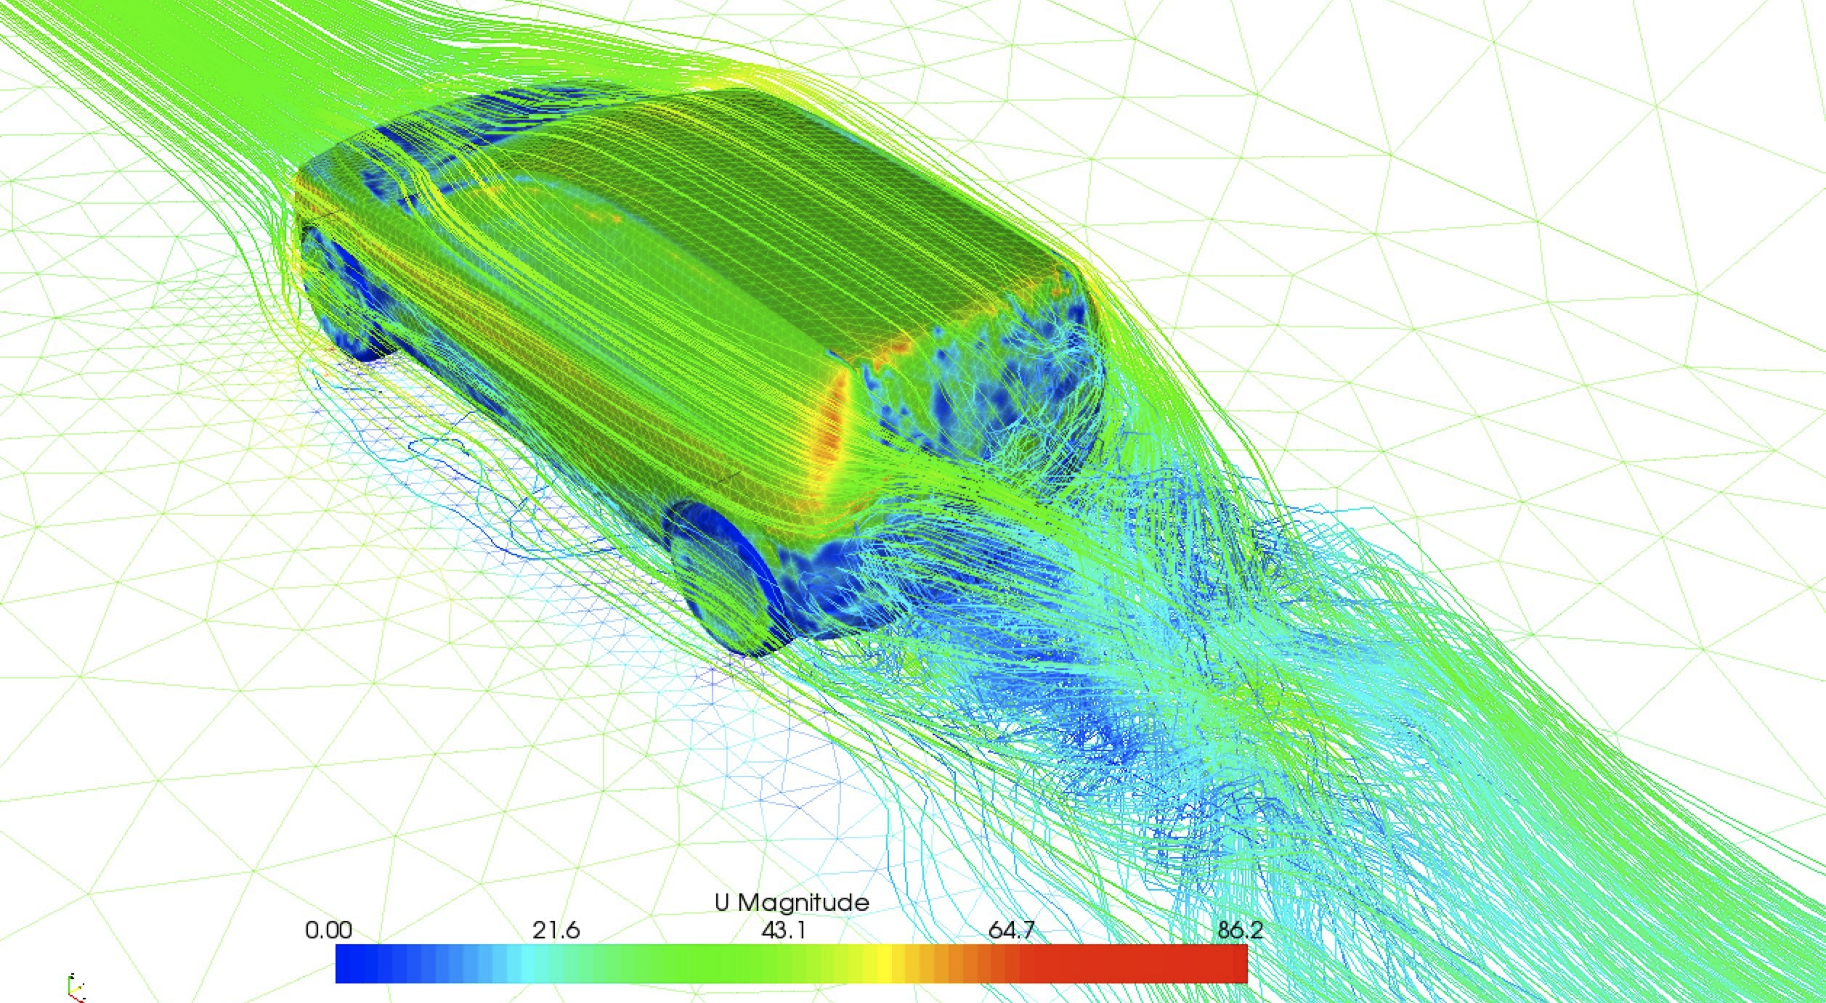
TURBULENT FLOW: DRAG

Slide 10
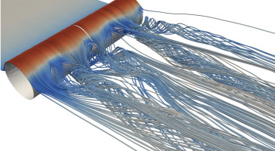
SECRET OF FLIGHT: LIFT + DRAG

Slide 11
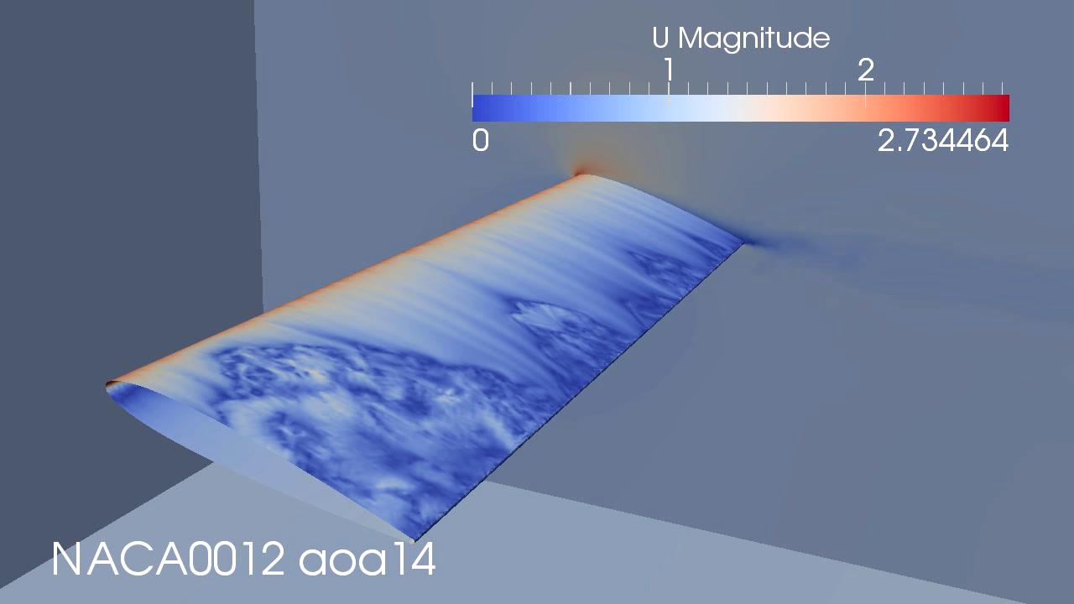
BEGINNING STALL AOA = 14

Slide 12
JOULE EXP 1845: VELOCITY T = 6

Slide 13
JOULE EXP: TEMP T = 12

Slide 14
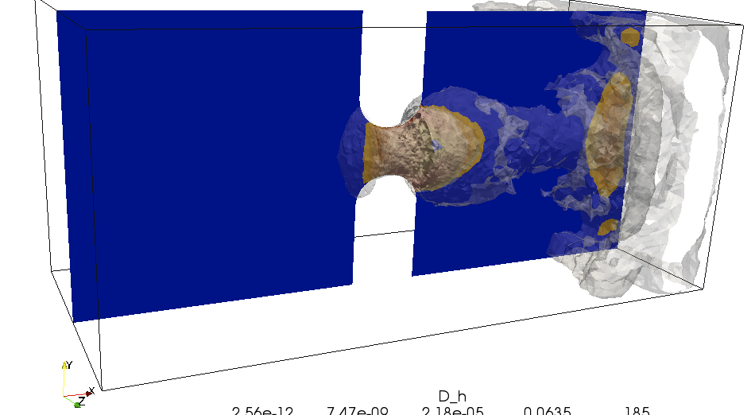
JOULE EXP: TURBULENT DISSIPATION

Slide 15
DENSITY + TEMPERATURE:
GAP LEFT RIGHT
STATISTICAL MECH: NO GAP: WRONG
COMPUT MECH: SPEC. GAP: CORRECT

Slide 16
MAIN RESULTS
RESOLUTION D’ALEMBERT’S PARADOX 1752
NEW THEORY OF FLIGHT
DETERMINISTIC 2ND WITHOUT ENTROPY:
KINETIC, HEAT ENERGY, WORK + TURB DISSIPATION
FINITE PRECISION COMPUTATION: ANALOG vs DIGITAL
COMPUTATION OF TURBULENT FLOW
MEANVALUES COMPUTABLE
MONTHLY MEAN VALUE PREDICTABLE OVER YEARS
DAILY TEMPERATURE UNPREDICTABLE OVER WEEKS
REFORM OF MATH EDUCATION: BODY&SOUL

Slide 17
2ND LAW WITHOUT ENTROPY
E = HEAT ENERGY
K = KINETICS ENERGY
W = WORK
D = TURBULENT DISSIPATION > 0
dK = W – D, dE = - W + D, dK + dE = 0
W > 0 EXPANSION, W < 0 COMPRESSION
D > 0 IRREVERSIBLE: FROM K TO E

Slide 18
TWO TOPICS
CLIMATE SENSITIVITY:
CHANGE OF TEMP UNDER CHANGE OF HEAT FORCING
BACKRADIATION:
UNPHYSICAL
FALSE STEFAN-BOLTZMANN
NOT IN PHYSICS LITERATURE

Slide 19
CLIMATE SENSITIVITY

Slide 20
GLOBAL CLIMATE
TOA TEMPERATURE AT 5 KM: -18 C
EFFECTIVE OUTGOING RAD. = 235 W/m2
= INSOLATION X ALBEDO = 235 W/m2
OBSERVED LAPSE RATE = 6.5 C/KM
OBSERVED SURFACE TEMPERATURE = + 15 C
CHANGE: TOA ALTITUDE + LAPSE RATE

Slide 21
CLIMATE SENSITIVITY: CO2 ALARMISM
NO FEED-BACK STEFAN-BOLTZMANN: 1 C
LINEARIZED SB: dQ = 4 dT
RADIATIVE FORCING FROM DOUBLED CO2 = 4 W/m2
WITH FEED-BACK: 3 - 4 C

Slide 22
ATMOSPHERIC CLIMATE SENSITIVITY
ATMOSPHERE EFFECT = 33 C (288 – 255 K)
DOUBLED C02 = 1% CHANGE OF ATMOSPHERE
1% OF EFFECT = 0.4 C

Slide 23
OBSERVATION: 0.4 C
VARIATION OF TEMP VS INSOLATION
DAILY, SEASONAL, REGIONAL,…
dQ = 10 dT
IDSO, LINDZEN, SPENCER,…
IPCC: 4 C: FACTOR 10??

Slide 24
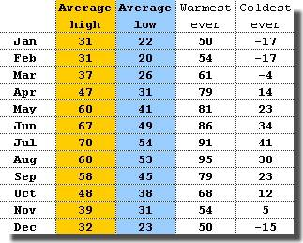
YEARLY VARIATION STOCKHOLM

Slide 25
DIURNAL + YEARLY VARIATION
BASIC MODEL: C dT/dt = F(t) – Lambda T
SENSITIVITY: S = 1/Lambda
DETERMINE C + S FROM MEASURED T(t) + F(t)
DIURNAL + YEARLY: S < 0.1
IPCC S = 1: 10 TIMES BIGGER.

Slide 26
PHASE LAG
LARGE: 1/4 PERIOD: Lambda SMALL
SMALL: 1/8 PERIOD: Lambda LARGE + S SMALL
OBSERVATION: SMALL:
DIURNAL: 3 HOURS: SMALL
YEARLY : ONE MONTH: SMALL

Slide 27
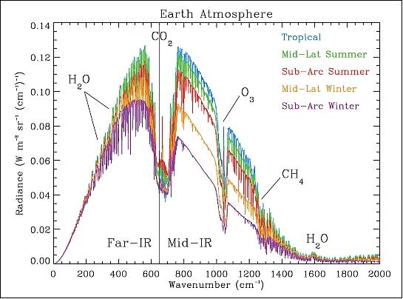
RADIATIVE FORCING: FACTOR 4
RADIATIVE FORCING = DIP IN THE SPECTRUM = 4% OF TOTAL AREA
DOUBLED C02 = 10% CHANGE OF WIDTH OF DIP = 0.4% OF TOTAL 250 = 1 W/m2
IPCC = 4 W/m2 = 4: FACTOR 4

Slide 28
THE IPCC TRICK: + 3 C
RADIATIVE FORCING dQ = 4 W/m2
= 6.3 LOG(2) W/m2 = AD HOC FORMULA
4 TIMES TOO BIG VS OBSERVATION
NO-FEEDBACK SENSITIVITY dQ = 4 dT
dT = 1 C
ONLY A DEFINITION; NOT ANY REALITY
FEED BACK dT = 3 C = CLIMATE SENSITIVITY

Slide 29
BACKRADIATION

Slide 30
BACKRADIATION
ATMOSPHERE to SURFACE 330 W/m2
SURFACE INSOLATION = 170 W/m2
GROSS SURFACE INFLUX = 500 W/m2
NET FLUX EXCHANGE = 60 W/m2
FACTOR 10: GROSS FLUX VS NET FLUX

Slide 31
CLIMATE SENSITIVTY: REAL vs FICTION
OBSERVATION = 0.4 C
BY DEFINITION SB = 1 C
SIMPLISTIC RADIATION MODEL
SAYS NOTHING ABOUT REALITY
IPCC FEED BACK = 4 C
INFLATION FACTOR = 10
HOW TO MAKE SMALL BIG
A BIG LIE MORE CREDIBLE THAN SMALL LIE

Slide 32
IPCC FACTOR 10
CLIMATE SENSITIVITY
PERTURBATIONS OF HEAT FLUX
PERTURBATIONS OF NET FLUX
PERTURBATIONS OF GROSS FLUX??
FACTOR 10??

Slide 33
1 = 10 - 9
1% of 1 = 0.01
1% of 10 = 0.1
FACTOR 10

Slide 34
MATHEMATICAL ANALYSIS
BACKRADIATION
2ND LAW THERMODYNAMICS
FACTOR 10?

Slide 35
MATH-PHYSICS-REALITY
REAL PHYSICS: ANALOG COMPUTATION
SIMULATION: DIGITAL COMPUTATION
FINITE PRECISION COMPUTATION
DETERMINISTIC
UNDERSTANDABLE
STATISTICAL PHYSICS
NOT UNDERSTANDABLE
NON-PHYSICAL

Slide 36
2ND LAW: TURBULENT DISSIPATION
SMOOTHING-DECREASE DIFFERENCE-AVERAGE
DIFFUSION: HEAT CONDUCTION
DETAILS LOST: FINITE PRECISION
TURBULENCE
NO BACK-CONDUCTION
NO BACK-RADIATION
UNSTABLE – UNPHYSICAL:
IRREVERSIBLE: DIRECTION OF TIME

Slide 37
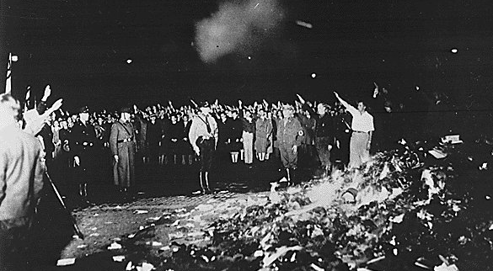
2ND LAW: BURNING BOOKS IS EASY

Slide 38
2ND LAW: CATABOLIC
FINE IMAGE TO COARSE IMAGE: POSSIBLE
JPEG
COARSE IMAGE TO FINE IMAGE: IMPOSSIBLE
BURNING BOOKS EASY
WRITING BOOKS DIFFICULT
DESTRUCTION: QUICK AND EASY: CATABOLISM
CONSTRUCTION: SLOW AND DIFFICULT: ANABOLISM

Slide 39
2ND LAW:FINITE PRECISION
HIGH FREQ TO LOW FREQ: POSSIBLE
LOW FREQ TO HIGH FREQ: IMPOSSIBLE
WARM – HIGH FREQ TO COLD – LOW FREQ: POSSIBLE
HEAT FROM WARM TO COLD: POSSIBLE
HEAT FROM COLD TO WARM: IMPOSSIBLE
BACK-RADIATION UNPHYSICAL, UNSTABLE

Slide 40
FINITE PREC COMPUTATION 2ND LAW
DETERMINISTIC 2ND LAW
NO STATISTICS
UNDERSTANDABLE
NO BACKRADIATION
BOLTZMANN 2ND LAW
STATISTICS
AD HOC NOT UNDERSTANDABLE

Slide 41
BLACKBODY
OSCILLATOR: LATTICE OF ATOMS (MATTER)
RADIATION: ACC. CHARGE gener. EM-LIGHT
FORCING: EM-LIGHT
INTERACTION MATTER-LIGHT: FORCE BALANCE
OSC FORCE + RADIATION PRESSURE = FORCING
d OSC ENERGY/dt + RADIANCE = INPUT ENERGY
d INTERNAL/dt + OUTPUT = INPUT
STATIONARY: OUTPUT = FORCING ENERGY

Slide 42
STUDENT-TEACHER
STUDENT: BLACKBODY
TEACHER: FORCING SPECTRUM: LOW TO HIGH
STUDENT ABSORBS ALL BELOW CUT-OFF
RE-EMITS ALL BELOW CUT-OFF
HEATS UP BY FORCING ABOVE CUT-OFF
CUT-OFF INCREASE WITH TEMPERATURE

Slide 43
CUT-OFF FREQUENCY
ABSORPTION + RE-EMISSION BELOW CUT-OFF
ABSORPTION + HEATING ABOVE CUT-OFF
WARM HEATS COLD
CUT-OFF INCREASE WITH TEMPERATURE
TRANSFORMATION FROM HIGH TO LOW FREQ
STABLE - PHYSICAL

Slide 44
BACKRADIATION UNPHYSICAL
BACKRADIATION: LOW FREQ TO HIGH FREQ
COLD HEATS WARM
UNSTABLE – UNPHYSICAL
VIOLATION OF 2ND LAW

Slide 45
SWING AS BLACKBODY
SMALL RADIATION COEFF.
FORCING OUT-OF-PHASE WITH OSC VELOCITY
FORCING IN-PHASE WITH OSC

Slide 46
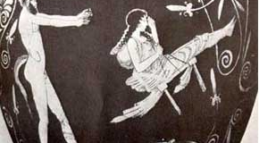
SWING + DAMPING = FORCING

Slide 47
PIANO AS BLACKBODY
FORCING BALANCED BY OSC
PIANO AS ACOUSTIC BLACKBODY
FINITE NUMBER OF KEYS

Slide 48
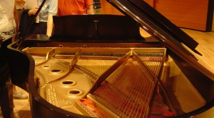
STRING-SOUNDBORD-OUTPUT

Slide 49
STEFAN-BOLTZMANN LAW
RADIANCE = R = c T⁴, T TEMPERATURE
R-NET = c (T⁴ – TB⁴), TB = BACKGROUND TEMP
PHYSICAL: WARM HEATS COLD
ONE-WAY NET HEAT TRANSFER

Slide 50
UNPHYSICAL FALSE SB
R-NET = c T⁴ – c TB⁴ = R-OUT – R-IN
R-OUT = c T⁴
R-IN = c TB⁴ BACKRADIATION
TWO-WAY GROSS HEAT TRANSFER
c T⁴ – c TB⁴ = c (T⁴ – TB⁴)
ALGBRAICALLY BUT NOT PHYSICALLY
R-IN = R-OUT – R-NET: BACKRADIATION
UNPHYSICAL – UNSTABLE: COLD HEATS WARM

Slide 51
PYRGEOMETER FICTION
MEASURES R-NET FROM TB AND T
DEFINES R-IN = R-OUT – R-NET
EXISTENCE BY DEFINITION NOT OBSERVATION
INVENTED TWO-WAY GROSS HEAT TRANSER

Slide 52
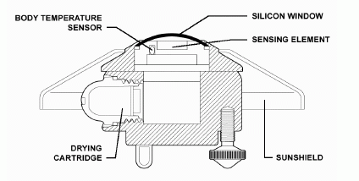
MEASURING WHAT DOES NOT EXIST

Slide 53
PHOTON - WAVES
BACKRADITION: UN-PHYSICAL
TWO-WAY STREAM OF PHOTONS
PRIMITIVE TRIVIAL MODEL
NO BACKRADIATION: PHYSICAL
ONE-WAY NET HEAT TRANSFER
TWO-WAY LIGHT WAVES
EDUCATED NON-TRIVIAL MODEL

Slide 54
ECONOMY VS NATURE
MASSIVE BACKRADITION =
MASSIVE TRANSFERS
UNSTABLE TWO-WAY FLOW OF MONEY
ROTATION OF MONEY
UNSTABLE TAX SYSTEM
NATURE HAS NO TAX SYSTEM
NATURE ABHORS INSTABILITY
NO BACKRADIATION

Slide 55
UNSTABLE TWO-WAY HEAT TRANSFER

Slide 56
HOW TO MAKE SMALL BIG
1 = 11 – 10
1 SMALL
10 BIG
ONE-WAY NET FLOW = 60 W/m2
TWO-WAY GROSS FLOW = 500 W/m2
60 = 500 – 440
INFLATION FACTOR 10: FROM 0.4 C TO 4 C

Slide 57
GLOBAL CIRCULATION MODELS
NAVIER-STOKES + RADIATION
TURBULENT (CHAOTIC) SOLUTIONS
MEAN-VALUES COMPUTABLE
POSSIBLE PRECISION: 5% ??
LONG TIME – SHORT TIME
DATA (SUN…) – MODELING (CLOUDS…)
THE ONLY THING WE HAVE…

Slide 58
CONCLUSION
CO2 ALARMISM based on
INFLATED CLIMATE SENSITIVITY based on
UNPHYSICAL BACKRADIATION based on
UNPHYSICAL FALSE STEFAN-BOLTZMANN LAW
BIGGEST SCIENTIFIC FRAUD EVER?
IN FREE FALL: TRAGEDY OF SCIENCE

Slide 59
SCIENTIFIC FRAUD OF CO2 ALARMISM
MANIPULATION OF THEORY:
DEFINITION AS PHYS. FACT:
NO-FEEDBACK CLIMATE SENSITIVITY = 1 C
FALSE SB LAW WITH BACKRADITION
MANIPULATION OF DATA:
HOCKEY-STICK…

Slide 60
WHY PHYSICISTS SAY NOTHING
DEFINITION AS PHYS FACT COMMON IN PHYSICS:
CONSTANCY OF SPEED OF LIGHT BOTH DEFINITION AND PHYSICAL FACT
FALSE STEFAN-BOLTZMANN:
PLANCK’S LAW NOT UNDERSTOOD BECAUSE
PLANCKS PROOF NOT UNDERSTOOD
ABOUT FUNDING:
LHC MORE IMPORTANT THAN CO2 ALARMISM

Slide 61
BLOGOSPHERE
WINDOW OF SKEPTICSIM
ARENA OF SKEPTICISM
CANNOT BE CENSORED
STOPPING CO2 ALARMISM
CHANGING SCIENCE

