Slide 1
Sorting algorithms
And implementation
Christian Jonsson
Jonathan Fagerström

Slide 2
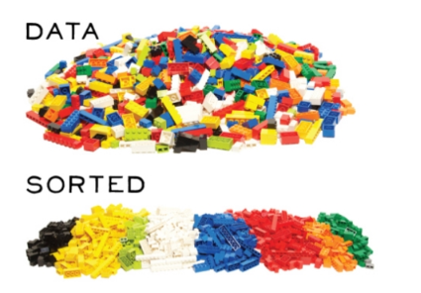
Agenda
Background
Examples
Implementation
Conclusion

Slide 3
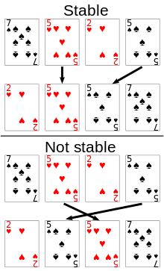
Background
Many different sorting algorithms
There is no best sorting algorithm
Classification:
Computational complexity (comparisons)
Typical behavior is O(n log n)
Computational complexity (swaps)
Swap or in-place
Memory usage
typically O(1) for in-place
Recursion
non-recursive, recursive or both
Stability
Keep order of equal elements

Slide 4
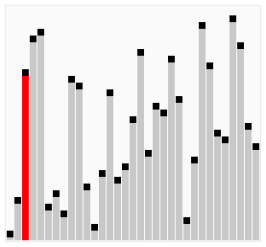
Bubble sort
Properties:
Stable
O(1) extra memory
O(n²) comparisons and swaps
Adaptive, O(n) when nearly sorted
Algorithm
for i = 1:n
swapped = false
for j = n:i+1
if a[j] < a[j-1]
swapped = true
end
break if not swapped
end
end

Slide 5
Selection sort
Properties:
Not stable
O(1) extra memory
O(n²) comparisons
O(n) swaps
Not adaptive
Algorithm
for i = 1:n
k = i
for j = i+1:n
if a[j] < a[k]
k = j
swap a[i,k]
end
end
end

Slide 6
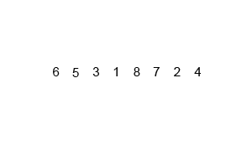
Merge sort
Properties:
Stable
O(n) extra memory
O(log n) extra mem. for linked lists
O(n log n) time
Not adaptive
Algorithm
m = n/2
sort a[1:m] Recursive sort
sort a[m+1:n] Recursive sort
b = copy of a[1:m]
i = 1; j = m+1; k = 1;
while i <= 1:n && j <= n
a[k++] = (a[j] < b[i]) ? a[j++] : b[++]
end
while i <= m
a[k++] = b[i++]
end

Slide 7
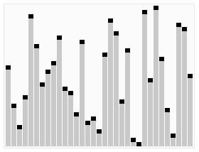
Quick sort
Properties:
Not stable
O(log n) extra memory
O(n log n) time
Not adaptive
Algorithm
swap a[1,rand(n)] Choose pivot
k = 1
for i = 2:n
if a[i] < a[1]
swap a[++k,i]
end
swap a[1,k]
end
sort a[1:k-1] Recursive sort
sort a[k+1:n] Recursive sort

Slide 8
Implementation of “Quick sort”
Most used sorting algorithm for larger arrays.
2-3 times faster than its main competitors, merge sort and heap sort
Operates “in-place” requiring small amounts of extra memory
The steps are:
Pick a “random” element from array, called pivot.
Reorder the array so elements with values less than the pivot come before the pivot, and greater elements come after it.
Recursively apply the above steps to the sub-array of elements with smaller values and separately to the sub-array of elements with greater values.
Notes:
In the early versions of quicksort, the leftmost element would be chosen as the pivot element. Unfortunately, this causes worst-case behavior on already sorted arrays, which is a common real world case. The problem is easily solved by choosing either a random index for the pivot, choosing the middle index, or choosing the median of the first, middle and last element of the partition for the pivot

Slide 9
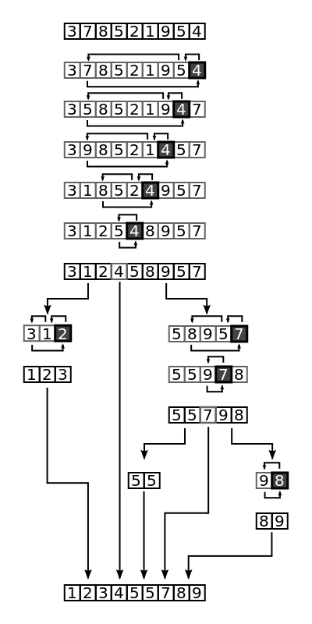
Implementation of “Quick sort”

Slide 10
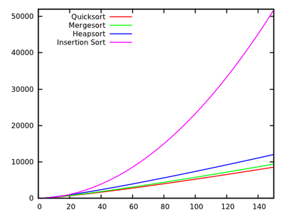
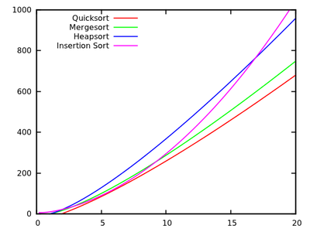
Discussion
Time
Number of elements

Slide 11
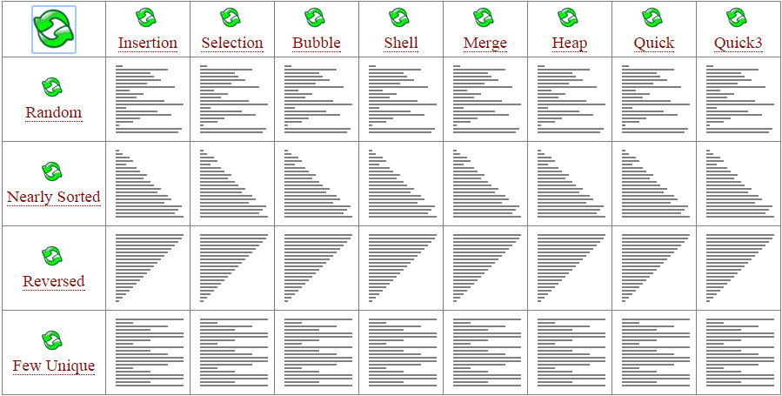
Discussion

