Slide 1
DeepFace Closing the Gap to Human-Level Performance in Face Veriﬁcation
By Yaniv Taigman, Ming Yang, Marc’Aurelio Ranzato, and Lior Wolf Facebook AI Group Tel Aviv University
Presented by: Vahid Kazemi

Slide 2
Face Recognition
Detect
Align (3D)
Represent (DNN)
Classify

Slide 3
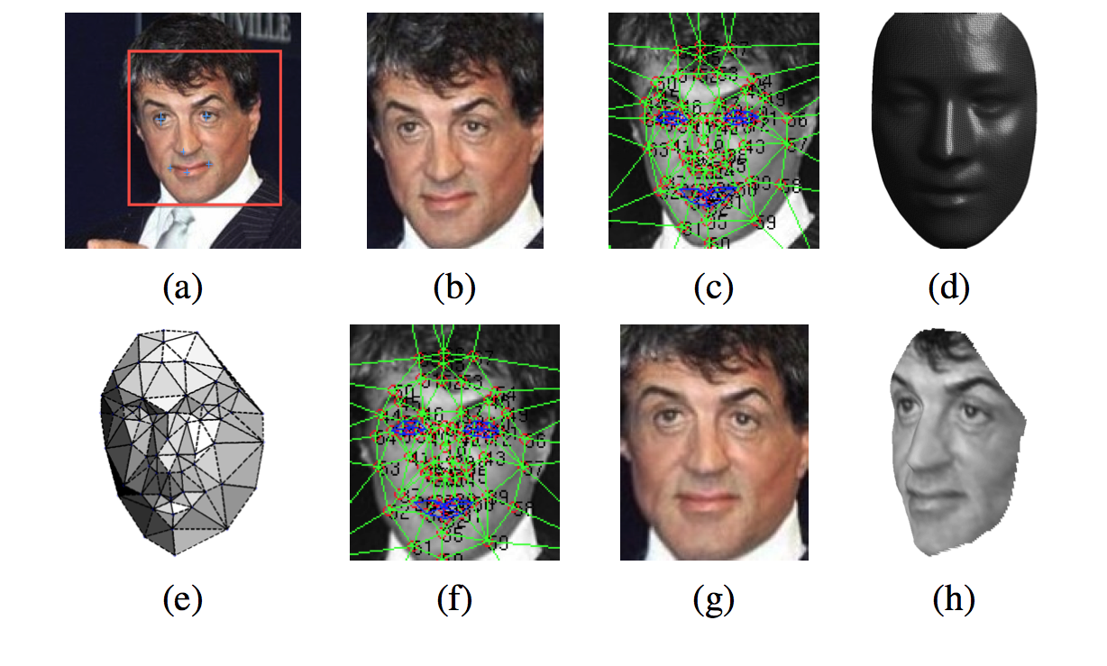
Alignment
Detect 67 landmarks using standard methods (LBP+SVR)
Use the 3D model to align the image to the mean shape

Slide 4
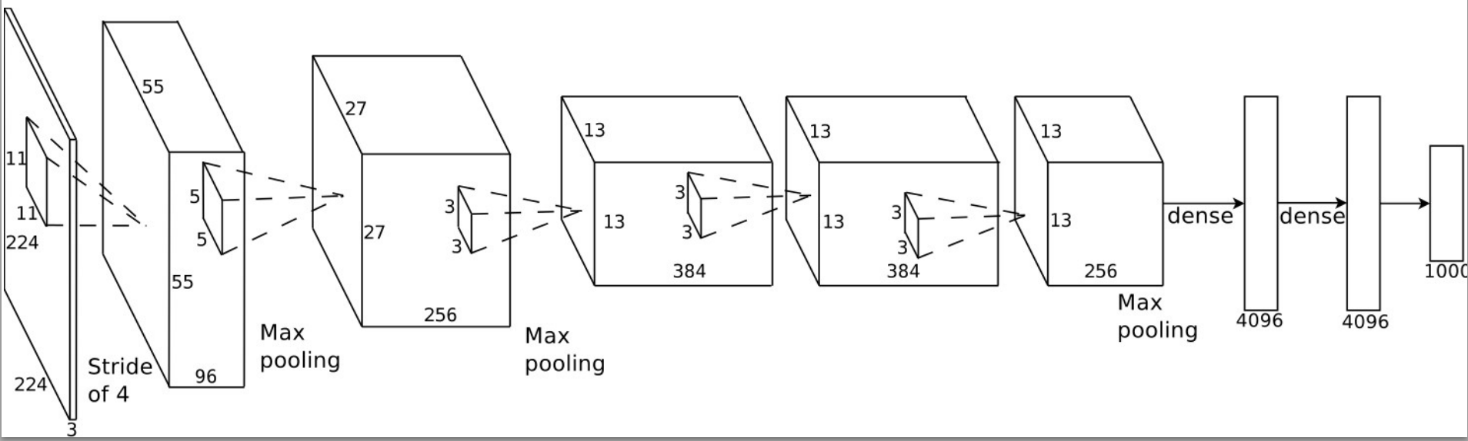
Alex Krizhevsky’s CNN
Input: RGB image, output: probability for 1000 classes
Convolutional layers -> local features
Max pooling -> invariant to local deformations
Fully connected -> global features

Slide 5
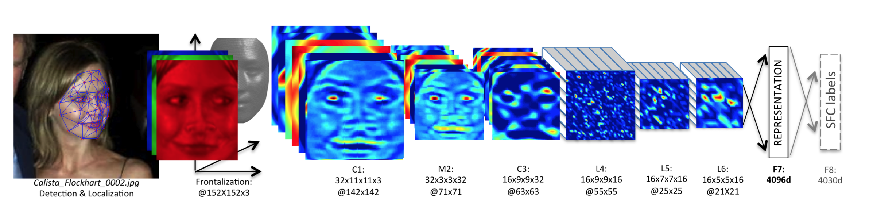
DNN
Input: aligned image, output: identity class
Standard convolution layers -> low level feature extraction (C1-C3)
Only one layer of pooling -> avoid losing details (M2)
Locally connected layers instead of conv. -> exploit alignment (L4-6)
Fully connect layers -> combine info. from distant parts (F7-F8)

Slide 6
Face Verification
Siamese network
Accepts two images as input, outputs same/not same
Similar to the DNN described, with an additional logistic regression layer, input: difference between DNN features
Only last two layers are trained to avoid over-fitting

Slide 7
Data
Facebook’s dataset (SFC):
4.4 million labeled faces
4030 people (800-1200 per person)
95% for training, 5% for test
LFW
13000 photos, 5749 people
YTF
3425 YouTube video clips, 1595 people

Slide 8
Training
4 million labeled images from SFC
Multi-class classification objective
Stochastic gradient descent
15 epochs
Took 3 days on GPU

Slide 9
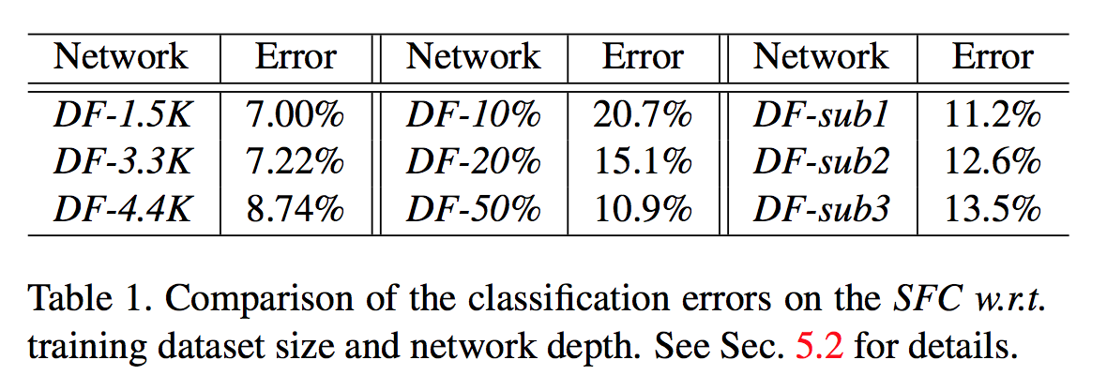
Results: Classification
Amount of data and size of the network

Slide 10
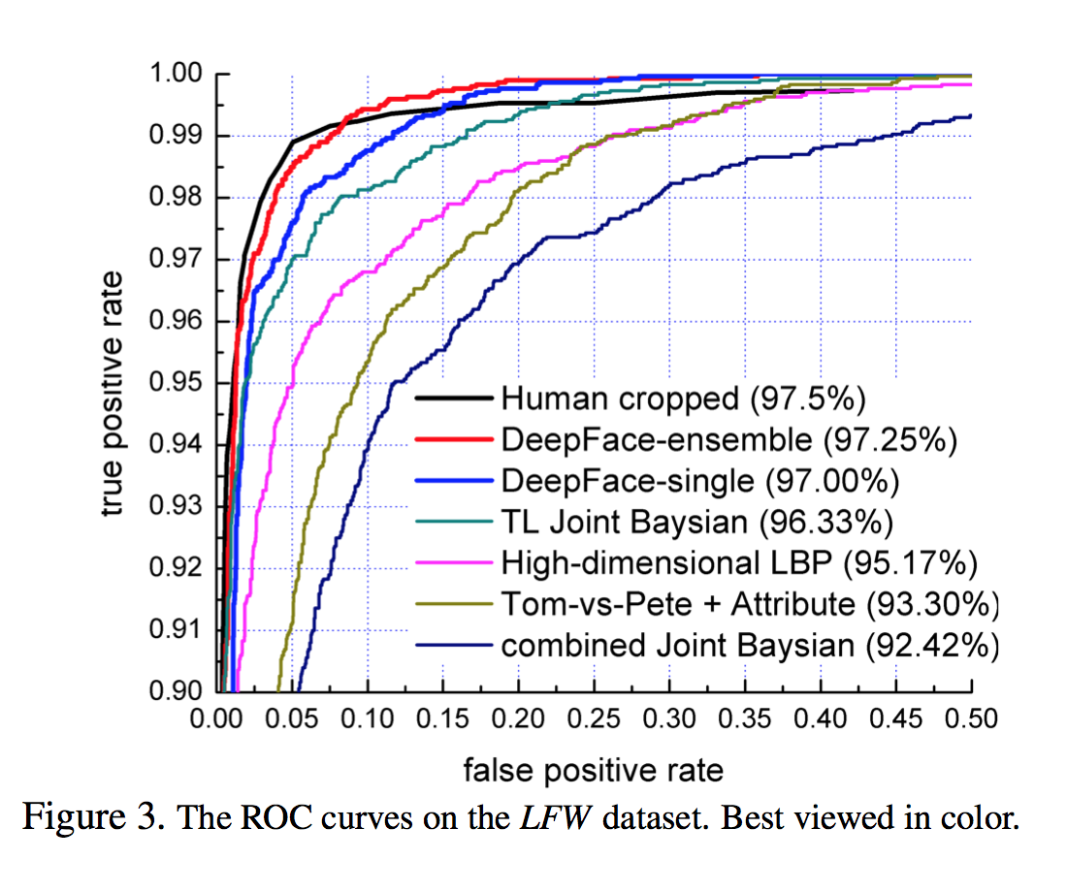
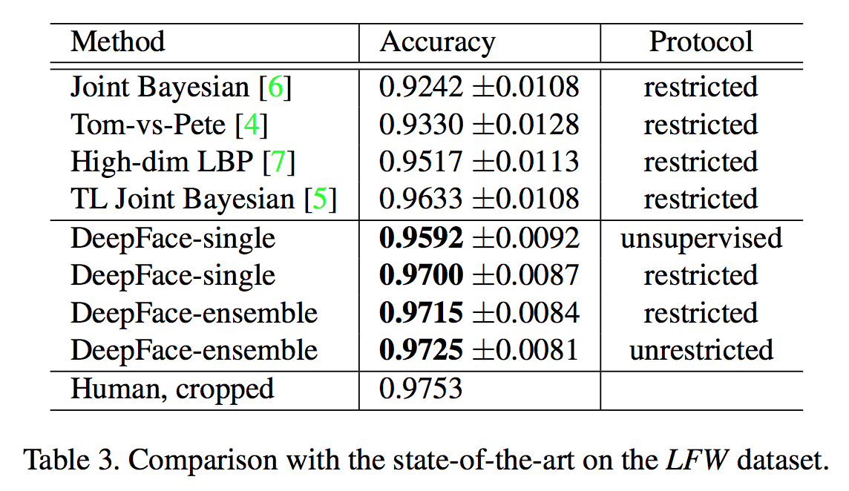
Results: Verification
Protocol:
Unsupervised: compare inner product of DNN features
Unrestricted: use additional training pairs to train Siamese network
Ensemble:
Combine 3 networks trained on different input data (e.g. RGB/gradients/etc.)

Slide 11
Efficiency
Runs in 0.33 second on a single core CPU

Slide 12
End

