Slide 1
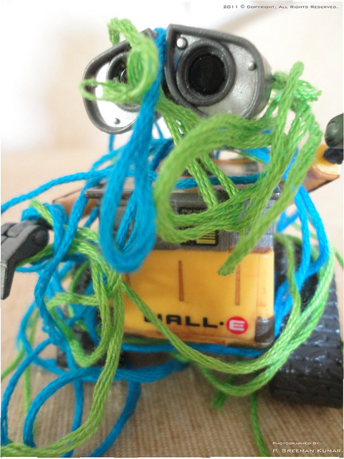
Some progress towards tethered pairs
Reza Hosseini Teshnizi and
Dylan A. Shell
Distributed AI and Robotics Lab
Computer Science and Engineering Dept.
Texas A&M University

Slide 2
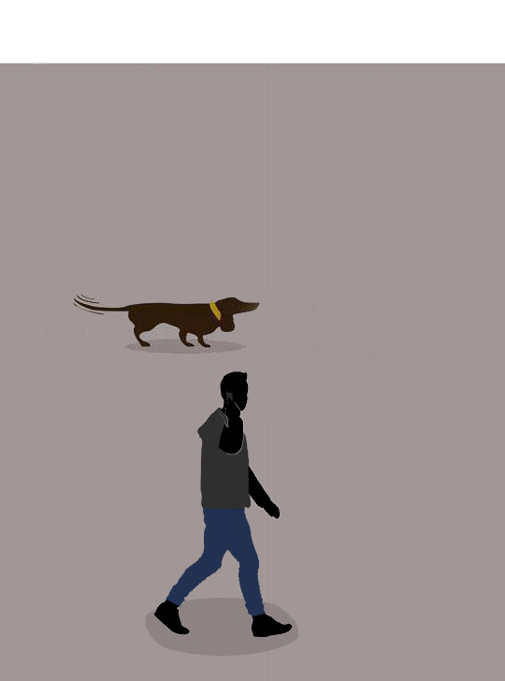
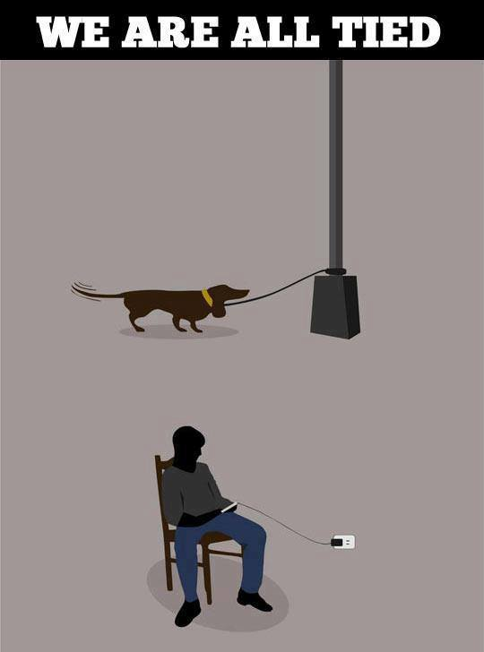
A tethered robot has…

Slide 3
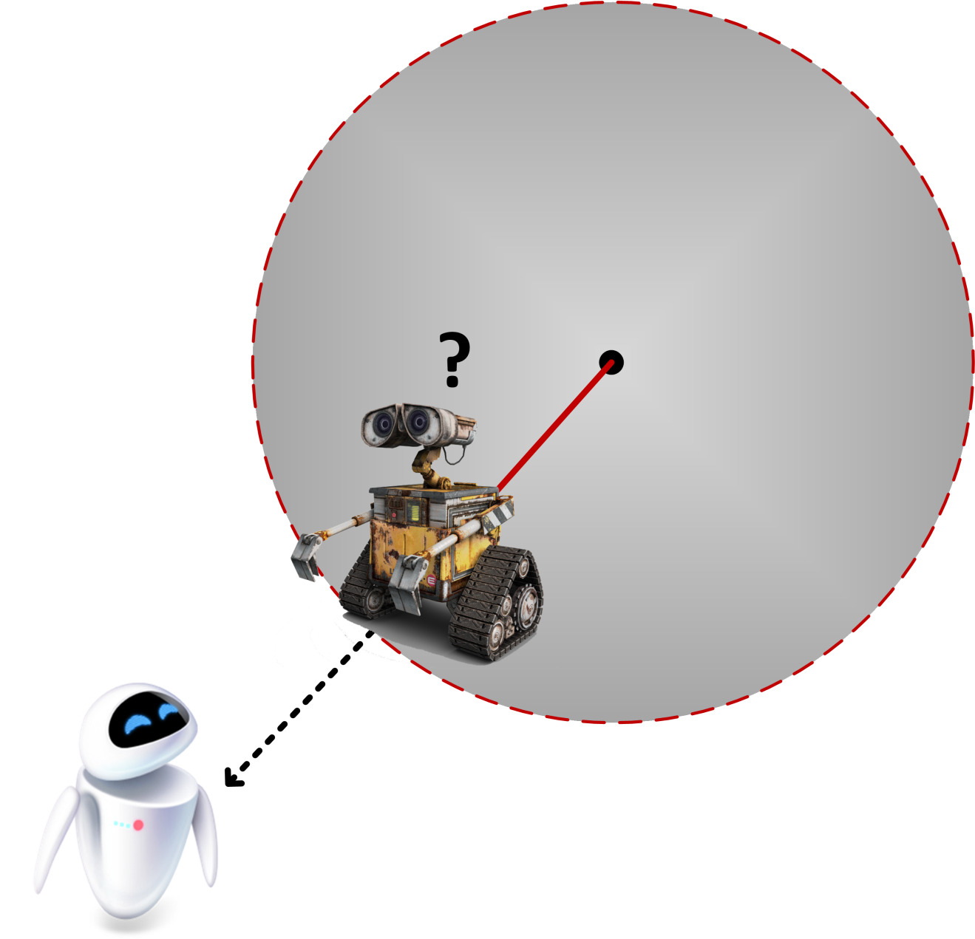
A tethered robot has…
Limited radius of movement

Slide 4
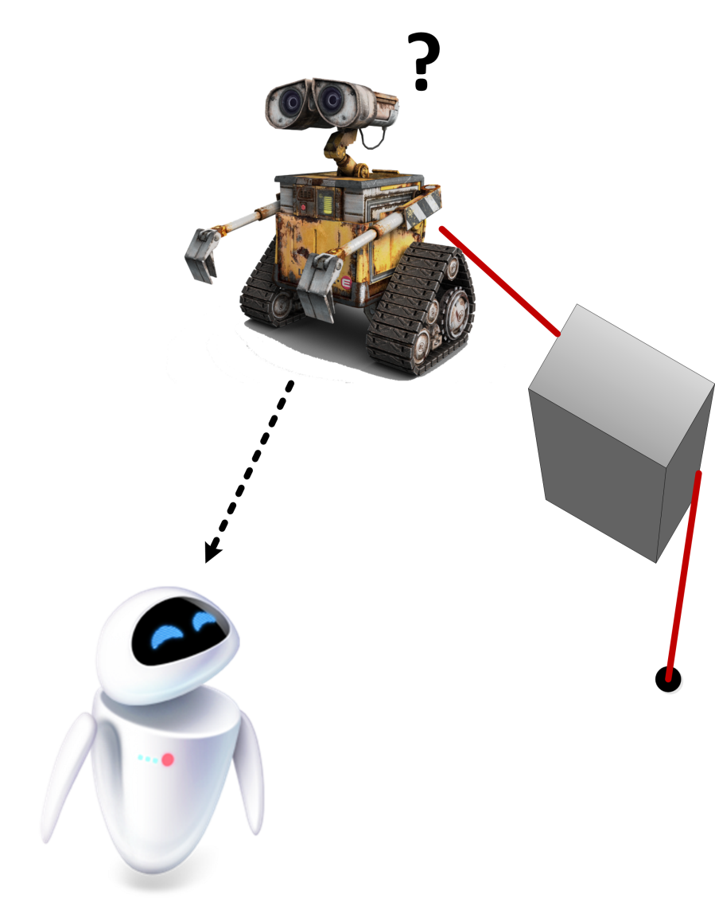
A tethered robot has…
Topological constraints imposed by the cable

Slide 5
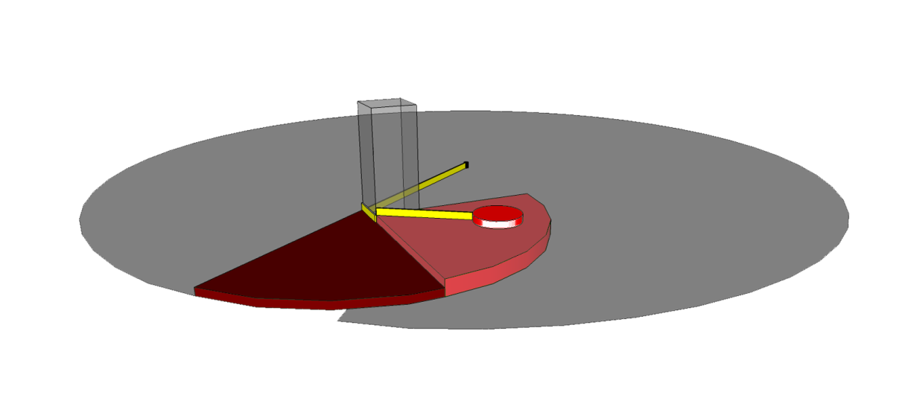
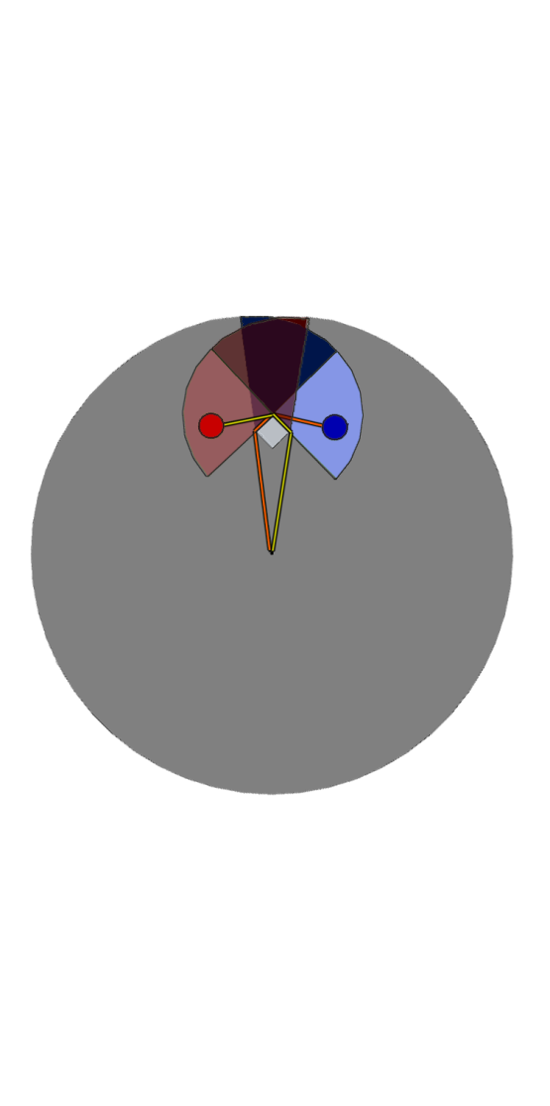
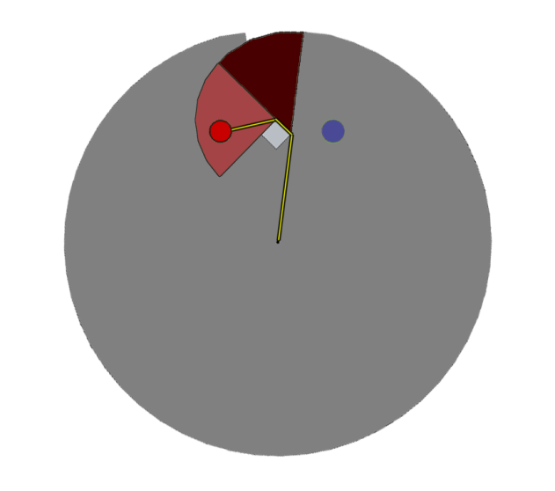
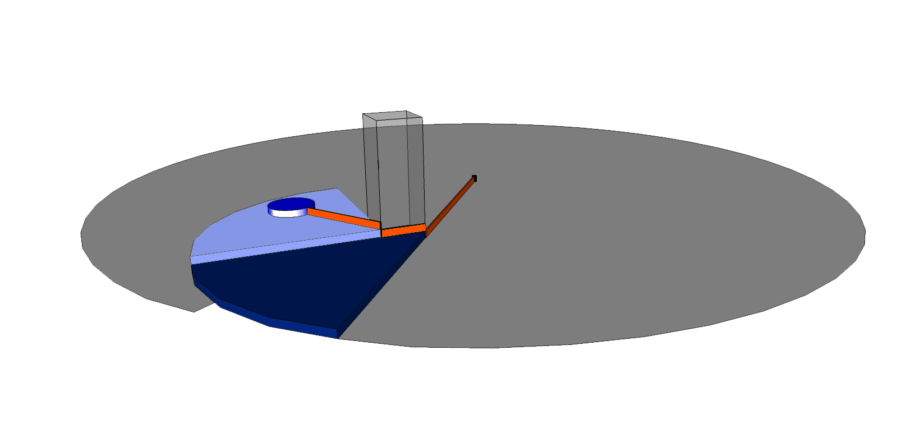
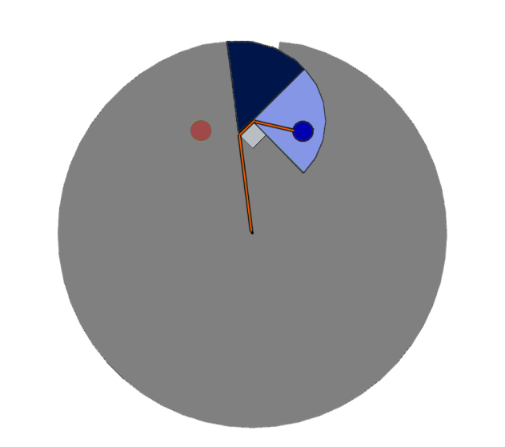
How we decompose the configuration space
Going counterclockwise
Going clockwise

Slide 6
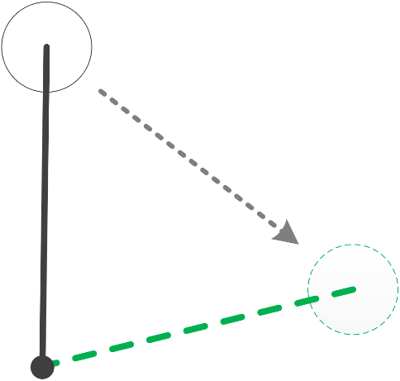
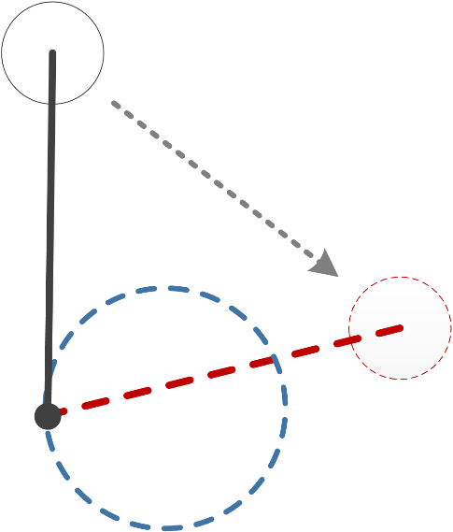
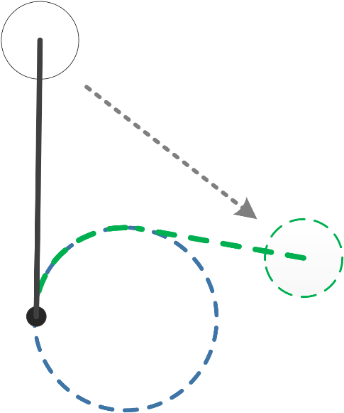
How to model a stiff cable?
Frictionless, taut, and unconstrained flexible cable:
Limited radius of movement.
Complex c-space topology.
Stiff Cable:
The cable cannot be bent beyond a certain point.

Slide 7
Curvature Constraint
Average Curvature of path
Curvature Constraint
An upper bound on average curvature

Slide 8
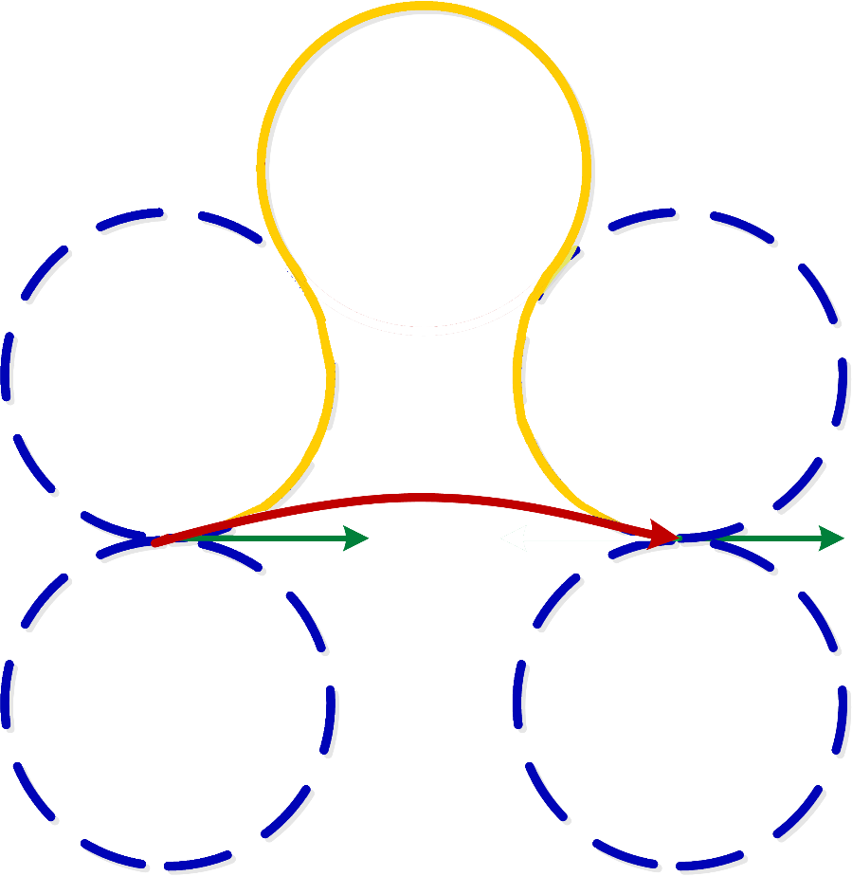
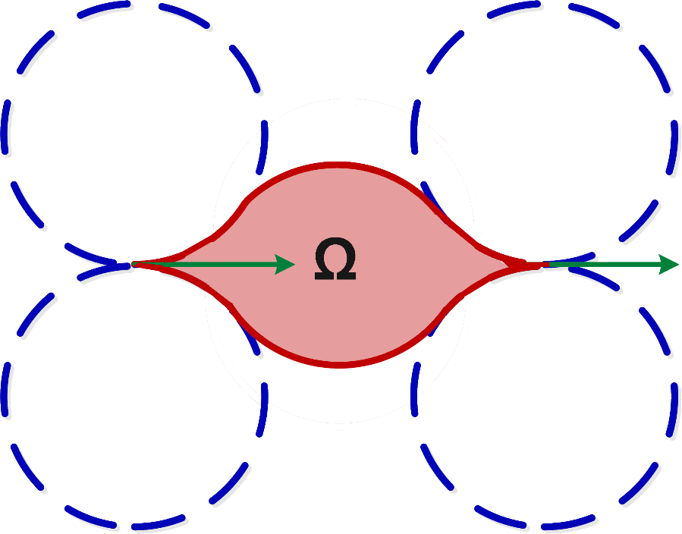
Omega Region
The boundary of a Cell is affected by the initial pose and the goal pose.

Slide 9
Come to our poster
It explores relaxation of the fixed base point assumption: we consider a pair tethered together.
We propose an algorithm that solves a subset of the cases via Dynamic Programming
Come to the poster to hear more specifically which ones.
Does not depend on the particular planner used
Could use the curvature constrained tether I’ve just spoken about.

