Slide 1
Sampling-Based Topological Motion Planning Algorithms and Application to Stochastic Optimal Control
Jung-Su Ha & Han-Lim Choi
Department of Aerospace Engineering
Korea Advanced Institute of Science and Technology

Slide 2
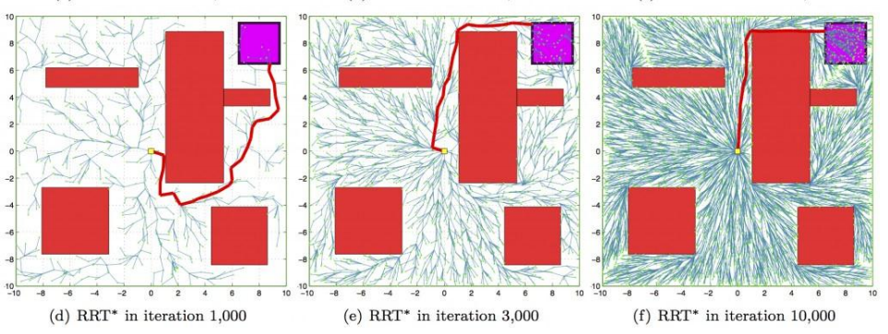
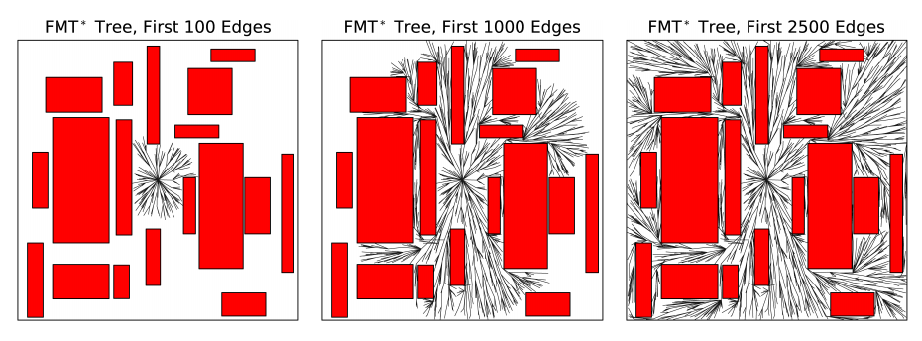
Sampling-based Motion Planning
Why sampling-based algorithm? (RRT* [1] & FMT* [2])
Perform graph construction and graph search concurrently =>Do not discretize the C-space =>Apply easily to high-dimensional C-space
Probabilistically complete
Asymptotically optimal
Rapidly-exploring Random Tree* (RRT*)
Anytime incremental algorithm
Find feasible solution quickly, and improve it
Fast Marching Tree* (FMT*)
Batch processing algorithm
Direct dynamic programming, lazy collision check
[1] Karaman, Sertac, and Emilio Frazzoli. "Sampling-based algorithms for optimal motion planning." IJRR 2011.
[2] Janson, L., Schmerling, E., Clark, A., and Pavone, M.. “Fast marching tree: A fast marching sampling-based method for optimal motion planning in many dimensions.” IJRR 2015,
2/4

Slide 3
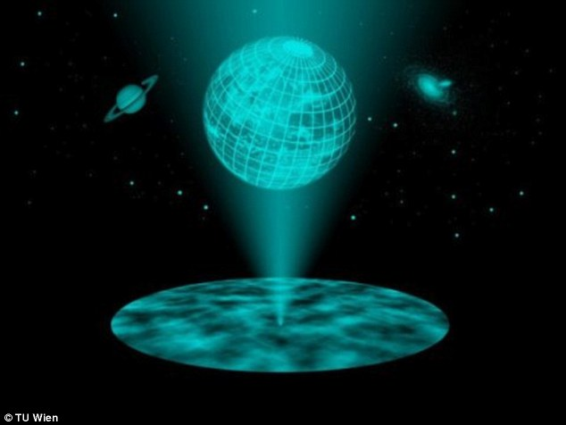
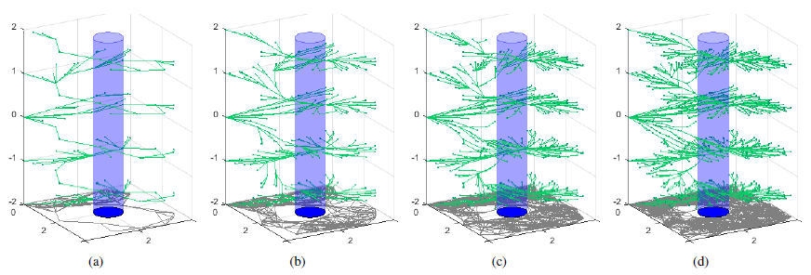
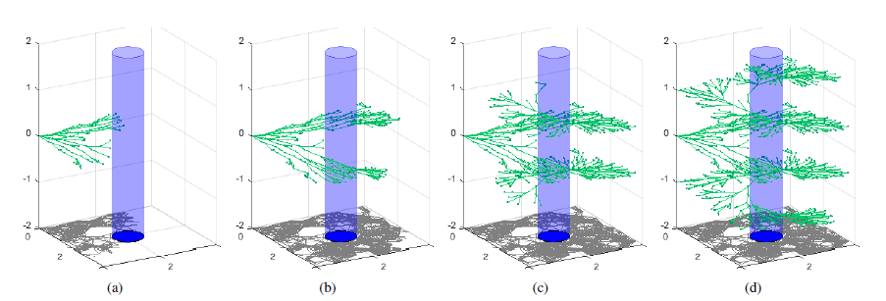
Planning in Augmented Space
Topological motion planning
Planning in H-augmented space
Utilize graph-construction and tree projection => construct a graph in original configuration space, and project a tree into the augmented space.
Rapidly-exploring Random Homology-embedded Tree* (RRHT*)
Anytime incremental algorithm
Find feasible solution quickly, and improve it
Fast Marching Homology-embedded Tree*
(FMHT*)
Batch processing algorithm
Direct dynamic programming, lazy collision check
3/4

Slide 4
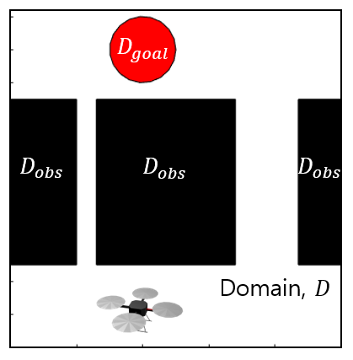
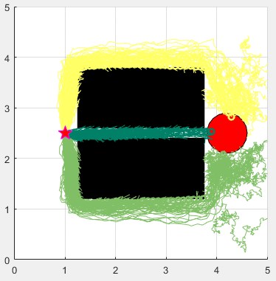
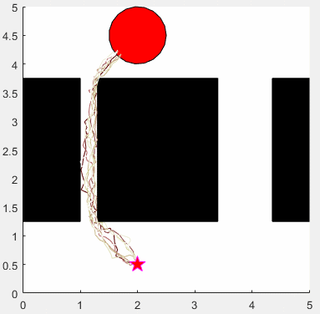
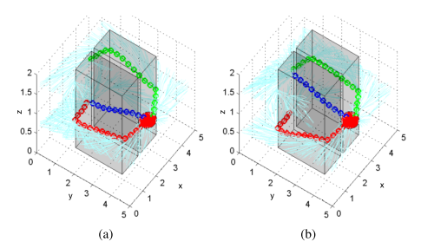
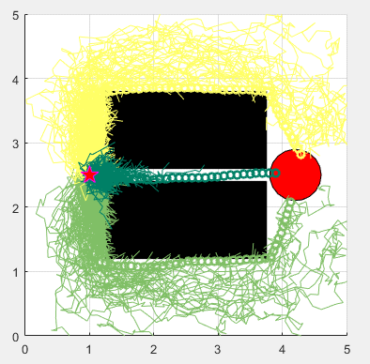
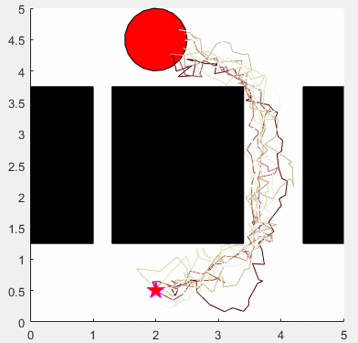
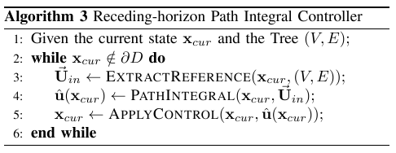
Application to SOC
- Control (online): Compute optimal control using diverse trajectories.
Stochastic dynamics: , , , is 2-dim Brownian motion
Cost functional: , with final cost
Planning/Control scheme - Planning (offline): Construct a (backward) motion tree,
Small noise, $b=0.1$
- Control (online): Compute a control using diverse trajectories.
Large noise, $b=0.3$
J.-S. Ha and H.-L Choi, "A Topology-Guided Path Integral Approach for Stochastic Optimal Control." ICRA 2016.
4/4

