Slide 1
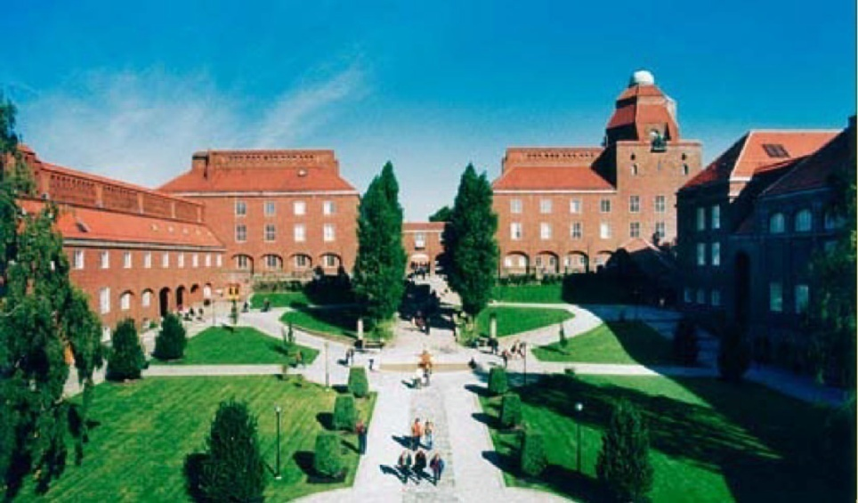
Perceptual and memory functions in a cortex-inspired attractor network model
KTH Campus
Anders Lansner
Dept of Computational Biology
KTH and Stockholm University

Slide 2


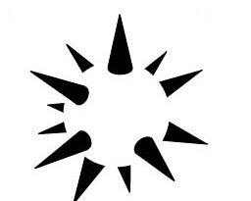

Donald Hebb’s brain theory
Hebb D O, 1949: The Organization of Behavior
Bliss and Lömo, 1973
Levy and Steward, 1978
LTP/LTD, STDP, ...
Cell assembly = mental object
Gestalt perception
Perceptual completion
Perceptual rivalry
Milner P: Lateral inhibition
Figure-background segmentation
After activity ≈ 500 ms
Persistent, sustained
Fatigue = Adaptation, synaptic depression
Generalizes to associative memory
Association chains
Time-asymmetric synaptic W
Notes:
Note close connection between holistic processing and memory retrieval from fragments, multi-modal integration (sound-vision) etc.

Slide 3
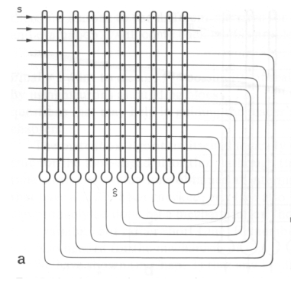
Mathematical instanciations of Hebb’s theory
1960’s-70’s Willshaw, Palm, Anderson, Kohonen
e.g. Hopfield network 1982
Recurrently connected
Layer 2/3, hippocampal CA3, olfactory cortex
Sparse connectivity and activity
Human cortical connectivity (10⁻⁶)
Activity (<1%)
Modular
Kanter, I. (1988). "Potts-glass models of neural networks." Physical Rev A 37(7): 2739-2742
Extensively studied
Simulations, e.g. memory properties
Theoretical analysis
Efficient content-addressable memory!
Notes:
Typically mapped to the cortical layers 2/3.
Biological plausibility?
Can this kind of memory network be implemented by a network of real neurons and synapses?
If so, what relation to cortical functional architecture and dynamics?

Slide 4
Question, outline of talk
Can such an recurrent associative “attractor” memory be implemented by a network of real neurons and synapses?
If so, what relation to cortical functional architecture and what emergent dynamics?
Top-down approach, complements data driven
First simulations early 1980’s
First journal publication Lansner and Fransén Network: Comput Neural Syst 1992
TALK OUTLINE
Model network description
Simulation of basic perceptual and memory function
Spike discharge patterns and population oscillations
Simulation of some basic ”cognitive” functions

Slide 5
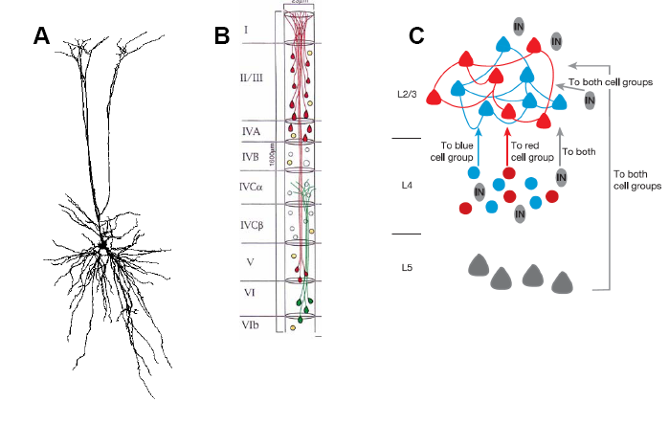
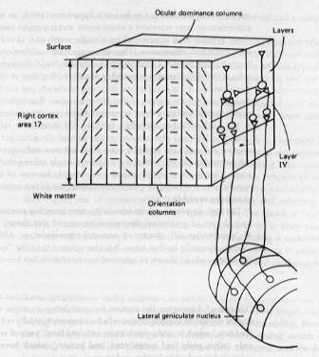
From conceptual and abstract models to biophysics
Computational units?
Neuron
Minicolumn
Distributed sub-network
Species differences?
Repetitive functional modules?
Hyper/Macrocolumns
How general?
Yoshimura and Callaway 2005
Peters and Sethares 1997
Hubel and Wiesel icecube V1 model
Notes:
12 min
Spike frequencies, EPSP-IPSP sizes, recall dynamics, oscillations
A fundamental question when using an abstract attractor network as a model for biology is: What do a unit in the abstract network correspond to?
Several possibilities are shown here, from single neuron to local sub-networks known from anatomy and pairwise recordings.
But in species with larger cortices from cat to man – mouse and rats may have more like single neuron units ...
We hypothesized early on that not the single neuron but the some minicolumn or sub-network represents a computational unit. This is what we used in our model.

Slide 6
A layer 2/3 cortex model Microcircuit layout “Icecube - Potts” like
70% -1.5 mV
70% 1.2 mV
70% 2.5 mV
25% 2.4 mV
¹17% 2.5 mV
²30% 0.30 mV
Minicolumns/local sub-networks with
30 pyramidal cells, connected 25%
2 dendritic targeting, vertically projecting inhibitory interneurons
RSNP, e.g. Double bouquet
Hypercolumns (soft WTA modules) with
Pool of Basket cells
Martinotti cells, with facilitating synapses from pyramidal cells
Large models: 100 minicolumns, 200 basket + Martinotti cells per hypercolumn
Currently rudimentary layers 4 and 5
Notes:
So our model has functional minicolumns and hypercolumns ...
To build a network model we need to model the invidividual neurons and synapses and this is done in a traditional way with compartmental model neurons of intermediate complexity (next slide)

Slide 7
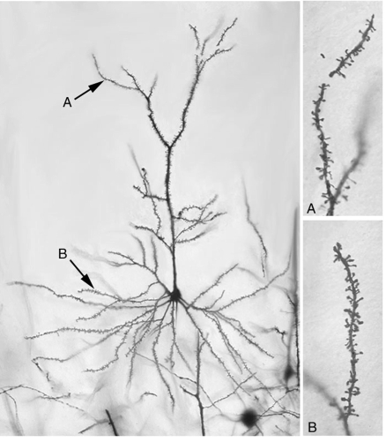
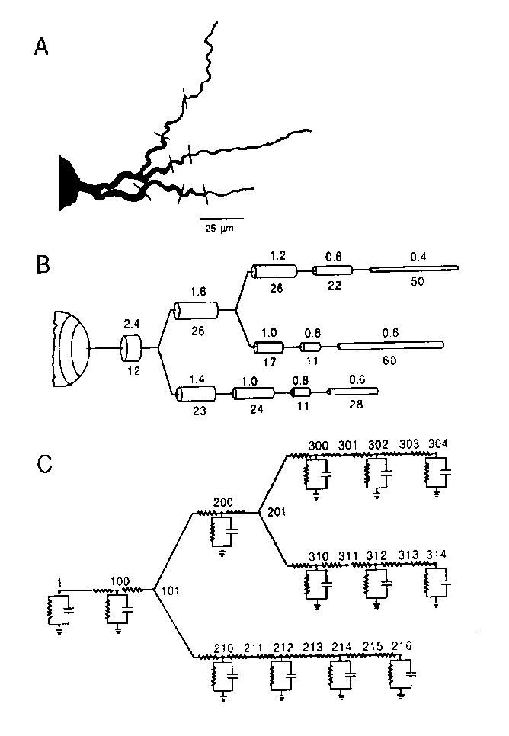
The layer 2/3 cortex model Single cell model
Hodgkin-Huxley formalism
Na, K, K_{Ca}, Ca-channels
Ca_{AP} and Ca_{NMDA} pools
Pyramidal cells
6 compartments
IS, soma, 1 basal, 3 apikal dendritic
Inhibitory interneurons
3 compartments
IS, soma, dendritic
AP and AHP shapes
Firing properties, adaptation
Neuron populations
Cell size spread (±10%)
Large-scale networks
SPLIT simulator (by KTH)
Parallel NEURON
NEST simulator

Slide 8
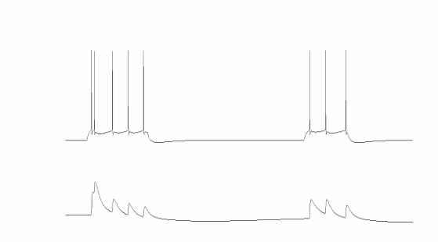
The layer 2/3 cortex model Synaptic properties and connectivity
Synaptic transmission
Glutamate (AMPA & voltage dependent NMDA)
Depressing synapses
GABA_{A}
Synaptic targeting of soma and dendrites
3D geometry ⇒ delays
0.1 - 1m/s conduction speed
Realistic amplitude of PSP:s in larger network models
pre
post
Pyramidal-pyramidal fast synaptic depression
[Tsodyks, Uziel, Markram 2000]

Slide 9
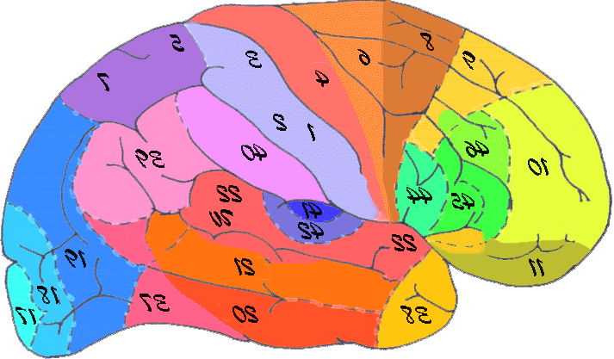
Conceptual model of Neocortex
Hypercolumns
Cortical areas
Hypercolumns are grouped into cortical areas of various sizes
Human V1 has ~40000 hypercolumns
Human neocortex has about 110 cortical areas (Kaas, 1987)
Notes:
Human V1 48 cm² (Andrews et al., 1997)

Slide 10
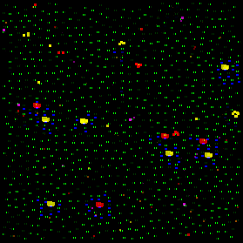
Network layout
1x1 mm patch
9 hypercolumns
Each hypercolumn
100 minicolumns
100 basket cells
29700 neurons
15 million synapses
100 patterns stored
W trained offline
(A-)symmetric
One of the 9 hypercolumns
Active minicolumn (30 pyramidal cells)
Active basket cell
Active RSNP cells

Slide 11

9 hypercolumns Spontaneous activity
1x1 mm patch
9 hypercolumns
Each hypercolumn
100 minicolumns
100 basket cells
29700 neurons
15 million synapses
100 patterns stored
Non-symmetric W

Slide 12
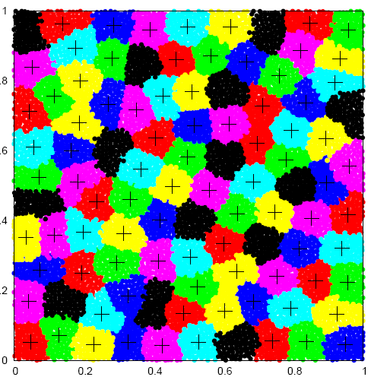

100 hypercolumns Spontaneous activity
330000 neurons
161 million synapses
≈ 4x4 mm
Notes:
20 min

Slide 13
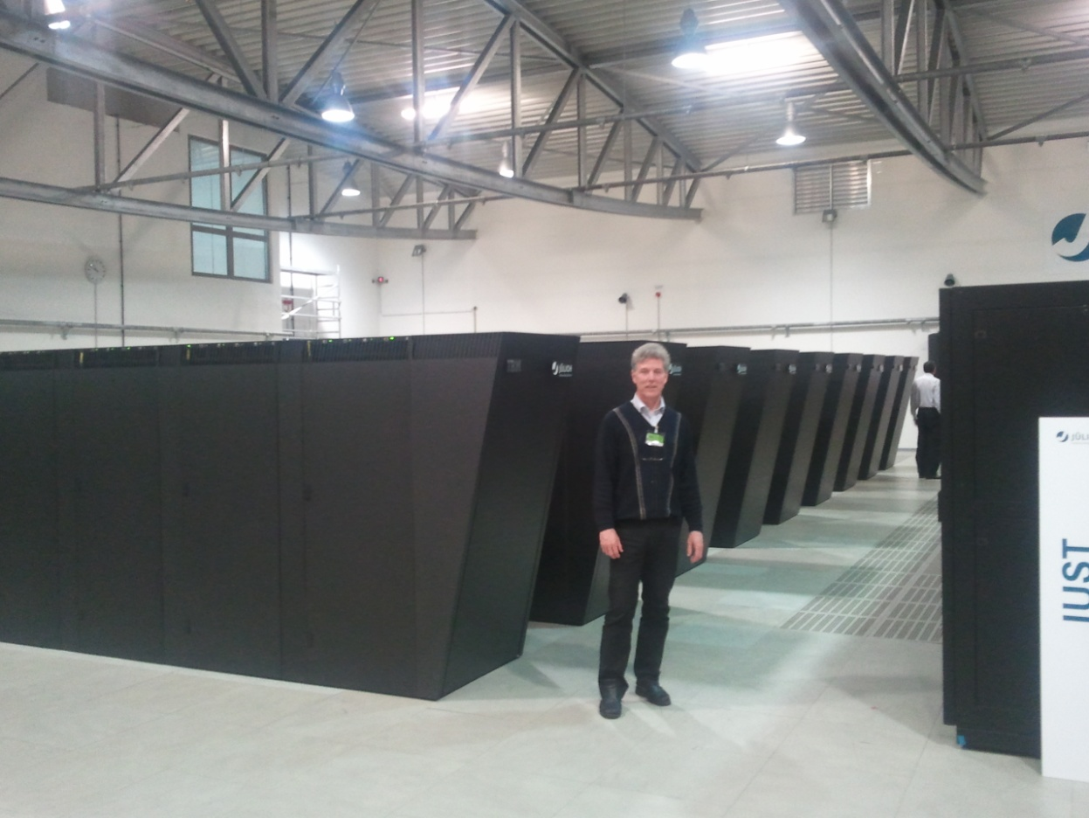
8 rack BG/L simulation October 2006 Djurfeldt M, Lundqvist M, Johansson C, Rehn M, Ekeberg Ö, and Lansner A (2008): Brain-scale simulation of the neocortex on the Blue Gene/L supercomputer. IBM J R&D 52:31-41
22x22 mm cortical patch
22 million cells, 11 billion synapses
SPLIT simulator
8K nodes, co-processor mode
used 360 MB memory/node
Setup time = 6927 s
Simulation time = 1 s in 5942 s
Massive amounts of output data
77 % estimated speedup (8K)
Linear speedup to 4K nodes
Point-point communication slows (?)
JUGENE FZJ
294912 cores

Slide 14
Supercomputing for brain modeling
Brain simulation parallellizes very well!
Feb 2011 on JUGENE
IBM Blue Gene/P
294912 cores
Spiking cortex model
N > 30 M
C > 300 G (Hebbian)
Real time encoding and retreival
Neuromorphic
HW ...
CNS workshop on Supercomputational Neuroscience – Tools and Applications
Thursday 09:00
Sign up on billboard!

Slide 15
2000+ neurons
250000+ synapses
5 s = 600 s on PC
Interplay of
Recurrent excitation
Cellular adaptation
Synaptic depression
(Synaptic facilitation)
Lundqvist M, Rehn M, Djurfeldt M and Lansner A (2006). Attractor dynamics in a modular network model of the neocortex. Network: Computation in Neural Systems: 17, 253-276

Slide 16
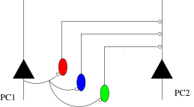
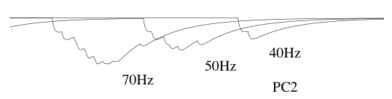
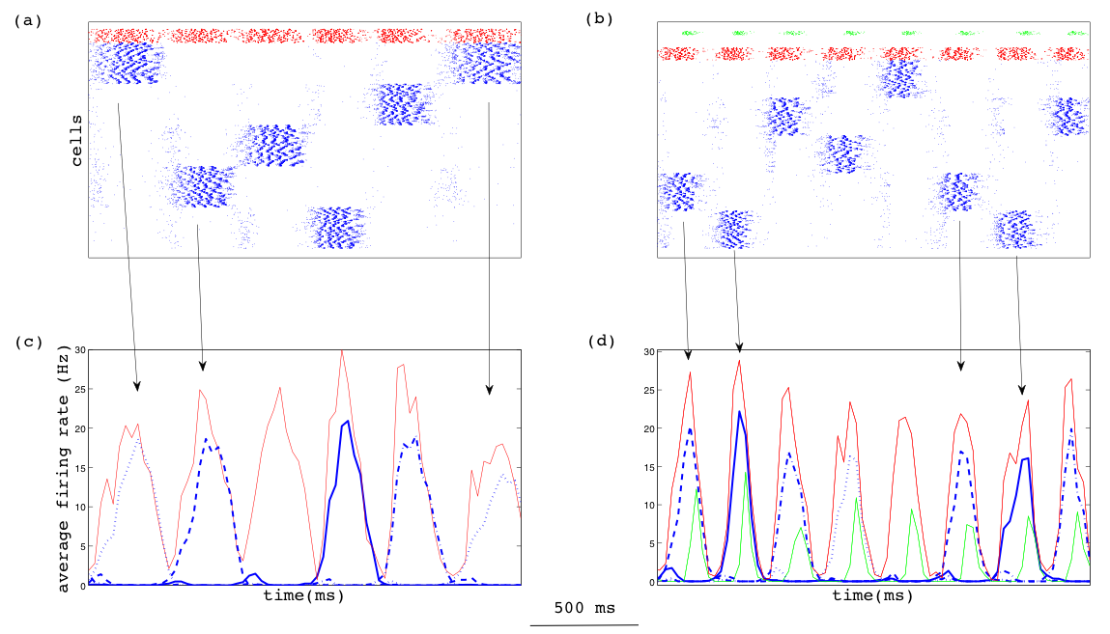
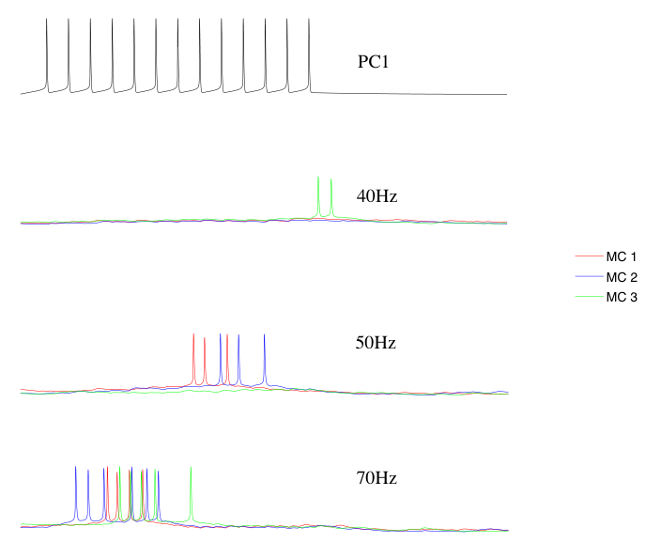
Adding an interneuron with facilitating synapses Krishnamurthy, Silberberg, and Lansner 2011, submitted
Silberberg and Markram Neuron 2007

Slide 17
Bistability, raster plot formats only pyramidal cells
Plot formats
Raw
Grouped
Bistable
Ground state
Many active (coding) states
Oscillatory
Criticality?

Slide 18
Spontaneous attractor ”hopping”
Memory replay at theta
Fuentemilla et al. Curr Biol 2010

Slide 19
Stimulus during spontaneous attractor hopping

Slide 20
Random long-range W?
Cortical pairwise connection statistics obeyed in both cases

Slide 21
Stimulus during ground state + pattern completion
L2/3
High input sensitivity
From groundstate to spontaneous wandering by excitation!
L4

Slide 22
Stimulus during ground state Modulated for persistent activity

Slide 23
Attractor rivalry

Slide 24
Hebb’s theory - summary
Can be implemented with biophysically detailed neurons and synapses
Basic perceptual and memory functions
Trained W
Perceptual completion and rivalry
Stimulus sensitivity
Psychophysical reaction/processing times, 100 ms
Theta, beta, and gamma power in LFP
But .... How many attractors can be stored? On-line STDP ...?
... and what about emergent dynamical properties, discharge patterns, oscillations?
Notes:
38 min

Slide 25
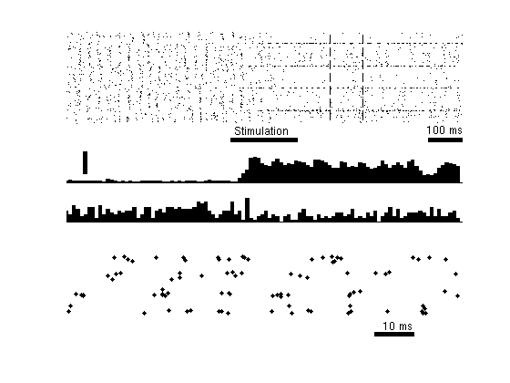
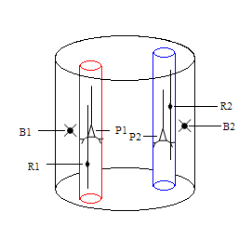
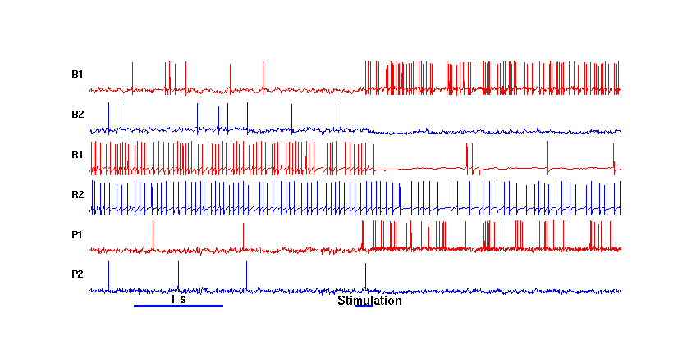
Bistable, irregular low-rate firing, spike synchronization Lundqvist, Compte, Lansner PLOS Comp Biol 2010
Balanced excitation-inhibition
High CV in both states, >1 during ”hopping”
Ground state Active (memory) state
1Hz/10Hz
Foreground neurons

Slide 26
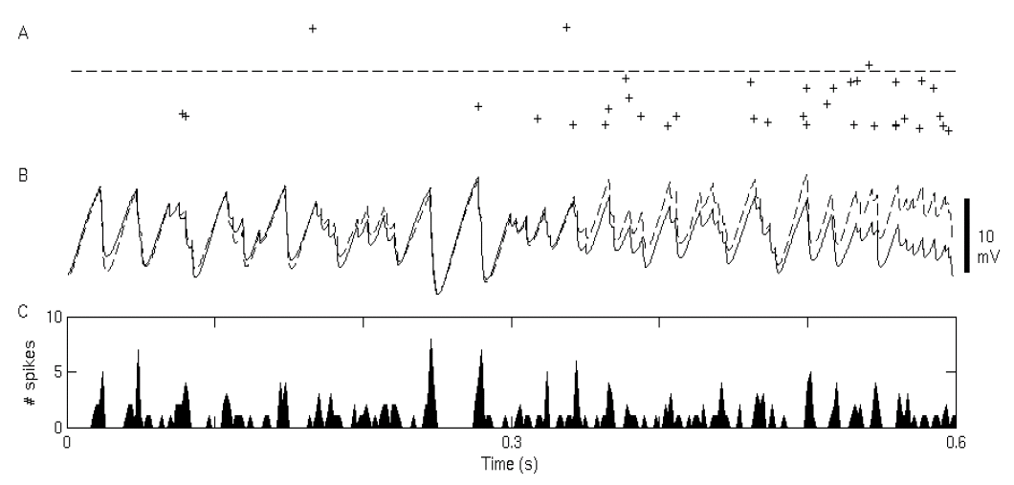
Spiking activity in ground and active state
Ground state – diffuse
Active state – focused
V_{m} is oscillatory
Foreground neurons lead
Race condition, Fries et al. TINS 2007
Same number of spikes in ground and active states
Backgound spikes
Foregound spikes
Notes:
First attractor memory model to show population oscillations in both ground and active state
Why?

Slide 27
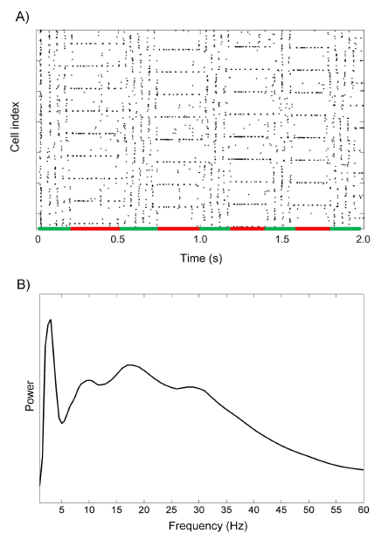
Oscillatory spontaneous activity
Rasterplot from 10000 pyramidal cells of the network.
Spontaneous switching between different memory states and a non-coding ground-state attractor
Alpha-Beta activity corresponds to the periods of ground state
Theta, lower alpha and gamma peaks corresponds with active recall

Slide 28
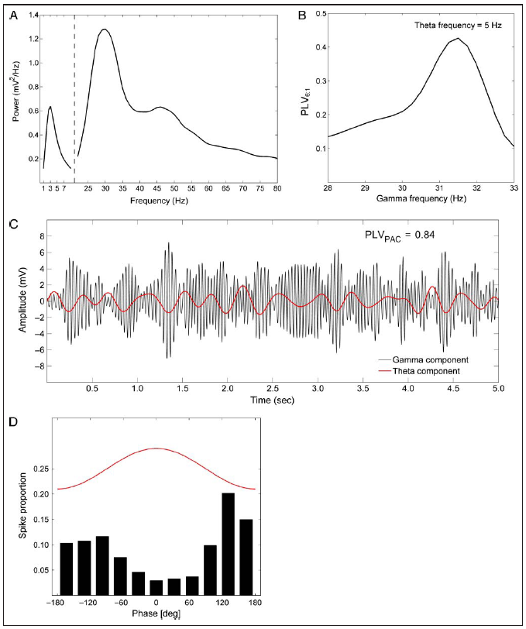
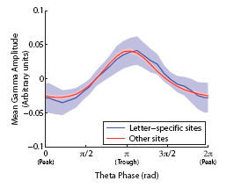
Theta – gamma phase locking
Theta-gamma phase locking
e.g. Sirota et al. Neuron 2008
Theta+gamma – memory retrieval
Jacobs and Kahana J Neurosci 2009
Spatial patterns of gamma oscillations code for distinct visual objects (intracranial EEG), Fig 6C
Attractor
shift
−π
0
π
2π

Slide 29
Bistability of oscillatory activity
Our attractor memory model shows stable population oscillations in both ground and active state and
Characteristics of in vivo cortical spiking activity
... low rate irregular spiking of neurons
Why is this model more stable than previous ones?
RSNP inhibitory interneuron?
Large number of neurons?
Modularity - hypercolumns and minicolumns?
Notes:
We first thought it was because it has two types of inhibitory interneurons (RSNP) with quite different roles. But that was not possible to show.
It is also modular more than most other models with spiking neurons, and that made a difference it turned out!

Slide 30
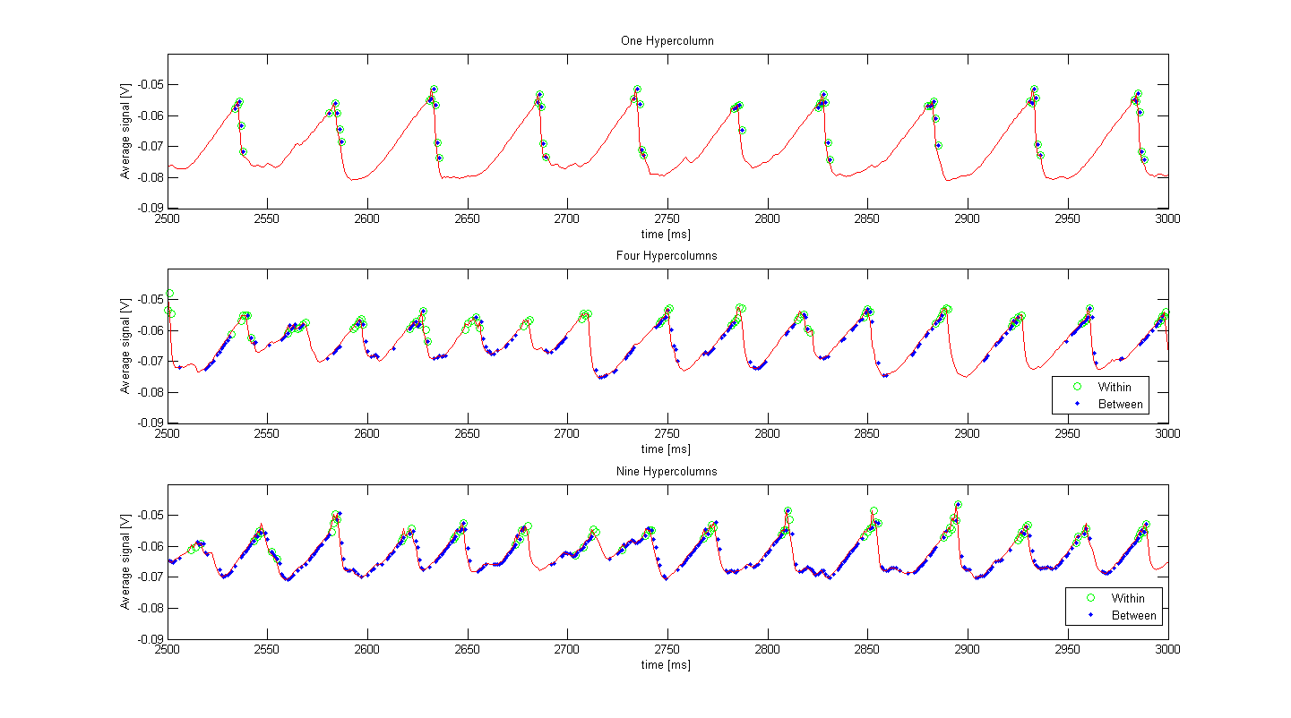
Importance of modularity
Hyper-column
Basket cells
Minicolumn
Pyramids
RSNPs
Gamma phaselocking/coherence No modules ⇨ high
Modules ⇨ 0.2-0.3
NMDA less important for stability
Average V_{m} of a minicolumn + own and external spikes
Notes:
We reshaped our modular network in steps to a nonmodular one, and the difference was clear!
Reason why provious models needed fine tuning to achieve realistic firing properties
These results are somewhat at odds with theories of binding by synchrony! Show that some synchrony develops, but that too much actually is destabilizing. Need more work to make this clear.
We have some ongoing work where we compare oscillaory activity and coherence in a two-connected-patches model with data acquired to test this theory in macuaqe monkey.

Slide 31
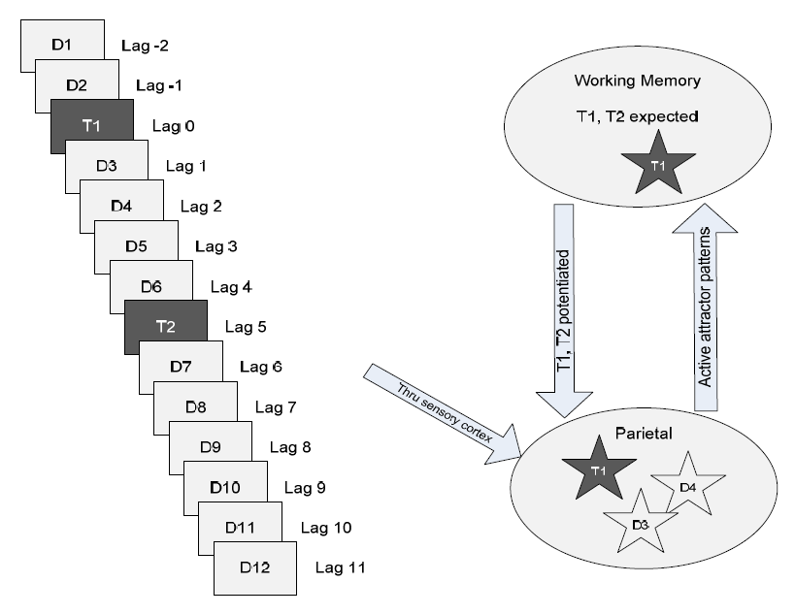
Is attentional blink a by-product of cortical attractors Silverstein, D. and A. Lansner Front Comput Neurosci 2011
RSVP of e.g. Letters
Two target letters. T1 & T2
T2 missed if too close
After-activity 300-500 ms, suppressing perception of T2?
Spiking H-H attractor network model
Attractors stored for each item
T1, T2 depolarized
Distractors hyperpolarized
±1 mV
Notes:
rapid serial visual presentation (RSVP)

Slide 32
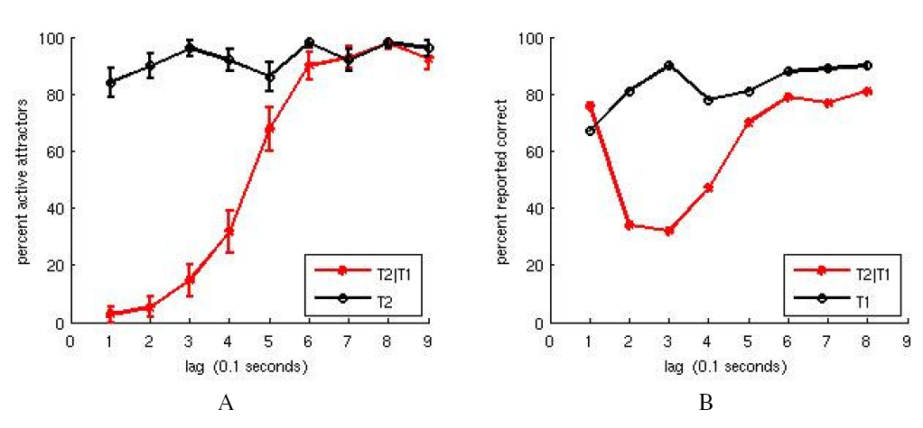
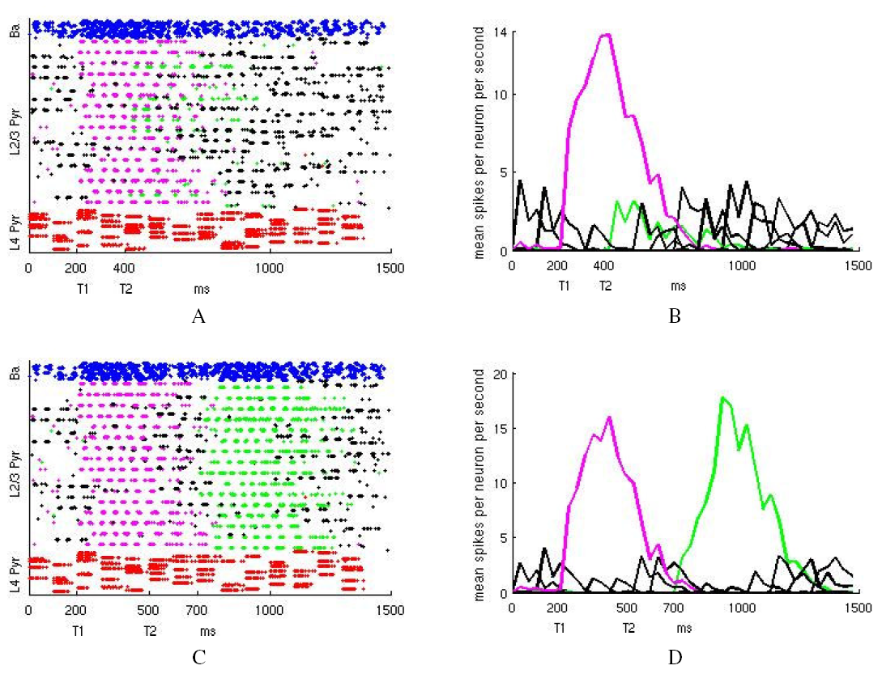
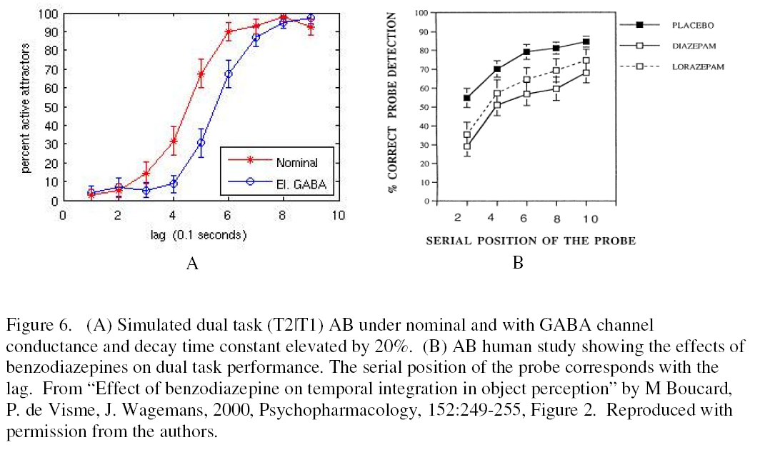
Attentional blink results
Simulation
Experiment
Powerful attentional modulation of target patterns by ± 1 mV
Lacking ”lag-1 sparing”
Benzodiazepine modulates GABA (amplitude & time constant)
Boucard et al. 2000, Psychopharmacology 152: 249-255

Slide 33
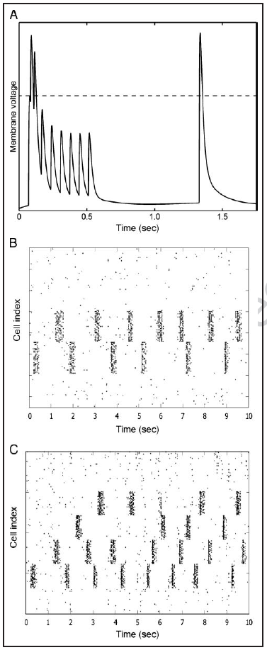
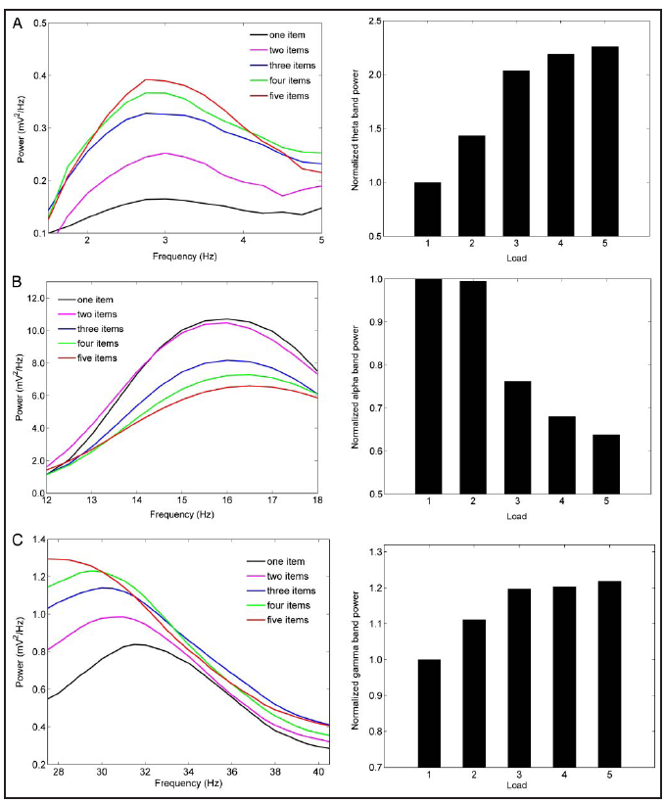
Oscillations and WM load Lundqvist, Herman, Lansner 2011 J Cogn Neurosci
Synaptic working memory
Sandberg et al. 2003
Mongillo et al. Science 2008
Stored patterns (LTP) + fast plasticity
Synaptic augmentation
Wang et al. 2006
Presynaptic, non-Hebbian
Storing 1 – 5 memories
Increasing memory load
Decreased alpha & beta
Increased theta & gamma
Intracranial EEG
Meltzer et al. Cereb Cortex 2008
θ
α − β
γ
Notes:
Augmentation: Wang, Y., Markram, H., Goodman, P. H., Berger, T. K., Ma, J.,
& Goldman-Rakic, P. S. (2006). Heterogeneity in the
pyramidal network of the medial prefrontal cortex. Nature
Neuroscience, 9, 534–542.

Slide 34
Conclusions
A Hebbian type associative memory can be built from real cortical neurons and synapses
Cortex-like modular structure, realistic sparse activity and connectivity
Connects some basic perceptual and memory phenomena to underlying neuronal and synaptic processes
Macroscopic dynamics, neuronal activity similar to that seen in data
Many extensions and details remain to be investigated
Complete the layers and understand their roles
Develop network-of-network architecturs with feed-forward, lateral, feed-back projections
Match new data on long-range connectivity
Temporal dimension, sequential association, serial order
Supercomputers enable brain-scale network models
Full size brain simulations feasible
Substantial work on scalable simulators and analysis tools remains
Will enable a better understanding of normal and diseased brain function
Notes:
Computer models in personalized heart medicine

Slide 35




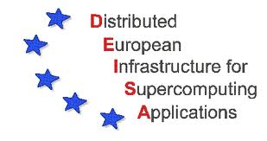

Acknowledgements
Early modeling studies, simulator development
Erik Fransén
Per Hammarlund, Örjan Ekeberg
Mikael Djurfeldt
Later model development and analysis
Mikael Lundqvist, PhD student
David Silverstein, PhD student
Pradeep Krishamurthy, PhD student
Data analysis
Pawel Herman, postdoc
EC/IP6/FET/FACETS
EC/IP7/FET/NEUROCHEM
STOCKHOLM BRAIN INSTITUTE
Swedish Foundation for Strategic Research
Swedish Research Council and VINNOVA
IBM
AstraZeneca
Select-And-Act

Slide 36
Thanks for your attention!

