Slide 1
Discriminative Decorelation for clustering and classification ECCV 12
Bharath Hariharan, Jitandra Malik, and Deva Ramanan

Slide 2
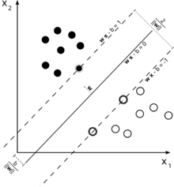
Motivation
State-of-the-art Object Detection
HOG
Linear SVM
Dalal&Triggs Histograms of Oriented Gradients for Human Detection CVPR05

Slide 3
Motivation
State of the art Object Detection
Mixture models
Parts Based Models
Train one linear for each class/mixture/part
Hundreds of objects of interest
Hard negative mining
Increasing number of mixtures (exemplar SVMs)
Increasing number of parts
Can we make the training fast (closed form, no iteration) without losing much in performance?
P. Ott and M. Everingham. "Shared Parts for Deformable Part-based Models” CVPR11
Lubomir Bourdev, et al. ,Detecting People Using Mutually Consistent Poselet Activations ECCV10

Slide 4
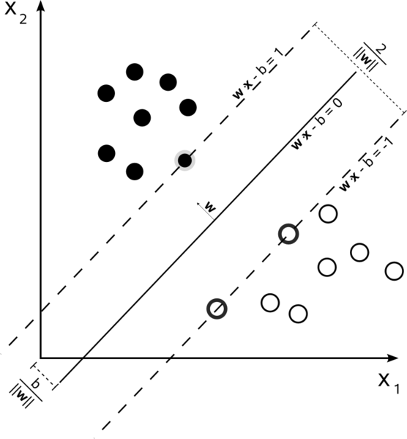
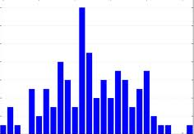
Motivation
What does linear SVMs do?
Discriminative Feature selection!
Can we do it closed form?
Seems possible with LDA
Image
HOG
SVM
LDA

Slide 5
Contents
Motivation
LDA
Closed form solution
Parameters reduction/Regularization
Properties of the model
Clustering
Results

Slide 6
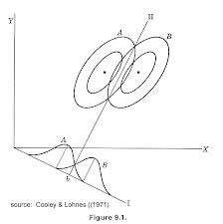

Linear Discriminant Analysis (LDA) – Binary case
Training set (X,Y)
Assumes normal $N\left({x;μ}_{y},\text{Ʃ }\right)$ conditional distributions P(x|y=0) and P(x|y=1)
Assumes equal class covariances
From log of likelihood ratios give
$w={\text{Ʃ }}^{−1}(μ_{1}−μ_{0})$
Dot product decision function: $f\left(x\right)= w.x<c$

Slide 7

Closed form Solution
Calculate object independent${ μ}_{c}$ and Ʃ
Assume we want the same Ʃ across different classes
MLE of Ʃ becomes the covariance computed over all training samples
Lets assume number of negative samples are very much larger than positives of each class
${ μ}_{c}$ can be computed once on all training samples including positives
Even so, Number of parameters in a HOG template can be very large making estimation of a Ʃ very hard

Slide 8

Regularization
Translation and scale invariance
Take all the negative windows from each scale and position
Stationary process
Mean will be computed for all HOG cells the same
Covariance will only model relative offsets
$N_{0}d$ parameters only
Covariance only on different cells offsets
Still low rank and not invertible
Add a small amount to the diagonal (0.01)

Slide 9
Properties of the Covariance
Structure of Ʃ
encodes spatial correlations between oriented gradients
Sparsity
- Covariance of 9 orientation dimensions of one cell to 4 horizontal neighbors
Dark is negative and light is positive
Precision matrix is sparse
Fades after a few cells away

Slide 10
Properties of the Covariance
Structure of Ʃ
encodes spatial correlations between oriented gradients
Sparsity
- Covariance of 9 orientation dimensions of one cell to 4 horizontal neighbors
Dark is negative and light is positive
Precision matrix is sparse
Fades after a few cells away

Slide 11

Properties of the Covariance
Transformed (Whitened) HOG Feature (WHO)
${x^{′}=\text{Ʃ}}^{−\frac{1}{2}}\left(x−μ_{0}\right)$
More meaningful distances
Comparison to PCA
PCA keeps the dimensions with most variance among training samples
Removes the discriminative information!
Image
HOG
LDA
PCA

Slide 12

Results – Pedestrian Detection
Comparing to Dalal Triggs HOG-SVM
With hard negative mining
Method
Averaging: Compute positive average HOG ($μ_{1})$
Centering: Subtract $μ_{0}$
Whitening: Multiply by ${\text{Ʃ }}^{−1}$
To check the whitening effect use the centered version only
Dalal&Triggs: 79.66%
LDA: 75.10%
Centered: 8%
Pedestrians are well aligned

Slide 13
Clustering
Use transformed feature
Recursive normalized cuts

Slide 14
WHO Clustering Results

Slide 15
Some minor results
Average over all clusters performance
Airplane, bus, horse
Correlation of SVM and LDA
Low training computation
Still slow in testing phase

Slide 16
Combining Across Clusters
1- Use Exemplar SVMs method
2- change the SVM to an LDA with object independent background model
3- To make it fast in test
Use clustering train a classifier for each cluster
Train an LDA for each cluster
Produce Feature Vector1: Dot product of a window WHO feature to all exemplars WHO
Produce Feature Vector 2: Dot product of a window WHO to all clusters WHO
Train a linear SVM on the concatenated feature

Slide 18
What we wanted! To do
Train exemplar SVMs for each sample
Take the selected feature as the new transformed feature
Do Image Classification (combined features and nonlinear SVMs)
Clustering and Linear SVMs ALMOST DONE
New similarity measure for verification (like face verification in LFW)
Model Natural images with some distribution to make training Exemplar SVMs fast DONE
One can use more sophisticated modelling of natural patches (GMM))
Make a pyramid of second, 3rd, … order discriminant features

