Slide 1
Embodied Cognition Course
Gert Kootstra

Slide 2
Embodied Cognition Course
Course coordinator
  Gert Kootstra, CVAP
  kootstra@kth.se
Other organizers
  Orjan Ekeberg, CB
  Giampiero Salvi, TMH
Time
  Wednesdays 10:00-12:00
Place
  For now Teknikringen, Room 304

Slide 3
Course setup
Lectures
  Lectures given by participants
  Invited lecture (internal and external)
Lab visits
  CVAP, TMH, CB

Slide 4
Course material
“How the Body Shapes the Way We Think” – Rolf Pfeifer and Josh Bongard
Additional papers selected by the participants
Papers provided by the invited speakers

Slide 5
Objectives
After the course you should be able to
  Demonstrate insights in the field of embodied cogn
  Have a multi-disciplinary perspective
  Know about the research at TMH, CB, and CVAP
  Place your research in a broader perspective
  Setup a multi-disciplinary research project

Slide 6
What you need to do to pass
Attend all lectures
Give one lecture (groups of two)
Actively participate in the lectures
Read the course material
Prepare questions for the invited speakers
Write a multi-disciplinary research proposal

Slide 7
To give a lecture
In groups of two
Discuss the content of a book chapter
Discuss some of the studies referred to in more detail
Choose two additional papers based on the content and your own interest/research
  Think about the diversity of backgrounds
  Mail articles a week before the lecture
End lecture with a discussion, provide topics

Slide 8
Invited speakers
External
  Peter König
  Luc Steels
  Auke Ijspeert
Internal
  From all groups
We will discuss papers a week earlier
You will have to prepare questions

Slide 9
Multi-disciplinary research proposal
Groups of two
Write a research proposal combining your research or research area (5 pages)
In the field of Embodied Cognition
Place your research in a broader perspective
Multi-disciplinary collaborations
Exercise to write a research proposal

Slide 10
Schedule for next few weeks
26 jan Introduction
2 feb Personal presentations (5 min pp)
9 feb Auke Ijspeert
16 feb Chapter 1&2 by me
23 feb Chapter 3 by …
… …

Slide 11
Introduction to Embodied Cognition

Slide 12
Embodied Cognition
Embodied Cognition
  Having a body, interacting with the world, is essential in cognition
  Active perception
    Perception ➔ Action , but also…
    Action ➔ Perception
  The body shapes the way we think

Slide 13
The body shapes the way we think
The brain obviously controls our body
  Consciously: we act when we want to act
  Unconsciously: heart beat, walking, dogging when something approaches us, etc.
Title of the book is the reverse.
  Aren’t we free to think what we want?
  The body constraints thought
  But also enables thought

Slide 14
Categorization example
Elementary capacity: categorization
  Eatable/non-eatable, friend/foo, etc.
Categories are determined by embodiment
  Morphology: shape of body, types of sensors, types of actuators
  Material properties of muscles, sensors
Categories are determined by interaction
  What can you do with an object
  A chair is a chair because you can sit on it.

Slide 15
Hypothesis
Cognition is grounded (shaped by) the body
  Categorization
  Spatial cognition
  Social cognition
  Problem solving
  Reasoning
  Abstract thinking
  Language

Slide 16
A theory of intelligence
Throughout the book, a general theory of intelligence is formed
Applicable to different types of agents
  Humans
  Animals
  Robots

Slide 17
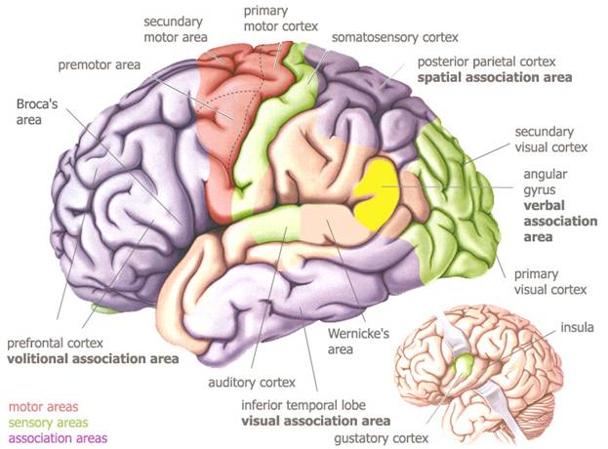
Our brain is involved with our body
motor
cortex
somatosensorisch
cortex
dorsal visual pathway
planning of
behavior
visual
cortex
cerebellum
Auditory cortex
motor control

Slide 18
A very brief history of
Artificial Intelligence

Slide 19
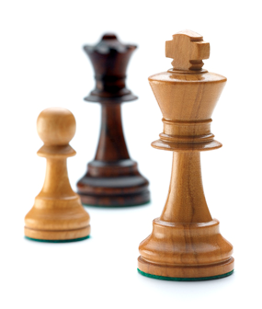
Chess as the holy grail of AI
Idea:
  Playing chess acquires high cognitive abilities
  Ergo, if we can solve that, we can solve AI
Good chess computer since 70’s
World-class level in 1997
  Deep-blue – Kasparov

Slide 20
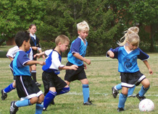
Success in computer chess
Advances made people positive about developments in AI and robotics
  Robots with the intelligence of a 2 year old
However, robots nowadays are far from the intelligence of a 2 year old
  Perception
  Action
  Learning
  …

Slide 21
Moravec’s paradox
High cognitive processes
  Conscious processes (chess, problem solving,…)
  Difficult for humans
  Easy for computers
Low cognitive processes
  Perception, action, (social) interactions
  Easy for humans
  Difficult for computers

Slide 22
Explanation: Moravec’s paradox
Interactions with the world have evolved over billions of years
  Essential for survival and reproduction
  Mainly unconscious processes
  We are not aware of the difficulty
Abstract thinking is much more recent
  Often conscious
  We are aware of the difficulty

Slide 23
The limited world of chess
Chess
  Limited number of states
  Limited number of actions
  No uncertainty
Makes use of symbols trivial
Not the case for real-world systems
Elephants don’t play chess (Brook 1990)

Slide 24
A Very Brief History of Robotics

Slide 25
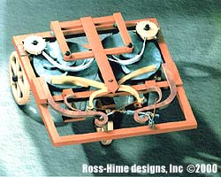
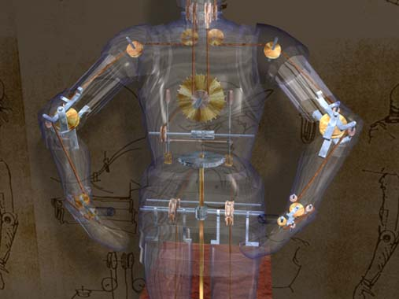
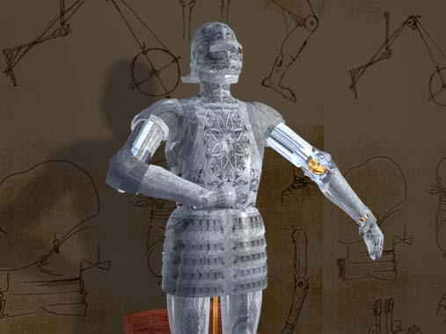
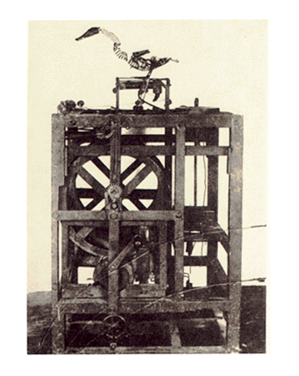
Mechanical period
Leonardi Da Vinci (1478)
Jacques de Vaucanson (1738)

Slide 26
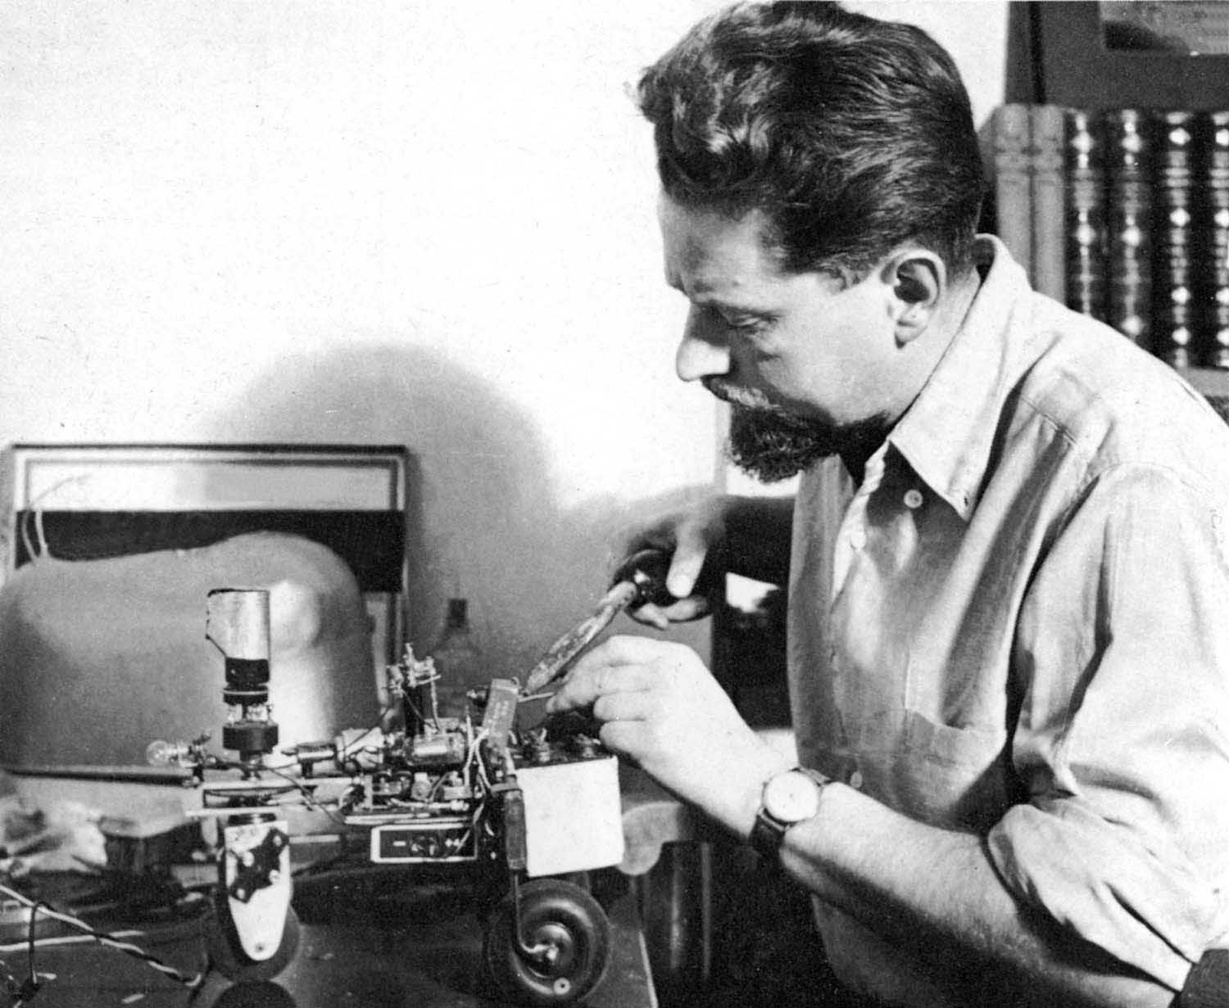
Electronic period
W. Grey Walter
  Neuroscientists
Robots Elmer and Elsie
(1948)
  Phototaxis
  Simple mechanisms

Slide 27
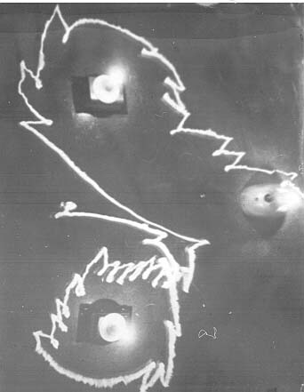
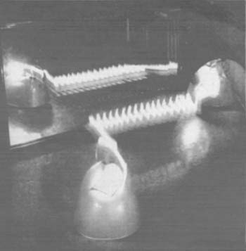
Elmer and Elsie
Results
  Simple mechanisms, but …
  Complex real-time behavior
  Emerging properties
    Mirror
    Reduced capacity of battery

Slide 28
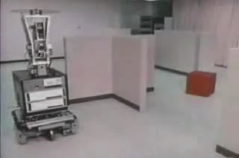
Digital period
Shakey (1966-1972)
  Slow, non real-time behavior

Slide 29
Cognitivistic view on cognition
Sense – think – act
Perception
  Creating a complete world
  model of the sensory info
Cognition
  Processing of symbols
Slow processes
Under-appreciation of body, environment, noise and uncertainty
Perception
World model
Memory
Symb Reasoning
Action Planning

Slide 30
Representation

Slide 31
The impression of seeing everything
Despite only a small fovea, we have the impression of seeing everything
Classically view
  We integrate the information gathered while making eye movements
But do we make a detailed representation of the scene?

Slide 32
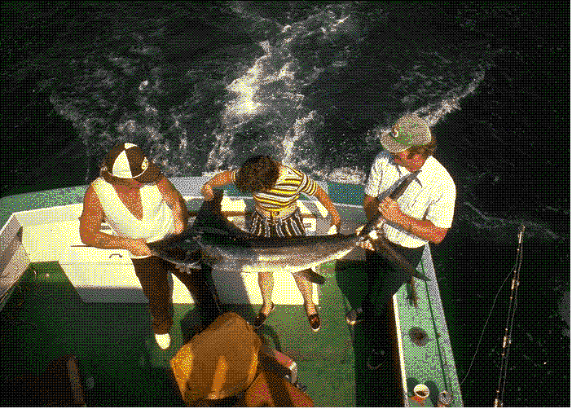
Spot the change
(O’Regan & Noë, 2000)

Slide 33
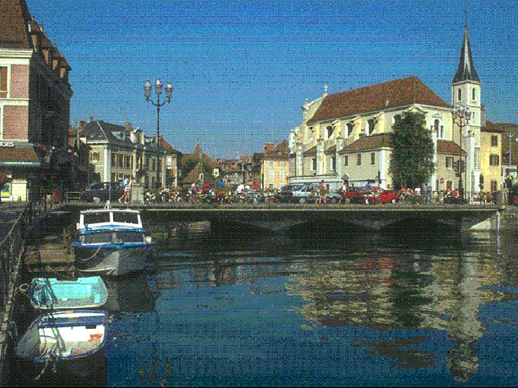
Spot the change
(O’Regan & Noë, 2000)

Slide 34
Change blindness
Without blank frame
  Change is spotted easily by motion detectors
With blank frame
  Change is hart to spot
  Blank frame create motion all over the image

Slide 35
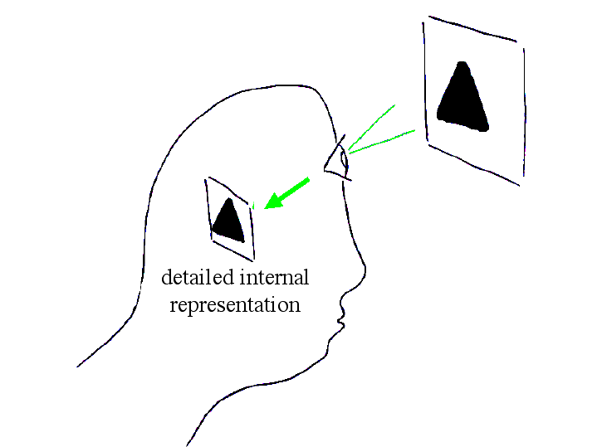
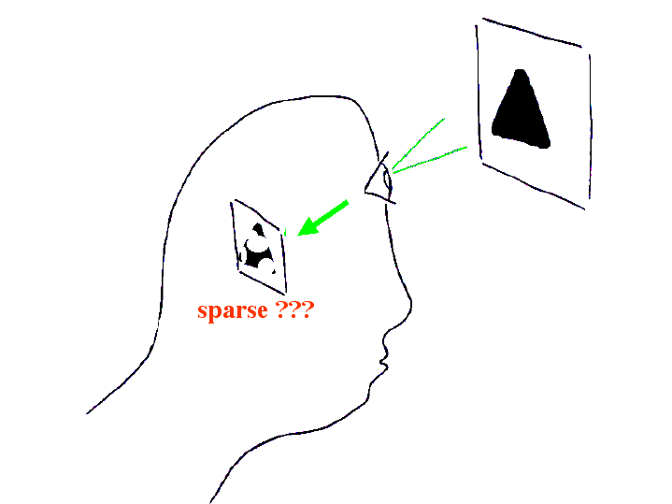
Change blindness
Indication that our brain does not store a detailed representation (O’Regan & Noë, 2000)

Slide 36
The world as outside memory
We have an impression of a full representation of the scene, because we can access the information if needed
  Only the recipe to get at the info need to be stored
  Active perception
The world as outside memory
We make use of our embodiment!

Slide 37
The world as outside memory
Intelligence without representation (Brooks ‘91)
    “the world is its own best model. It is always exactly up to date. It always has every detail there is to be known. The trick is to sense it appropriately and often enough.”

Slide 38
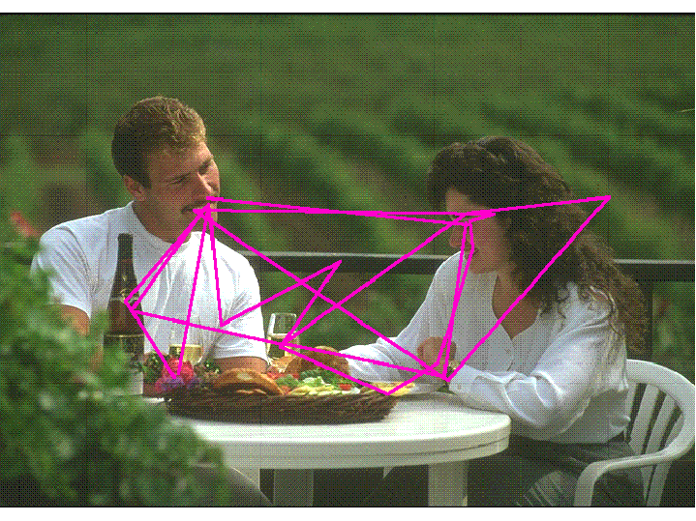
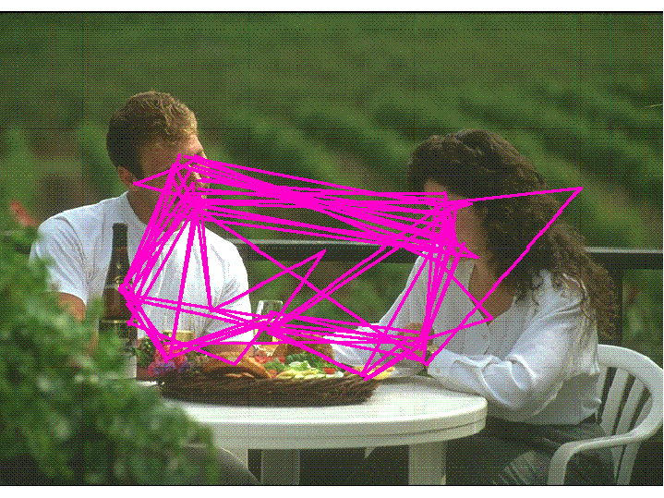
The world as outside memory
Typical scan paths

Slide 39
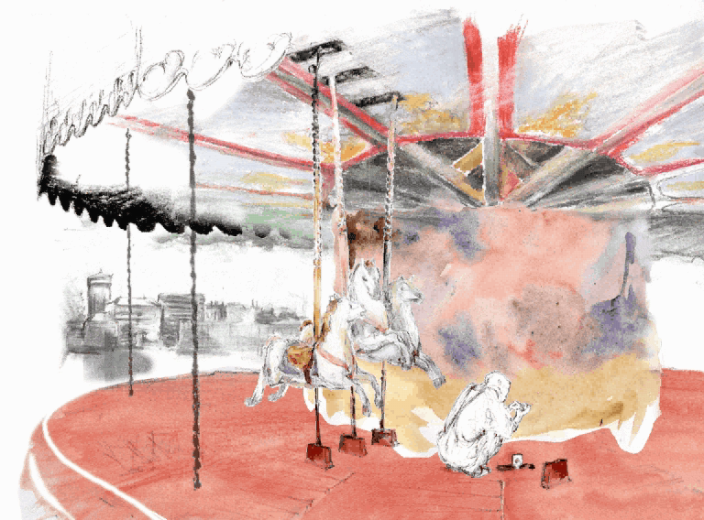
More change blindness

Slide 40

More change blindness

Slide 41
Complete Agent

Slide 42
A complete agent
Complete agent
  Situated: capable of sensing the world
  Embodied: capable of acting in the world
All natural agents through out evolution are complete agents
Agent
Agent
perception
action
World
World

Slide 43
Complete agent
Important to keep in mind when
  Studying natural systems
    E.g., Interpreting brain functions as being part of a complete agent
  Developing artificial systems
    E.g., Exploiting active capabilities of the agent

Slide 44
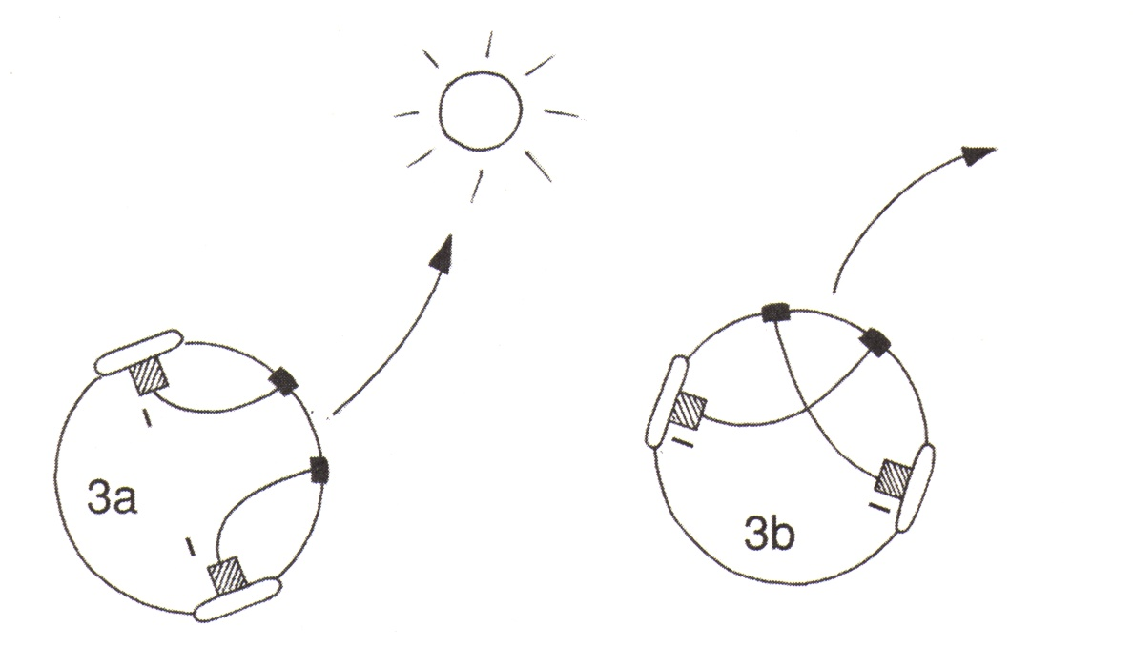
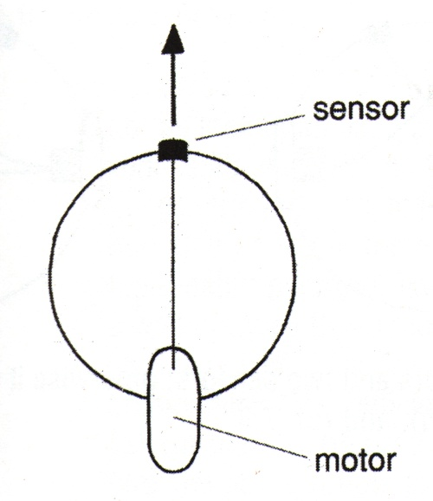
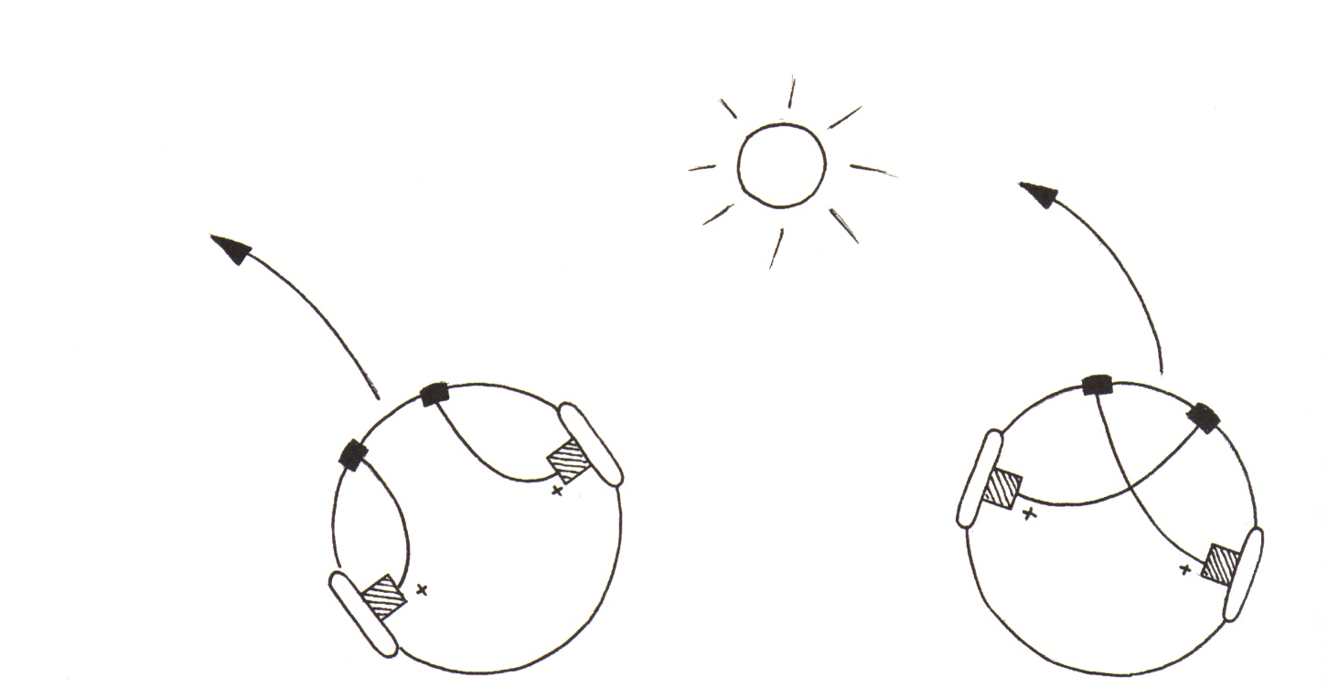
Braitenberg vehicles
Valentino Braitenberg (1984)
  Simple vehicles, but already complex behavior

Slide 45
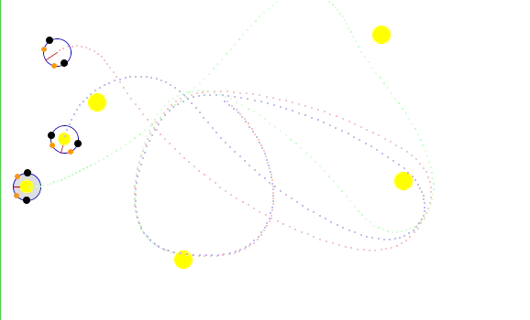
Braitenberg vehicles
Complex behavior from interaction with the world and other agents

Slide 46
Interaction

Slide 47
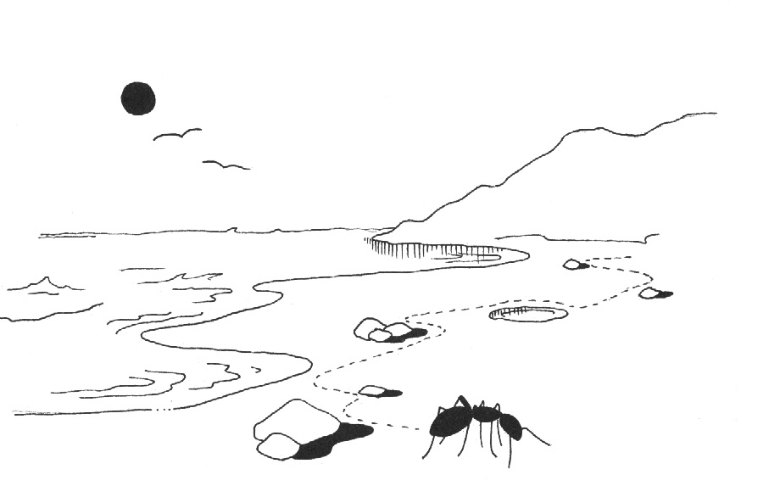
Herbert Simon’s ant on the beach
We observe a complex
path of the ant
Does this mean that the
internal mechanisms are
complex as well?
No, path results from the interaction between the ant and the beach
Internal mechanisms are simple

Slide 48
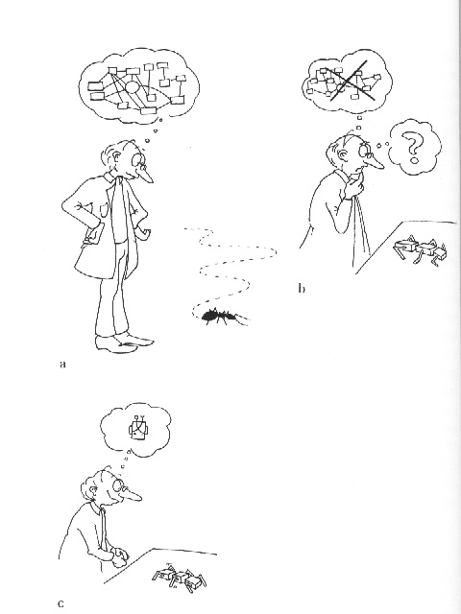
Frame of reference
To understand behavior, it is important to take the right frame of reference
  Right perspective
  Include the agent-environment
  interaction
  Realize that complex behavior
  does not mean complex
  mechanisms
Same for the development of
artificial systems

Slide 49
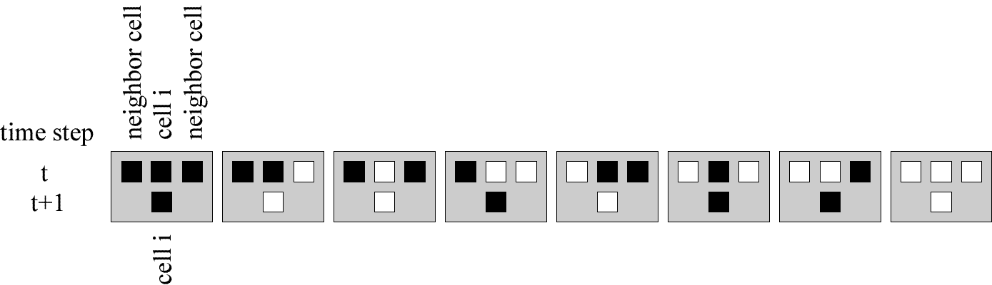

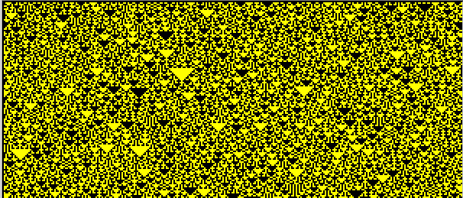
Interaction between agents
Conway’s Cellular Automata (Conway 1982)
Simple internal mechanisms but many agents

Slide 50
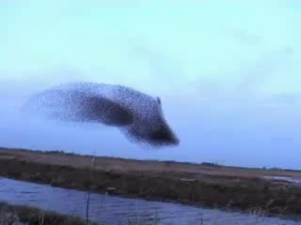
Interaction between agents
Flock of birds

Slide 51
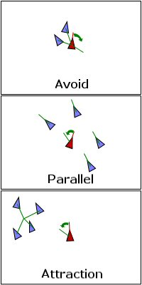
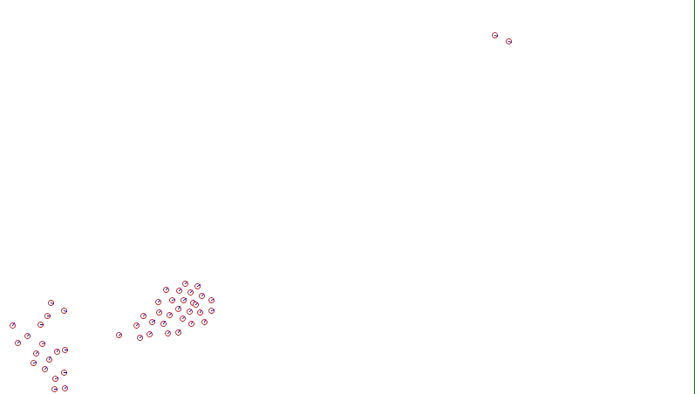
Boids: agent-based model
Boids (Reynolds 1987)
Three simple rules
Complexity through interaction

Slide 52
Active perception

Slide 53
Active perception
Gibson (1979)
  “....perceiving is an act not a response, an act of attention, not a triggered impression, an achievement, not a reflex”
Sensori-motor coordination
  Perception for action
  Action for perception
Agent
World

Slide 54
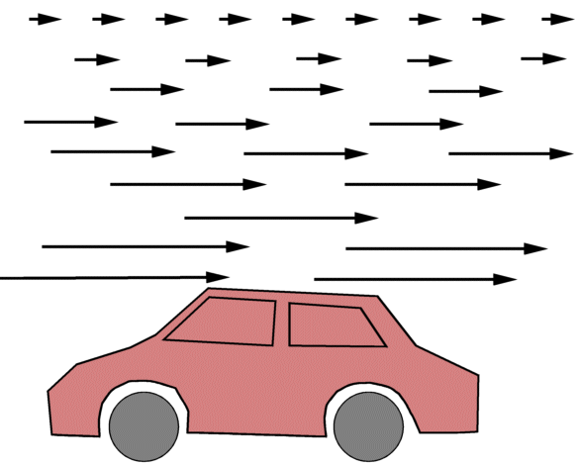
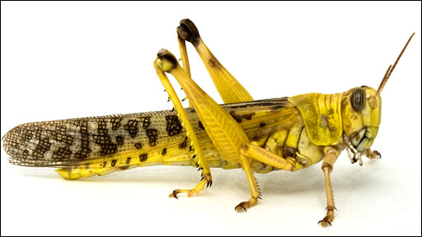
Example: the locust
Depth perception by a locust (Sobel 1990)
  Not possible to perceive depth by stereopsis
  Motion parallax by moving head left to right

Slide 55
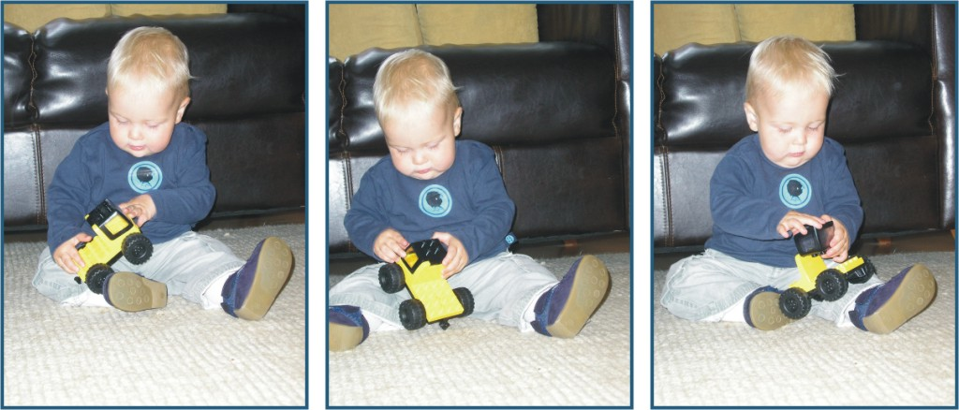
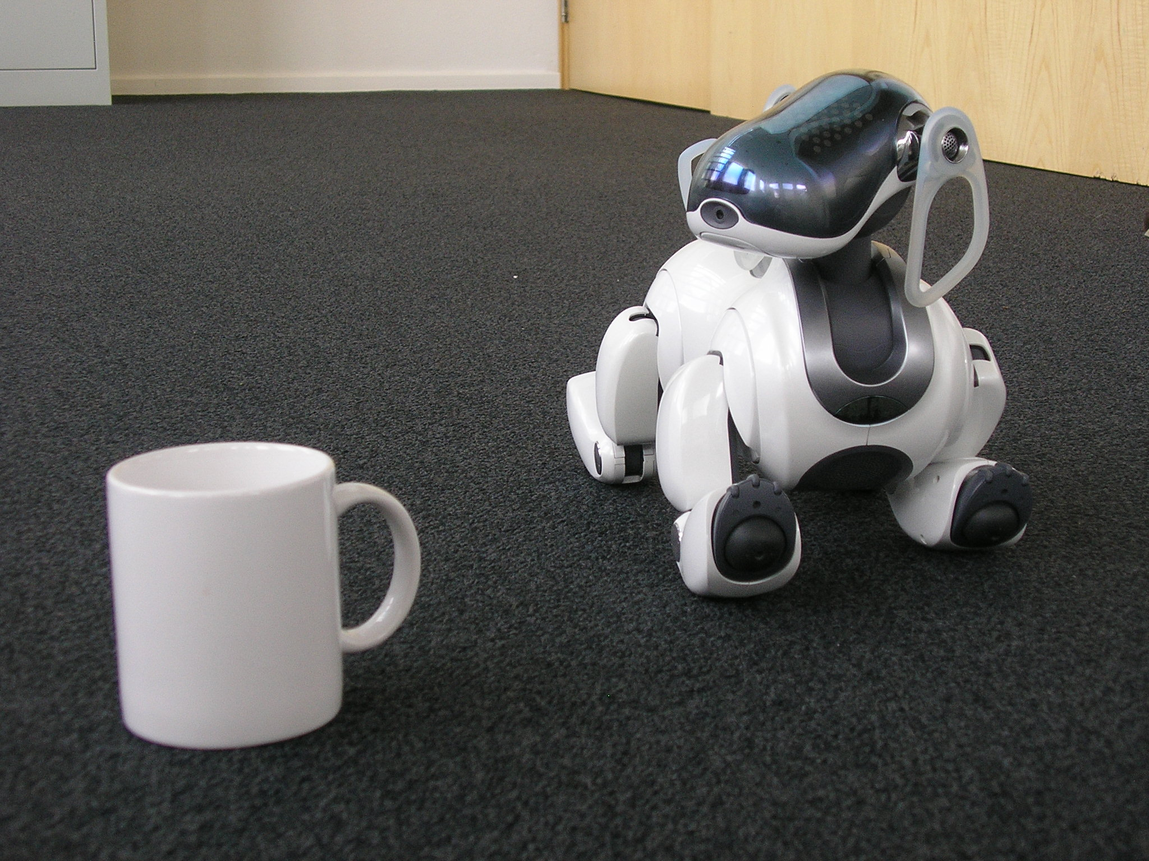
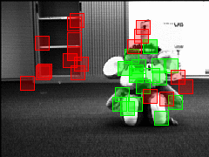
Example: object exploration
My nephew with a new toy
Active vision in object recognition (Kootstra ‘08)

Slide 56
Active perception
Actively change the input of sensors
  Disambiguation
  Egomotion
  Simplifies many perceptual tasks

Slide 57
The Intelligent Body

Slide 58
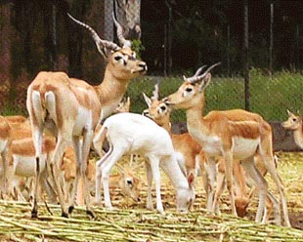
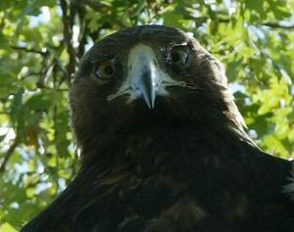
The intelligent body
A smart morphology helps solving tasks
E.g., positioning of sensors

Slide 59
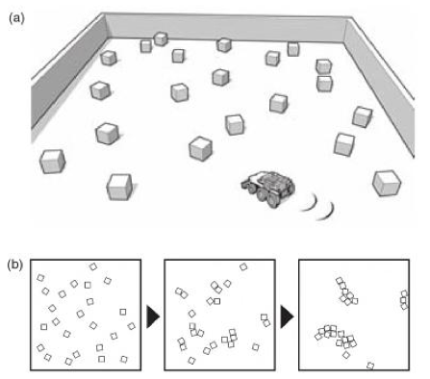
Smart positioning of sensors
Block
sorting

Slide 60
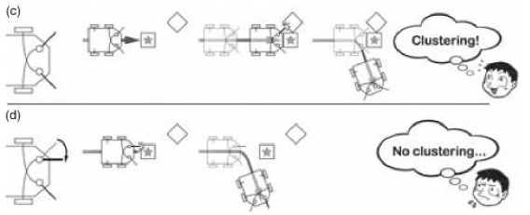
Smart positioning of sensors
Same mechanisms, different embodiment
Behavior depends on position of the sensors

Slide 61
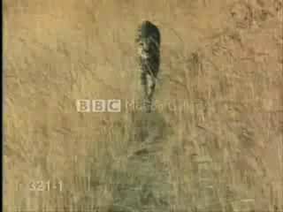
Smart action: stabilization

Slide 62
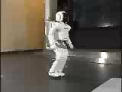
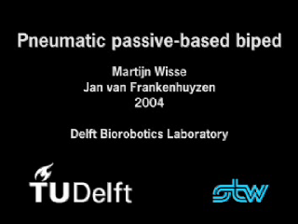
Exploiting physics
Exploit system-environment dynamics
  Efficient walking

Slide 63
Synthetic approach

Slide 64
Synthetic approach
Learning by building
  Robotics
  Computational modeling
Why?
  Learning by building
  Need for specific models, no black boxes
  Can be used to make predictions

Slide 65
Take home message

Slide 66
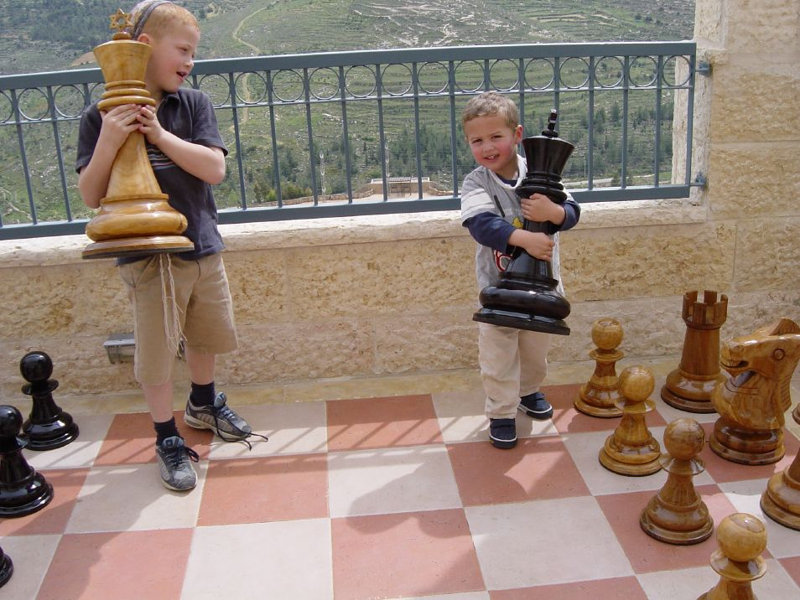
Take home message
Intelligence is much more than chess

