Slide 1
Geckobot: A Gecko Inspired Climbing Robot Using Elastomer Adhesives
Climbing robots

Slide 2
Geckobot
The animal: Tokay gecko
300 gram, 35 cm length
The most able climber in the vertebrate world
video

Slide 4
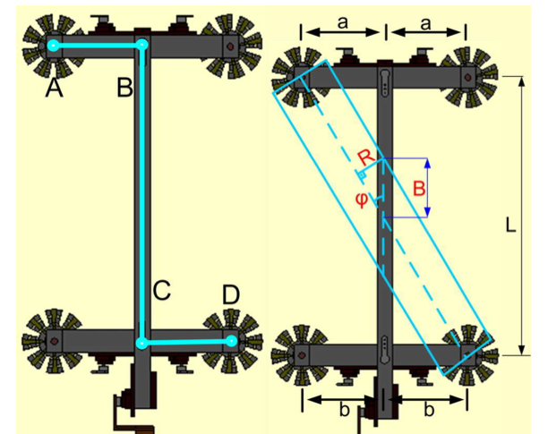
The design
Four bar mechanism

Slide 5
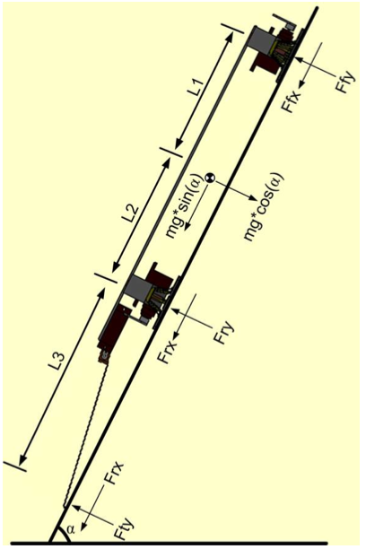
Dynamics of Geckobot climbing
Upwards/downwards safety region
Sideways safety region

Slide 6
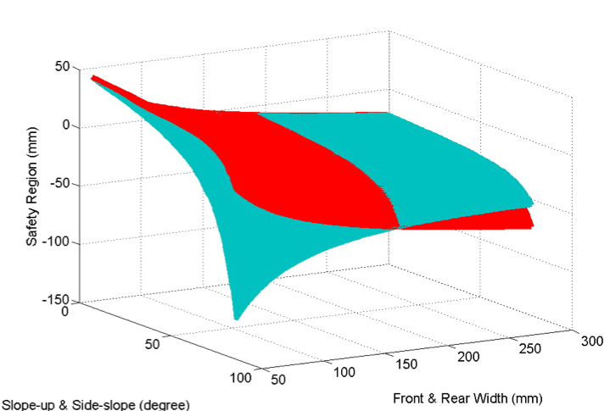
Dynamics of Geckobot climbing
Vertical safety region
Sideways safety region
Geckobot length optimization

Slide 7
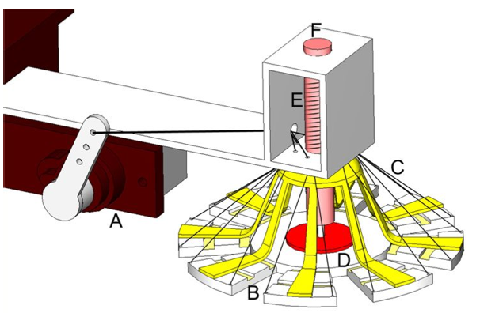
Active tail (video)
Transfer load from front and rear legs via an active tail

Slide 8
GeckoTape

Slide 9
Results
PDMS elastomer adhesive
Final design:
100 grams
190 mm length without the tail
5 cm/s speed
Can climb up to 85 degrees and 50 degrees sideways

Slide 10
Geckobot taxonomy
Waalbot
Tankbot (video)
Wormbot (picture)
…

Slide 11
Water runner robot
Video

