Slide 1
Chapter 4 Intelligent Systems: Properties and Principles
by Marianna Madry-Pronobis
23.03.2011

Slide 2
Introduction Complete Systems
Masanao Toda in 60s:
Integligence is NOT about solving one task
We will not learn much about inteligance testing systems in artificial lab enviroment
Inteligance is about:
dealing with the real-world enviroment (multiple tasks, unpredictability)
complete systems have to be studied:
„Systems that have to act and perform tasks autonomously
in the real world” (Toda, 1982)

Slide 3
Introduction Exampel, Outline
Exampel:
Fungus Eaters - creatures exploring planets looking for uranium ore
Requirments - Complete system has to be:
Embodied (physical system)
Autonomous
Self-sufficient
Situated (use their sensors to learn)
Outline:
Real worlds vs. virtual worlds
Propeties of complete agent
Main part: 8 desining principles

Slide 4
Real Worlds vs. Virtual Worlds
In the real world:
Acquisition of information takes time
Aquired information is:
partial
error-prone
not divisiable into discrete states
Agent always has several things to do simultaneously
The real word changes all the time in higly unpredictable way
agent is forced to act whether it is prepared or not
Real world is challenging and „messy”
Puts several constraints into an agent

Slide 5
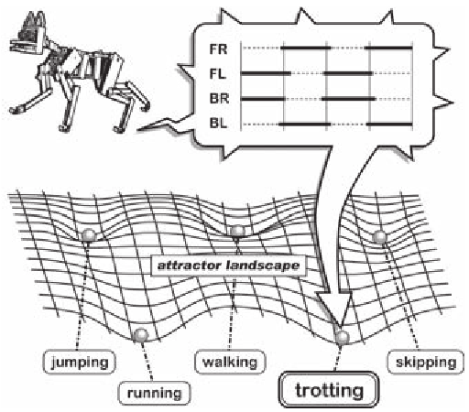
Properties of Complete Agents
they follow from agent’s embodied nature
A complete agent:
is subject to the laws of physics, e.g. gravity
generates sensory stimulation through interaction with the real word
affects its environment
is a complex dynamical system which, when it interacts with the environment, has tendance to settle into attractor states
performs morphological computations, i.e. certain processes are performed by the body without using the neural control system (brain).
Note! System that are not complete hardy ever possess all these properties

Slide 6
Properties of Complete Agents Example: Robot Puppy
Example of how cognition might emerge from the simple, basic actions of walking or running
Observations:
Number of stable gaits for any given system is limited
Gates are „attractor states” that the robot falls into based its own (e.g. speed) and environment properties
Basin of attraction - area that ends up in the same state
Some gaits are more stable than others (larger basin of attraction)
Complex systems are characterized by higher number of attractor states, e.g. salamandra vs. puppy
Complete agent is a dynamic system and its behaviours can be viewed as attractors.

Slide 7
Set of design principles
Where to start when we would like to design an agent?
The real world is ”messy” it is hard to define neat ”design principles”
It is rather a set of huristics providing a guidence how to build an agent!
Let’s go to the 8 design principles...

Slide 8
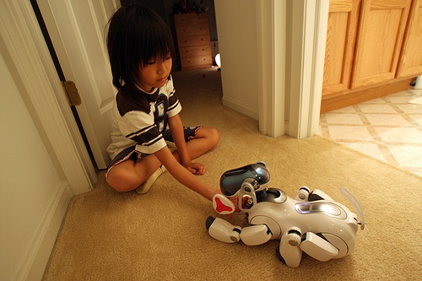
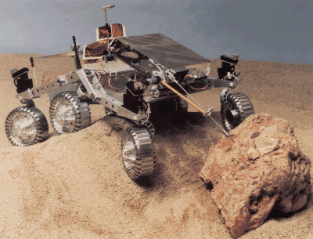
Principle 1: The Three-Constituents Principle
When designing an agent we need to:
define its ecological niche
define its desired behaviors and tasks
design the agent
Example: Sony AIBO vs. Mars Sojourner
Note :
Robot behaviors can be only indireclty designed, since they emerge from the agent-environment interaction
Scaffolding – way in which agents structure their environments to simplify the disired task, e.g. road signs replace geografical knowledge

Slide 9
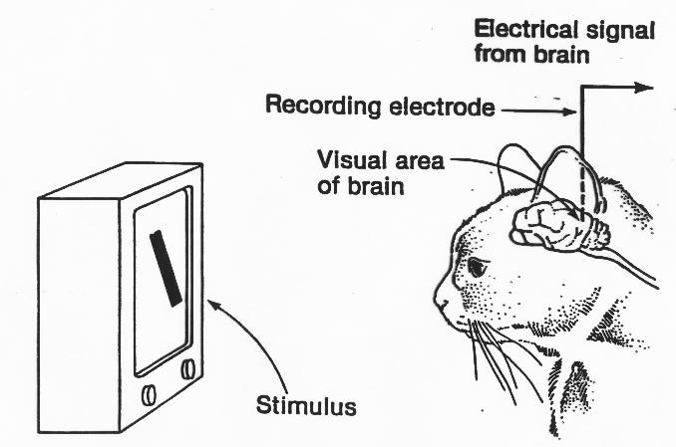
Principle 2: The Complete-Agent Principle
When designing agents we must think about the complete agent behaving in the real world.
This principle is in contrast with ”divide and conquer” rule:
Artifacts may arise when treating problems in insolation, e.g segmentation in computer vision
Human brain is not comprised of separete modules, e.g. Hubel and Wiesel’s edge-detection cells are also involved in other activities
In designing agents we need to deal with complete sensory-motor loops, e.g. when grasping a cup

Slide 10
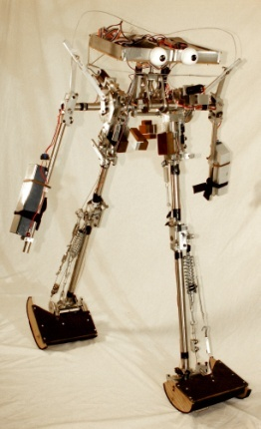
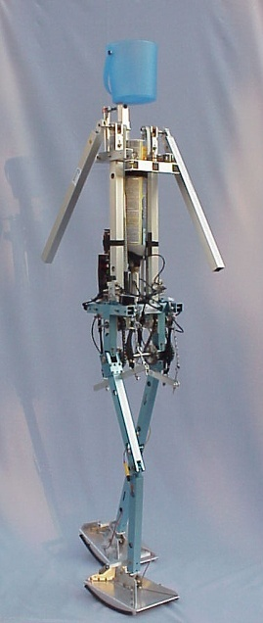
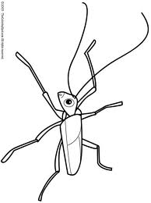
Principle 3: Cheap Design
The more and better an agent exploits properties of the ecological niche and interaction with the enviroment, the simpler and ”cheaper” it will be
Exampels:
Dynamic Walker
Leg movements are entirely passive, driven only by gravity in a pendulum-like manner
very narrow niche - only slopes of certain angles
”Danise”
Additional motors + control systems
a bit wider niche
Insect Walking:
Insect use interaction with environment to walk
pushing of one leg forward, pushes the whole body and other legs forward too.

Slide 11
Automatic Understanding of Human Emotions & Behaviors
Based on:
M. Pantic, A. Pentland, A.Nijholt and T. Huang
„Human Computing and Machine Understanding of Human Bahavior: A Survey”. ICMI, 2007

Slide 12
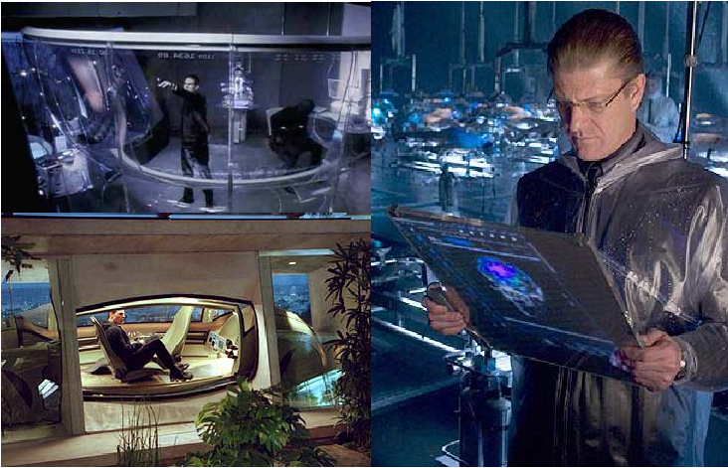
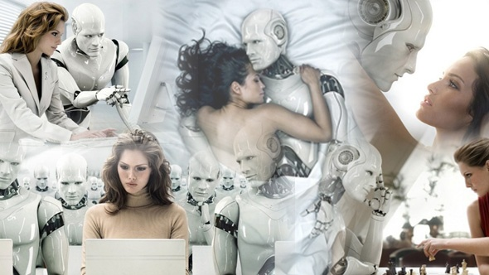
Applications
”In the vision of future, humans will be surrounded by intelligent systems (interfaces and robots) that are sensitive and responsive to the presence of different emotions and behaviour in a seamless way. ”
Human-Computer Interaction
Robotics
Notes:
Traditionally, automatic understanding of human emotion and behaviour lays in the fieald of HCI
However, it is neccessary for robotics:
Understanding of human emotions by robots

Slide 13
Focuse of the paper
Main focus: understanding certain human emotion and behaviors
Outline:
What is communicated, How, Why
Challenges, Building a system
State of the field

Slide 14
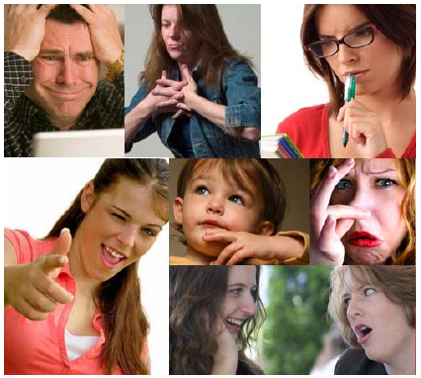
What type of messages are communicated by behavioral signals?
Type of messages:
Affective states (fear, joy, stress);
Emblems
Manipulators
Illustrators
Regulators
All of them carry information, but lack of consensus regarding their specificity and universality
Six basic emotions:
Happiness, anger, sadness, surprise, disgust & fear
Additional ”socialy motivated” emotions:
interest, boredom, empathy etc.

Slide 15
Which communicative cues convey information about human behaviors?
Cues: audio, visual, tactile
Vision:
Most important: (1) face & body, (2) face, (3) body
Association between posture and emotion:
e.g. static body=anger &sadness
Speech:
Not words (!)
Nonlinguistic messages:
important for humans
hard to reliably discretized for scientist
Physiological signals:
Are very acurate: pupillary diameter, heart rate, temperature, respiration velocity
Require direct tactile contact -> novel non-intrusive

Slide 16
How are various kind of evidance to be combined?
Behavioral signals convey usually more then one type of massage
E.g. squinted eyes: sensitivity to light or eye blink
Context is crucial to interpret a signal:
Place, task, who express the signal, other people involved

Slide 17
How to build a system?
Challenges:
Fusion of modalities depends on context
Initialization
Robustness
Speed
Training
In the paper ”pragmatic approach” is advocated:
User-centered approach
System training:
Large number of mixed emotions -> unsupervised learning
Learning in real environment (”complete system”)
Importance of fusion of different cues – system based on facial expression, body gestures, nonlinguistic vocalization

Slide 18
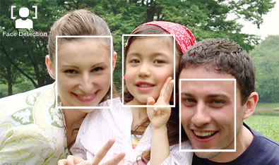
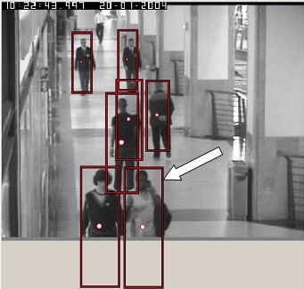
State of the field Sensing human behavioral signals
Techniques focus on:
FACE: face detection and recognition, eye-gaze tracking (Tobii), facial expresion analysis (Noldus)
BODY: body detection and tracking , hand tracking, recognition of postures, gestures (Panasonic) and activity
VOCAL NONLINGUISTIC SIGNALS: based on auditory features such as pitch, intesity, speech rate; recognition of nonlinguistic vocalizations like laughs, cries, coughs etc.
Notes:
3 main group of techniques, focused on sensing signal comming from humans,

Slide 19
Conclusions
More about the state of the field:
Context sensing (Who? Where? What? How? When?)
Understanding human social signaling
Conclusions:
Great progress during the last two decades
Driven by: face recognition, video surveillance, gaming industry
Different parts of the field are still detached...

