Slide 1
Chapter 4:
Towards a Theory of Intelligence
Gert Kootstra

Slide 2
Principle 4: Redundancy

Slide 3
Principle 4: Redundancy
An agent has
  Different sensory modalities
  With partial overlap
Information extracted from one modality can be partially extracted from another modality
  Robustness: functioning in different circumstances
  Enables learning

Slide 4
Principle 4: Redundancy
Also redundancy
  In the processing system, e.g., the brain
  In the body, e.g., left and right hand, two eyes
  In functionality, e.g., grasping cup in different ways
Robustness

Slide 5
Principle 4: Redundancy
Visual and haptic system
  Sensation of electromagnetic waves and pressure
  With overlap (consider walking in light/dark)
Cross-modal prediction
  Based on visual observation, the haptic sensation can be predicted and vice versa
  This is learned

Slide 6
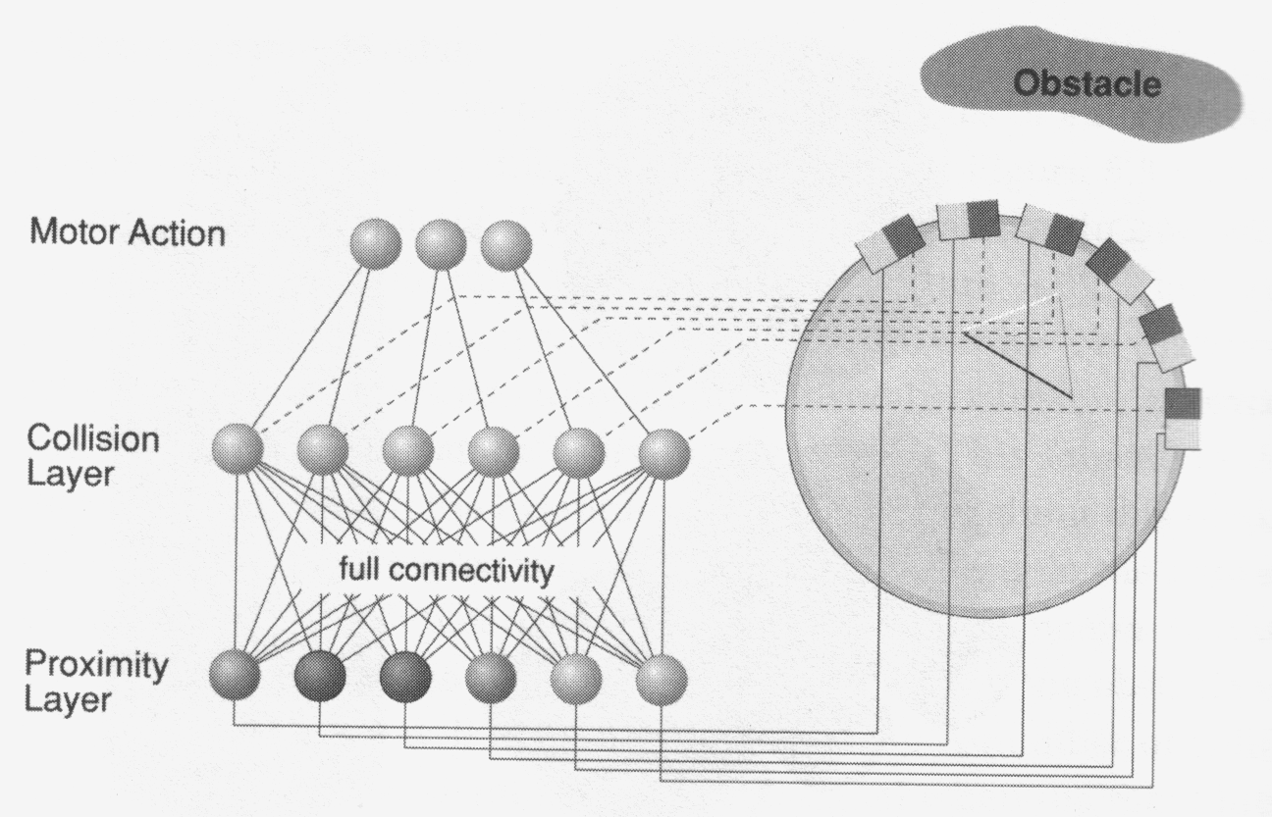
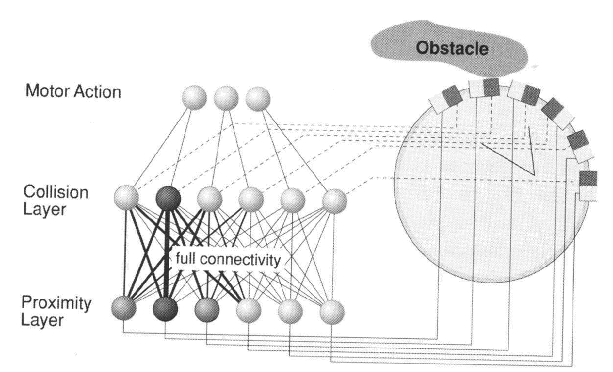
Principle 4: Redundancy
Example: DAC
Initial:
  Proximity and touch sensor
  Touch reflex
Hebbian learning:
  Association touch and proximity
  Avoid obstacles before bumping

Slide 7

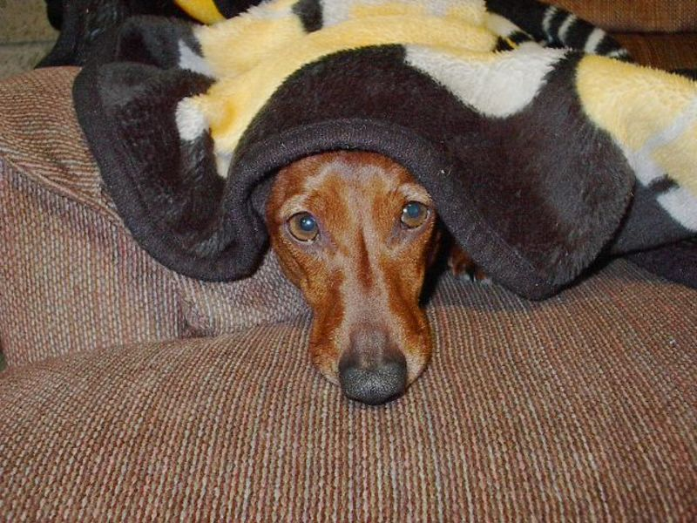
Principle 4: Redundancy
Redundancy by exploiting regularities/laws
  Robustness in perception, e.g.
    Constraints by body, gravity
    Constraints by grammar in
    speech recognition
Redundancy in the stimulus

Slide 8
Principle 5: Sensory-motor coordination

Slide 9
Principle 5: Sensory-motor coord.
Through sensory-motor coordination, structured sensory stimulation is induced
Useful sensory information can be obtained by interaction with the environment
  Simplifies perception

Slide 10
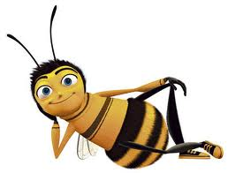
Principle 5: Sensory-motor coord.
Example: the bee
Egomotion induces optical flow
  Centering response.
  Regulating speed
  Regulating altitude
  Smooth landing
  Odometry
speed

Slide 11
Principle 5: Sensory-motor coord.
Inducing correlations
  Stability and synchronization through sensorimotor coordination
Picking up a cup
  Visual focusing on cup (stable and normalized view)
  Grasping cup (synchronized sensation in visual, tactile, and proprioceptive information)
  Lifting the cup (idem)
Easier to extract information and learn correlations

Slide 12
Principle 5: Sensory-motor coord.
Sensory-motor coordination: connection of body and information
Example
  Lifting a full glass of beer
  Through visual information we see the glass is full
  Prediction that proprioceptive sensors will sense a heavy object
  Therefore preparation of the body to lift the object

Slide 13
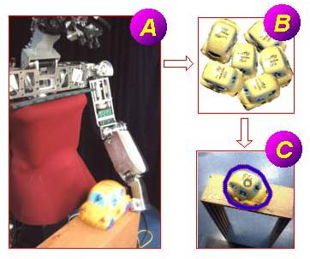
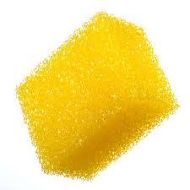
Principle 5: Sensory-motor coord.
Object recognition through interaction
  Interaction simplifies perception
  Interaction can reveal new
  information
    E.g., a sponge

Slide 14
Principle 6: Ecological balance

Slide 15
Principle 4: Balance
1. Balance of sensory, motor and neural system
Example (Dawkins)
  Hypothetical snail with human-like eyes
  Eyes are too complex for the snails motor system
  Being able to detect fast-moving predators gives no advantage, since the snail can not escape anyway
  Huge heavy eyes do have disadvantages
  Thus, this unbalance give fitness disadvantage

Slide 16
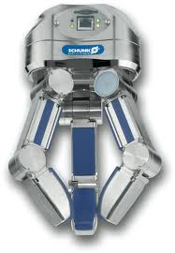
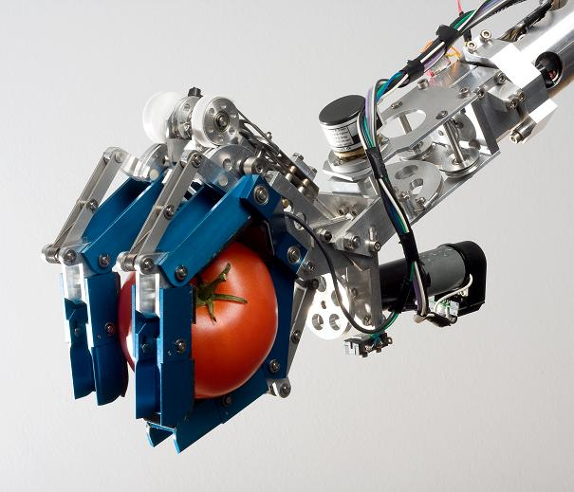
Principle 4: Balance
2. Balanced interplay between morphology, materials, control & environment
Example: robotic hands
Completely stiff, high control demand
Smart design and compliant, less control needed

Slide 17
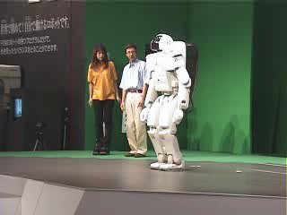
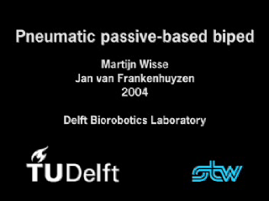
Principle 4: Balance
Outsourcing control to body & environment
Example: walking
Exploiting physical forces and material properties
Highly controlled

Slide 18
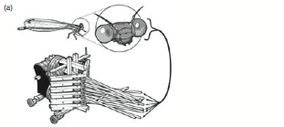
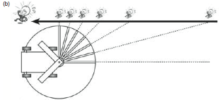
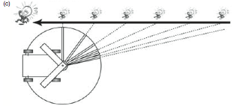
Principle 4: Balance
Morphological
“computation”
Eggenberger ‘95)

Slide 19
Principle 7: Parallel, Loosely Coupled Processes

Slide 20
Principle 7: Parallel, loosely…
Intelligent emerges from a (large) number of parallel processes
Processes are (often) coordinated through embodiment
  Interaction of agent with the environment

Slide 21
Principle 7: Parallel, loosely…
Classical view
  Sequential organization
Subsumption architecture
  Rodney Brooks 1986
  Parallel organization
  Control
    Higher layers
    Environment
Perception
World model
Memory
Reasoning
Action planning
Setting goals
Goal-oriented navigation
Obstacle avoidance
Forward motion

Slide 22
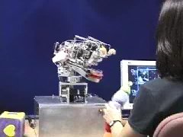
Principle 7: Parallel, loosely…
Example: Kismet (Breazeal, 2002)
Many parallel behaviors
  Visual attention
  Auditory attention
  Object tracking
  Emotional responses to sound
  Emotional responses to distance
  …

Slide 23
Principle 8: Value

Slide 24
Principle 8: Value
A system which constitutes basic assumptions about what is valuable for the agent
  Which situations are valuable to learn from?

Slide 25
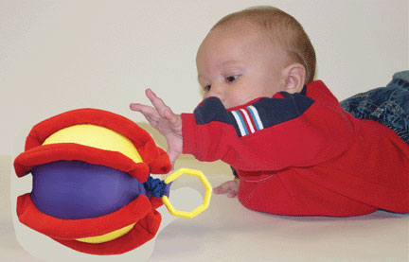
Principle 8: Value
Implicit value system
  Mechanisms that increase the probability of the agent being in a valuable situation (reflexes/biases)
  E.g., Reflex to pay attention
  to brightly-colored objects
  and grasping reflex

Slide 26
Principle 8: Value
A not B error
  Study by Piaget
    Object is hidden under lit A an number of times
    Child reaches for lit A
    But when object is hidden at B, still reaches for A
    Cognitive problem?
  Thelen (2001)
    No, child is stuck in a physical attractor state “reaching for A”.
    When posture is changes, he does reach for B

