Slide 1
Approximation Algorithms
Ola Svensson

Slide 2
Course Information
Goal:
Learn the techniques used by studying famous applications
Graduate Course FDD3390
6 Points
One Lecture a Week
Examination
Topics

Slide 3
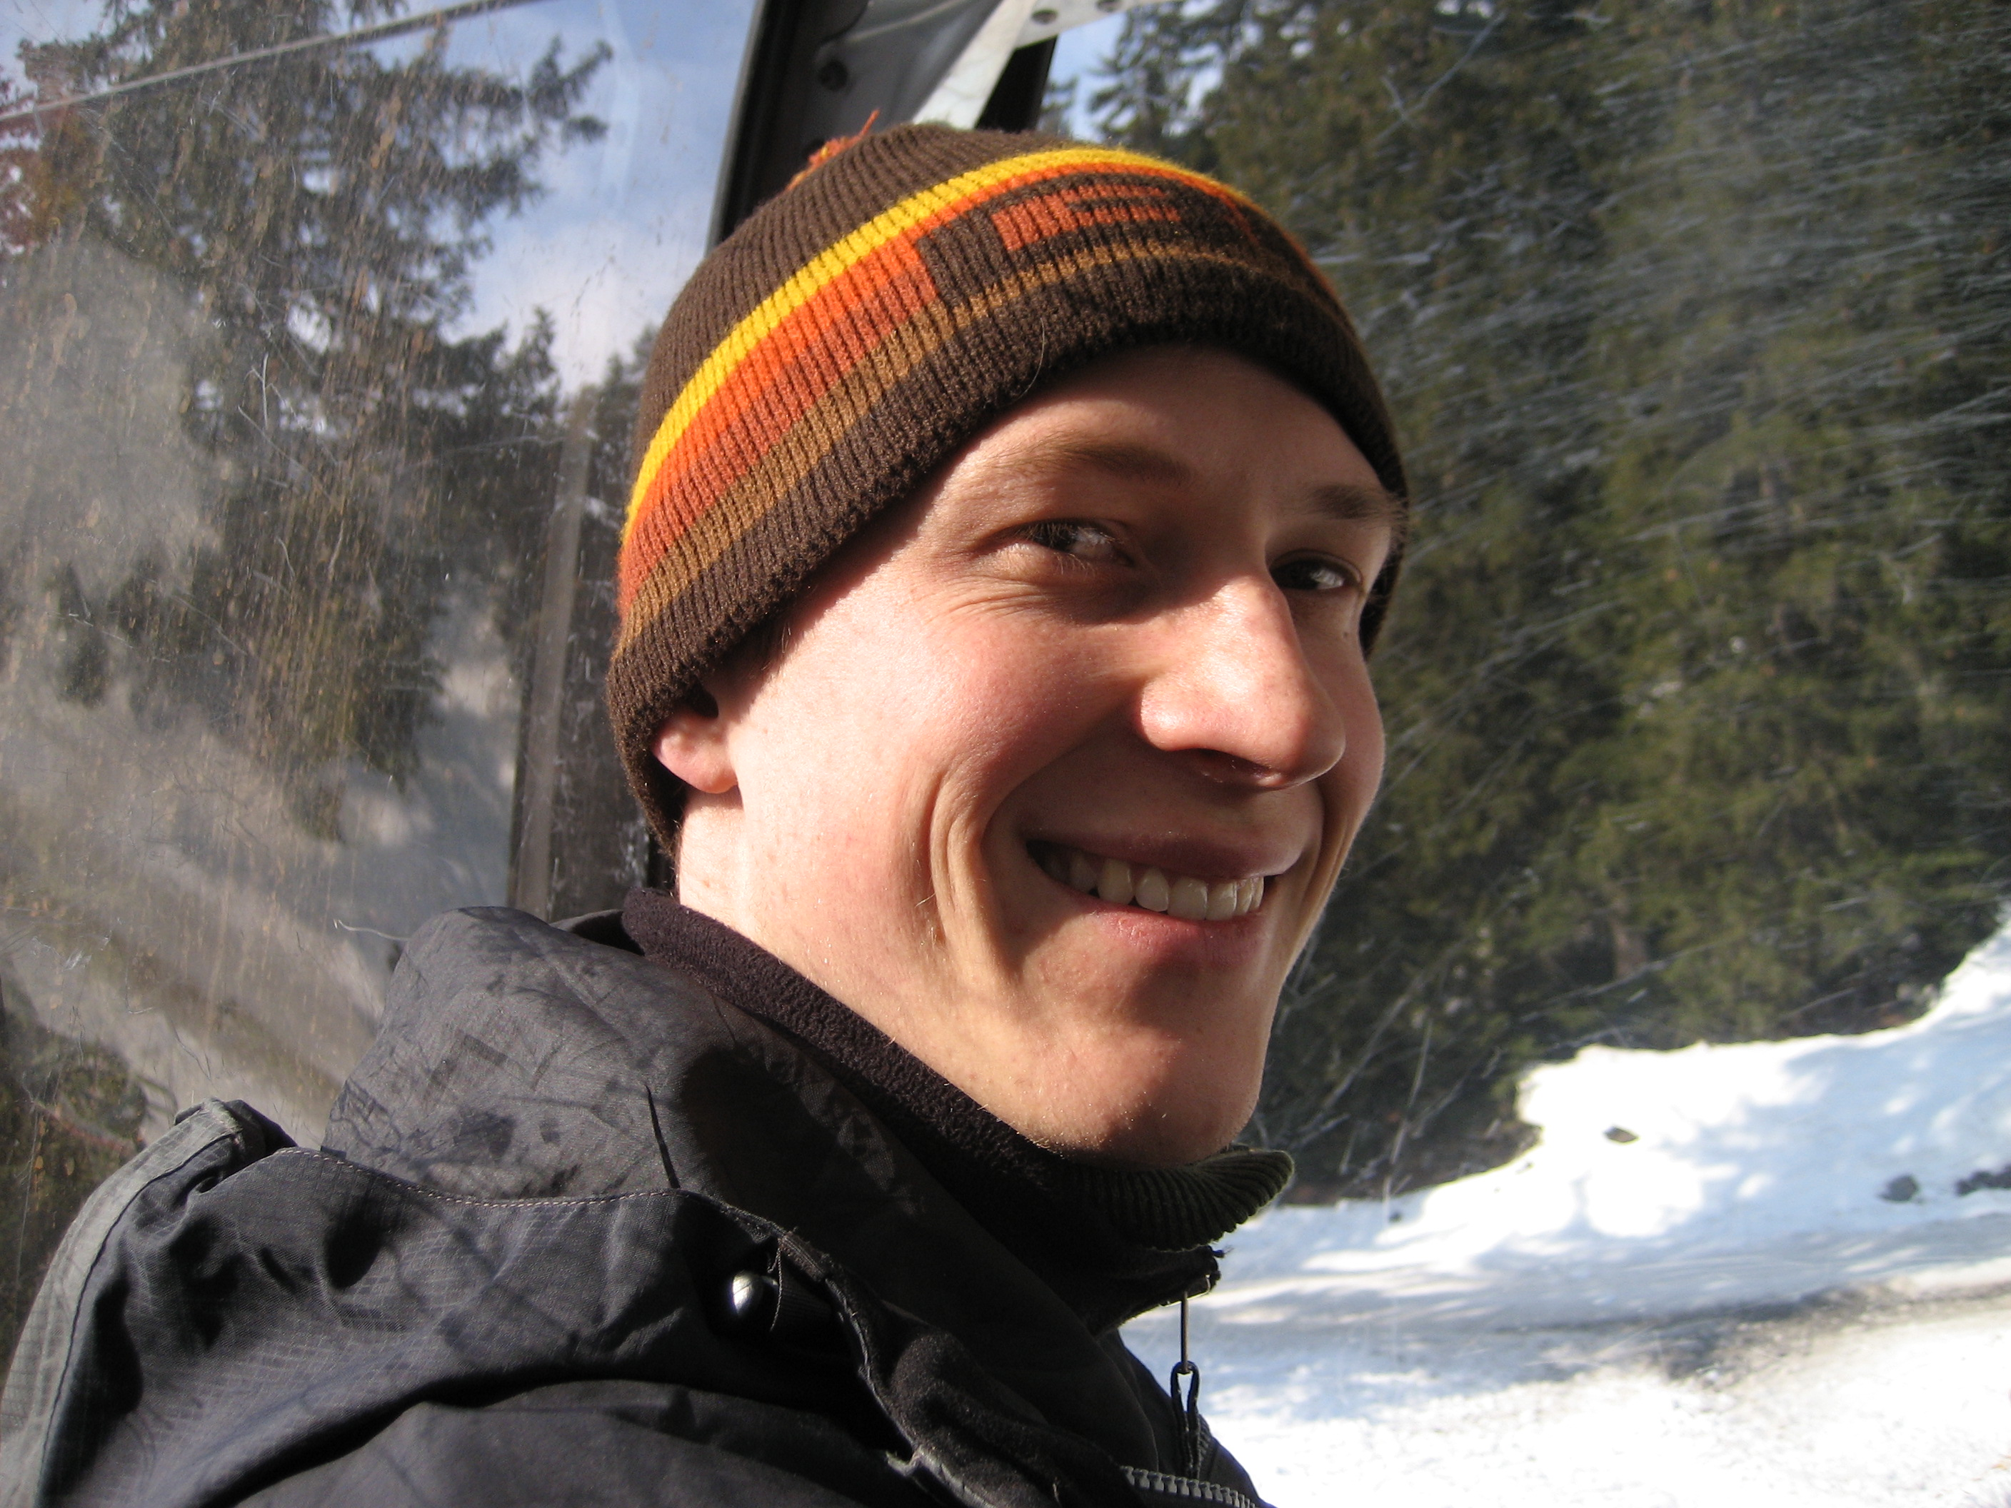
Teacher Information
Ola Svensson
Email: osven@kth.se
Room: 1444
PhD on Approximation Algorithms
Second year post-doc
First time responsible for a course:
you have a lot of influence
feedback during course welcome!

Slide 4
Approximation Algorithms
Optimization problems
Not tractable (NP-hard)
Want to find good solution
Optimal Tour
Ola’s Tour
Google Tour
Length
1000
1700
3000

Slide 5
r-Approximation Algorithm
A polynomial time algorithm that
returns a feasible solution
with value at most if minimization
with value at least if maximization
For any instance:
OPT

Slide 6
Impossible to Analyze?
How can we compare our solution to the optimal that we cannot compute?
lower bound optimal value
lb
OPT

Slide 7
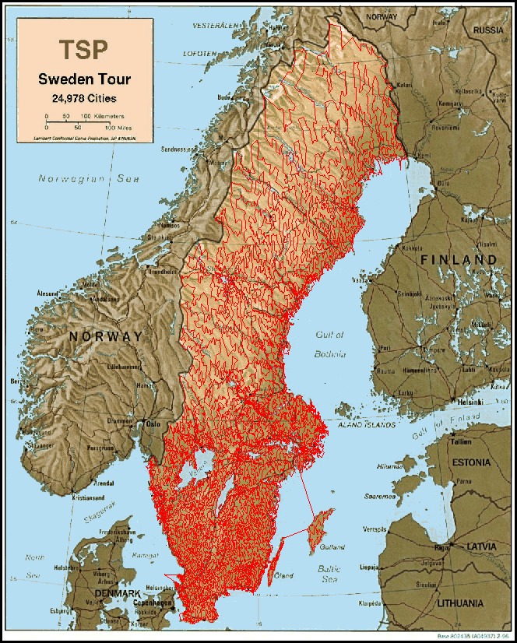
Example: TSP (1/4)
Given n cities with distances between them
Find the shortest tour that visits each city at least once
d(1,2)
1
2
1
2
1
2
3
4
3
4
3
4
5
5
5

Slide 8
Lower bound (2/4)
1
2
1
2
3
4
3
4
5
5
Removing one edge gives a spanning tree
Kruskal’s algorithm runs in time O(n²log n)

Slide 9
Constructing tour from MST (3/4)
1
3
2
5
4
Run DFS on MST
Each vertex is visited at least once
Each edge traversed at most twice
Value of tour at most

Slide 10
2-Approximation Algorithm (4/4)
Find MST as lower bound
Construct tour by running DFS on MST
MST
OPT
2*MST

Slide 11
Summary
Lower bound optimal value
Constructing feasible solutions that is “close to” bound
Verifying that analysis is tight
lb
OPT

