Slide 1
Expectation-Maximization (EM) Algorithm & Monte Carlo Sampling for Inference and Approximation

Slide 2
Expectation-Maximization Algorithm
“The Expectation-Maximization algorithm is a general technique for finding maximum likelyhood* solutions for probabilistic models having latent variables” (Dempster et al., 1977; McLachlan and Krishnan, 1997).
Is an iterative process and consists of two steps: E-step and M-step.
General purpose technique:
- Needs to be adapted for each application
- Versatile. Used in machine learning, computer vision, language processing....

Slide 3
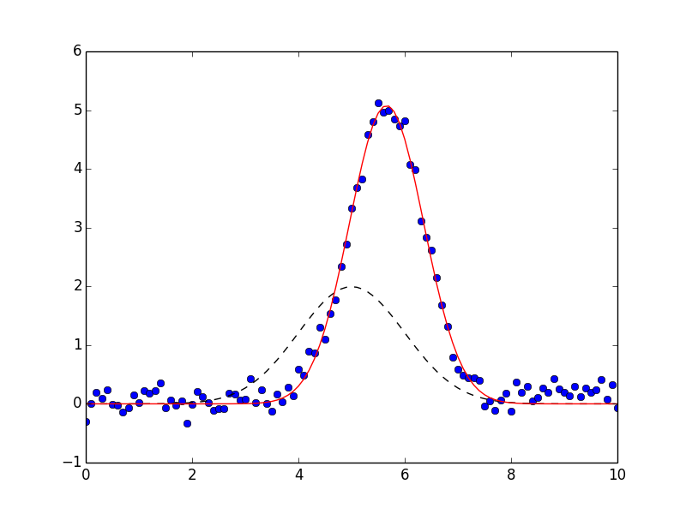
Intro: Maximum Likelihood Estimation methods
Maximum Likelihood Estimation (MLE) are methods to estimate parameters of an unknown, parameter-dependent probability density function p( x | θ ) from the observed sample (x₁,x₂,...,x_{n}).

Slide 4
- When is EM useful?
- When MLE solutions are difficult or not possible to get because there are latent variables involved.
- Either missing values or we decide to get aditional unkown variables for modelling simplicity.

Slide 5
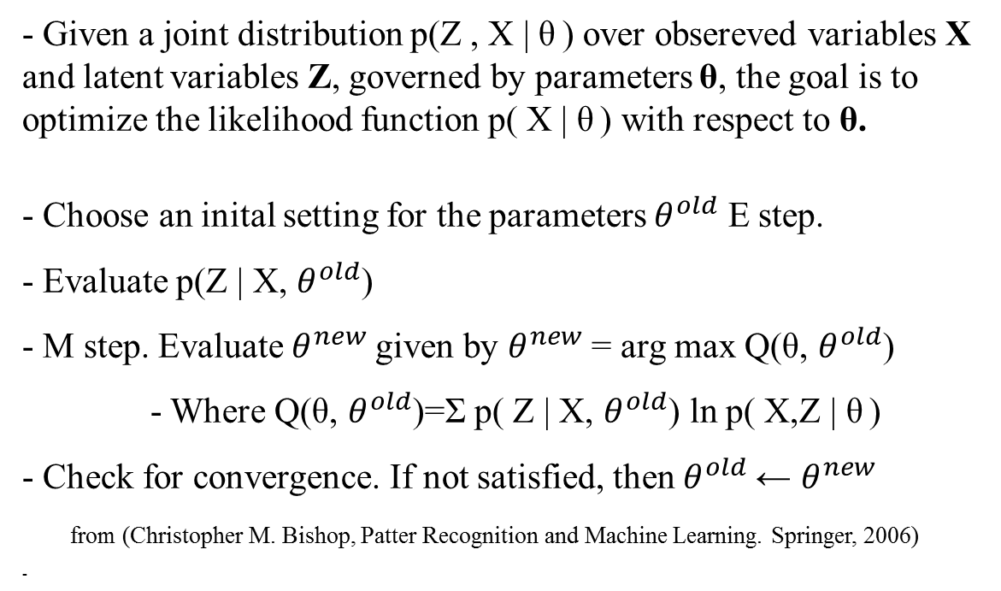
EM summarized
- Given a joint distribution p(Z , X | θ ) over obsereved variables X and latent variables Z, governed by parameters θ, the goal is to optimize the likelihood function p( X | θ ) with respect to θ.
- Choose an inital setting for the parameters $θ^{old}$ E step.
- Evaluate p(Z | X, $θ^{old}$)
- M step. Evaluate $θ^{new}$given by $θ^{new}$= arg max Q(θ, $θ^{old}$)
- Where Q(θ, $θ^{old}$)=Σ p( Z | X, $θ^{old}$) ln p( X,Z | θ )
- Check for convergence. If not satisfied, then $θ^{old}$← $θ^{new}$
from (Christopher M. Bishop, Patter Recognition and Machine Learning. Springer, 2006)

Slide 6
Monte Carlo Sampling for Inference and Approximation
- Inference – To draw conclusions from gathered data.
- Monte Carlo Sampling – Broad selection of computational algorithms that rely on repeated random sampling to obtain numerical results.
- For a better understanding we have prepared two very simple examples.

Slide 7
Rolling a dice
- We know that the probability of getting a 4 is:
- 1/6 (approx 17%)
- Can we obtain the same result by Monte Carlo simulation?
- More iterations give less error in the result!

Slide 8
Calculating the area of the unit circle
10 iterations of Monte Carlo
Ratio: 2.4

Slide 9
Calculating the area of the unit circle
1000 iterations of Monte Carlo
Ratio: 3.04

Slide 10
Calculating the area of the unit circle
- 1 million iterations:
- Ratio: 3.1400
- 100 million iterations:
- Ratio: 3.1416
And so forth!

Slide 11
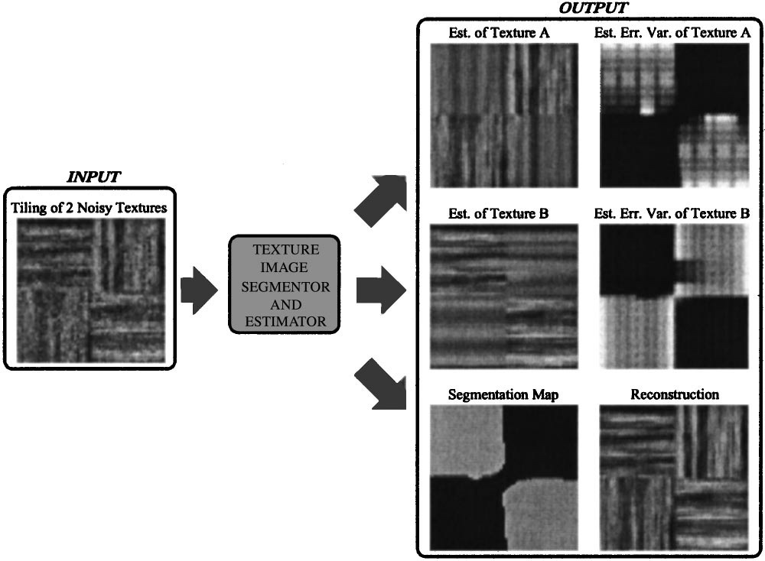
Application of EM
Pattern Recognition
Image Recognition
Computer vision
Maximum likelihood
Bioinformatics

Slide 12
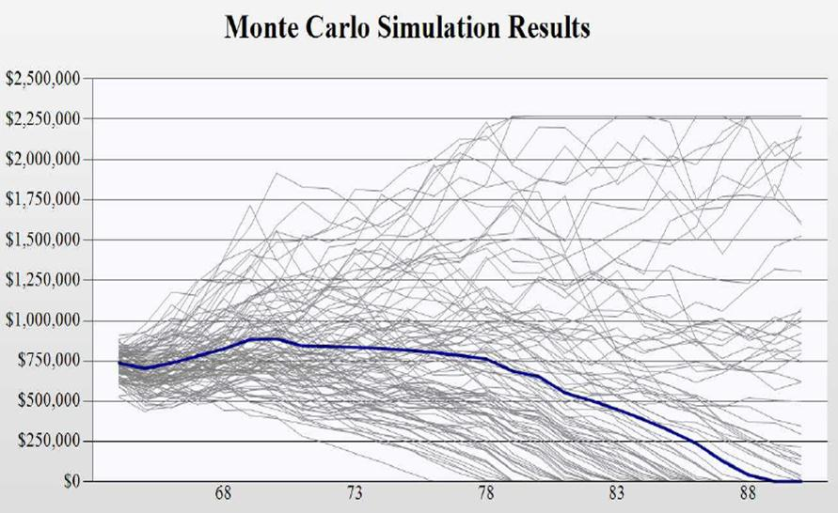
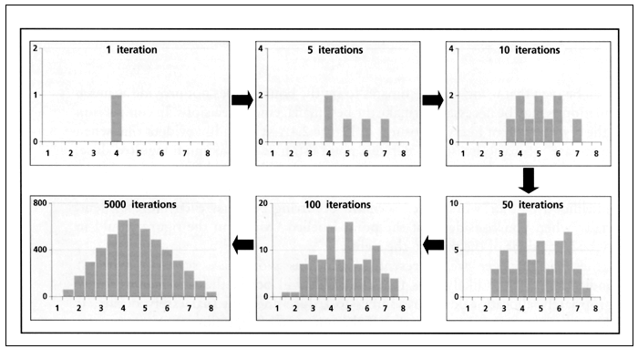
Application of MC
Finance
Statistics
Molecular dynamics
Computer Graphics
Fluid mechanics

