Slide 1
Genetic Algorithms
-A introduction with an example

Slide 2
History
The father of the original genetic algorithm (GA) was John Holland who invented it in the early 1970's .
The idea with GA is to use this power of evolution to solve optimization problems.
It started to get tracktion during the 90’s as computers was able to handle more complex problems and simulationsand has been used for example in creating evolved antennas¹.

Slide 3
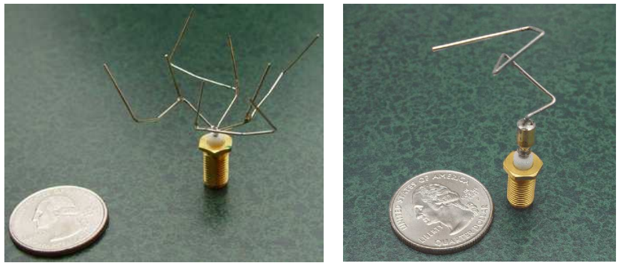
Evolved antennas
Antennas created by EAs for NASA for the ST5 mission

Slide 4
Workflow
Initalize
Evaluation
Selection
Crossover
Mutation
Termination

Slide 5
Initalize
Initalize the population, i.e. randomly generate ”attempted solution” to the problem
This involves allocating memory and filling it with the first generation of the population

Slide 6
Evaluation
Evaluate each induvidual, or solution, of the population
Base the assessment by the fitness of the solution to the evaluation criteria

Slide 7
Selection
Aim is to keep the fittest induviduals
Doing so by using probabilistical methods
Keep the top part of the population, elitism
Select which individuals to crossover

Slide 8
Crossover
Use these individuals to generate a new generation of the population

Slide 9
Mutation
Randombly flips some of the genes in an induvidual

Slide 10
Termination
Repeat steps two through five until one individual has enough of a fitness level

Slide 11
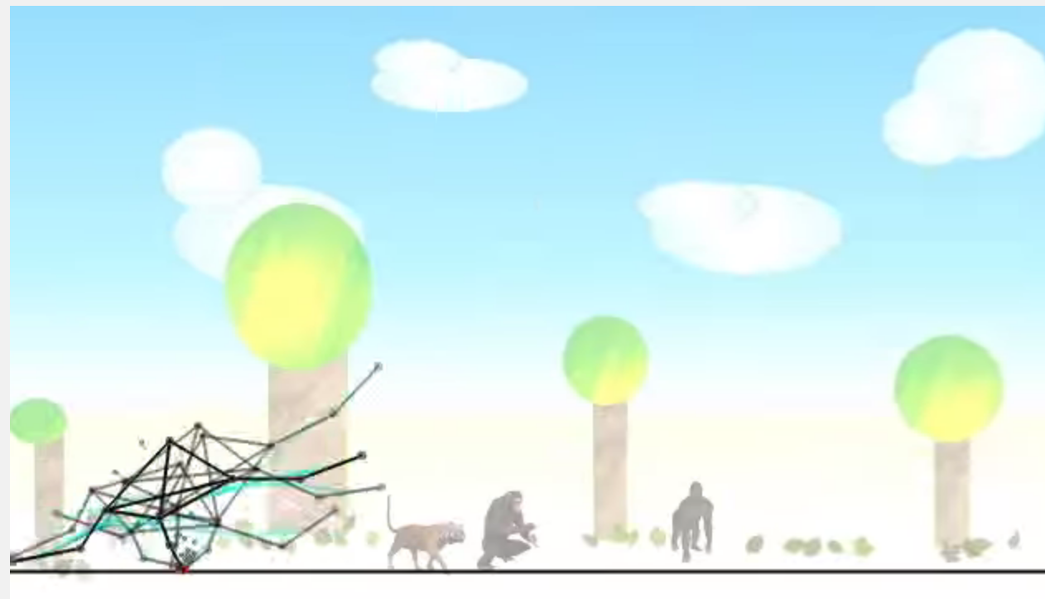
Learning to walk
Learning to walk

Slide 12
Problems with GAs
Local optimum
In many problems, GAs may have a tendency to converge towards local optima or even arbitrary points rather than the global optimum of the problem. This means that it does not "know how" to sacrifice short-term fitness to gain longer-term fitness
”Best solution”
The "better" solution is only in comparison to other solutions. As a result, the stop criterion is not clear in every problem.

Slide 13
Our example
Hello World!

